Slide 1
Affordable Housing Funding Committee
Introduction
2017 Town Meeting Charge
“The committee shall, generally, be charged with the responsibility of studying and determining cost-effective means by which the town may fund the continuing expansion of its inventory of affordable housing.”

Slide 2
Affordable Housing Funding Committee
Key Points
1) A wide perspective that is fair and does not rely on one group for revenue.
2) Recapturing our town’s housing diversity requires change.
3) By acting now, residents have more control for affordable homes to best fit the town’s #2 goal and maintain town character.
4) This is a fundamental next step to address this issue. We must start now.
Notes:
There are a few key points to consider about these options.
Town character is something we all cherish.
If we don’t start now, it will be very difficult to reach the town’s goals and to be the type of community to which we aspire.

Slide 3
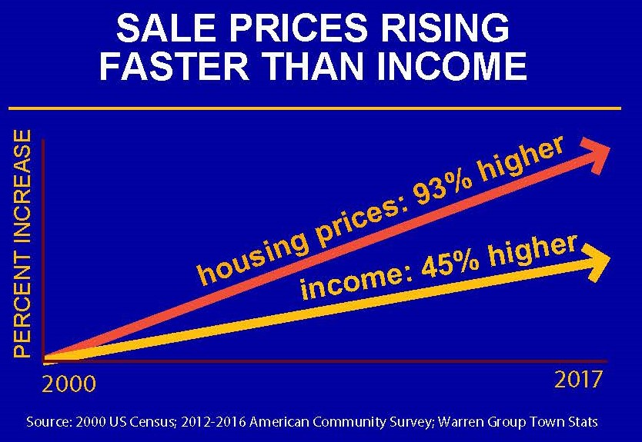
Housing Costs Are Out of Reach

Slide 4
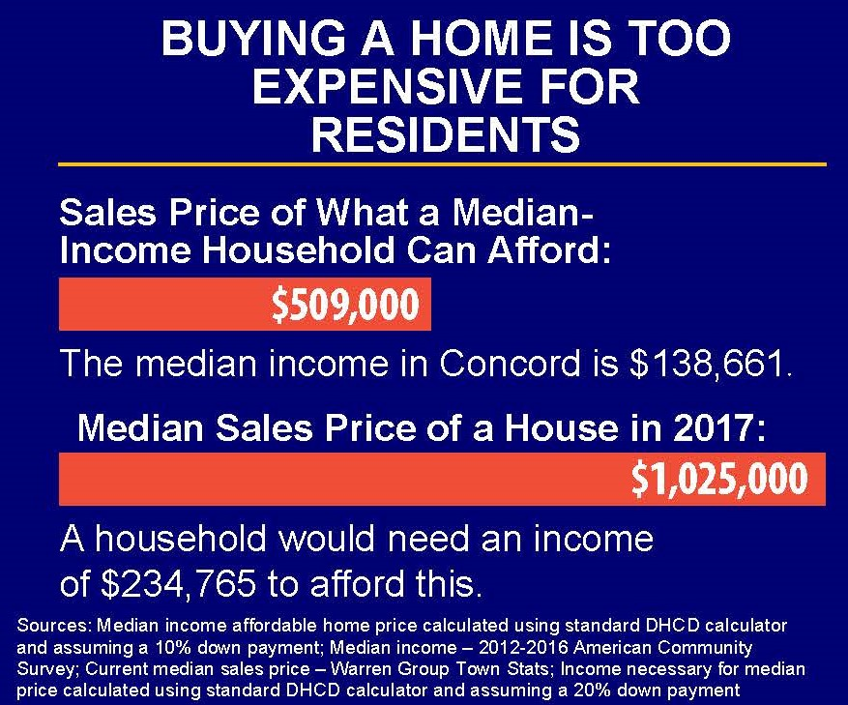
Housing Costs Are Out of Reach
Notes:
Concord’s current SHI figure is 10.52%. This includes 357 units of market rate rental. If you excluded those units, the percentage drops to 5.31%

Slide 5
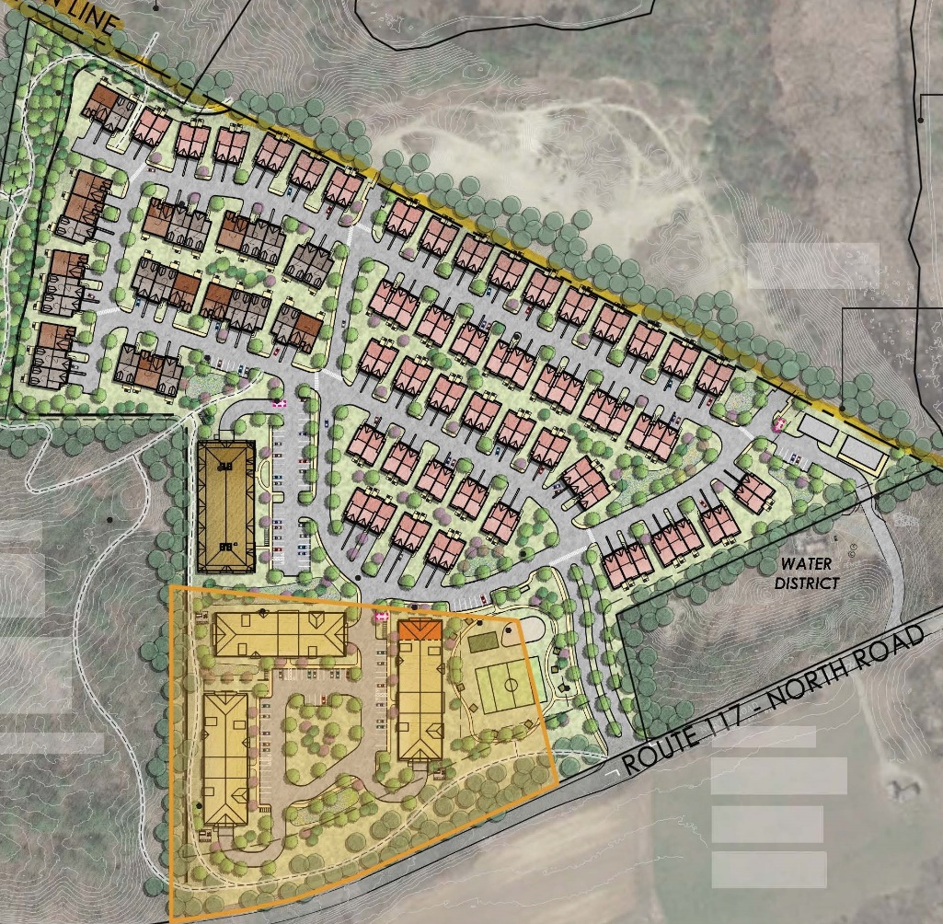
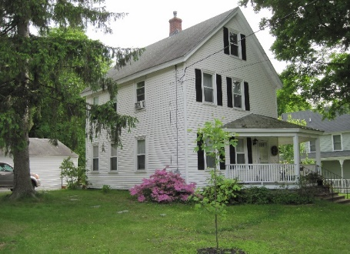
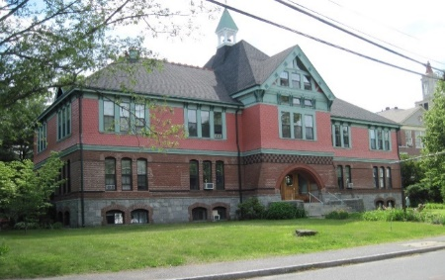
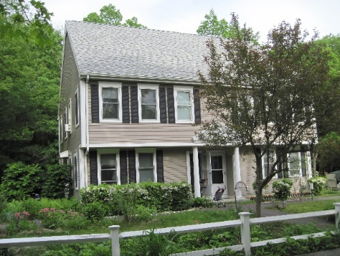
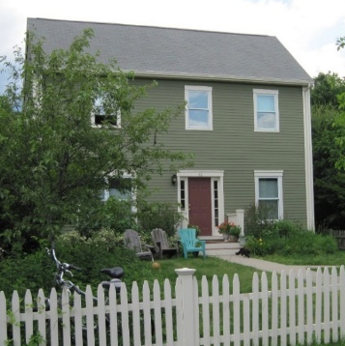
Home Options
Sudbury
Concord

Slide 6
Affordable Housing Goals
Keep town character.
For 10% of housing stock affordable: 9-10 affordable homes/year.
1 affordable home can cost $400k - $500k. Need $4 - $5 MM/year.
Lower wait times: 2–3 year wait for a senior, 6–7 years for a family
Increase downsizing options: 40 units - 10 affordable, 30 market
Enhance economic development for our town
Notes:
Decrease wait times:
2 – 3 year wait for a senior with local preference
Family 2-bedroom wait, with Concord connection, can be 6 - 7 yr.

Slide 7

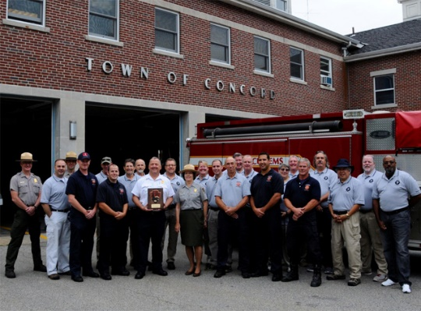
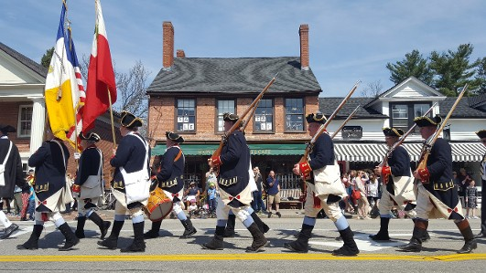

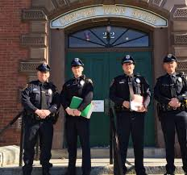
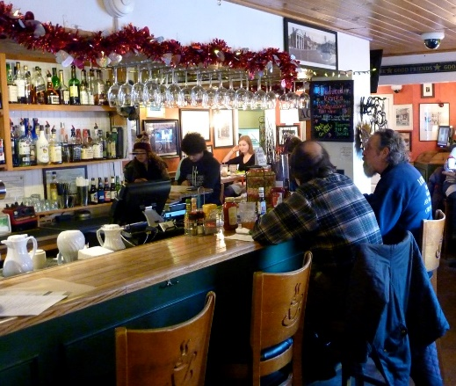



Slide 8
APPENDIX
Notes:
Wait list: Concord Housing Authority

Slide 9
Economic Benefits of Affordable Homes
1) Affordable homes help employers attract and keep workers for town and independent business opportunities
2) Of Concord’s 277 town employees, only 9% live in our town.
3) Increases revenue & decreases traffic: long daily commutes increase congestion & reduce profitability of local businesses by increasing costs and shrinking the area from which to draw customers and workers (Cambridge Systematics, Inc. 2005).
4) Residents of affordable homes generate earnings for local businesses and revenue for local governments
Notes:
National Association of Home Builders: residents in 50 affordable homes generate earnings for local business owners in excess of $1 MM per year increasing employment in retail, health and education, and restaurants
Benefits of building affordable homes are on par with the impacts of comparable market-rate homes
Town employee number EXCLUDES school employees. 26 of the 277 town employees live in Concord.
Concord Police: 50 employees

Slide 10
Economic Benefits of Affordable Homes
“The things that keep me up at night about other tech companies considering Boston are transportation and housing [challenges], less so about a fight for talent.”
“High housing costs and housing availability are a major concern of businesses looking to expand or relocate in Massachusetts.”
Over 2/3 of employers claim home prices and rental costs have affected their ability to recruit qualified candidates.
Notes:
Northeastern University survey of businesses in Greater Boston, April 2017
HubSpot chief people officer as quoted in the Boston Globe, 9/21/2017
MassEcon report, March 2017

Slide 11
Cost of an Affordable Home
Gerow Property Assessment and Feasibility Report - GPI
2-bedroom, 1,100 square foot home on a 9,400 square foot lot:
      $ 12,000 – Site preparation
      $ 40,000 – Foundation work
      $ 38,000 – Utilities
      $130,000 - House
      $ 8,000 - Landscaping
      $228,000 - Total
EXCLUDES cost of land and “soft” development costs such as architect fees, attorney fees, etc.
Notes:
Development costs including soft costs is expected to be $300,000.
Land cost would probably be approximately $150,000.

Slide 12
Article 23 – APPROPRIATE FUNDS FOR AFFORDABLE HOUSING DEVELOPMENT
1) Temporary: Allocation must be voted on at each future Town Meeting.
2) Funds for this strategy already exist.
3) This strategy is only to begin the practice of funding affordable homes while the other articles are going through the process.
4) Once the other strategies are in place, this strategy can be kept, reduced, or discontinued.

Slide 13
Article 24: Authorization to Accept M.G.L. c. 44, § 55C - Municipal Affordable Housing Trust Fund
Process
Board of trustees appointed by the Select Board will:
  “accept & receive real property, personal property or money, …”
  Town Treasurer would be custodian of the fund
This town entity will manage revenues for affordable housing.
Approximately 100 communities have established trust funds.
Notes:
Town Treasurer is custodian of the Trust Fund
Management of dedicated revenues for affordable homes
Looked at 7 options - proposed one of the three following options:
municipal affordable housing trust fund
non-profit fund
revolving fund
Flexibility for funds to be used in a timely manner and a transparent, clearly defined process for dispersing these funds should be an integral part of this process.

Slide 14
Article 24: Authorization to Accept M.G.L. c. 44, § 55C - Municipal Affordable Housing Trust Fund
Process
Bylaws: must be approved by state Attorney General
Municipal Body: Trusts are subject to state laws
Open Meeting Law: Applies to trusts like other public bodies
Communities can tailor the trust documents:
Notes:
Terms: Per statute - maximum term of two years for trustees.
Management of dedicated revenues for affordable homes
Looked at 7 options - proposed one of the three following options:
municipal affordable housing trust fund
non-profit fund
revolving fund
Flexibility for funds to be used in a timely manner and a transparent, clearly defined process for dispersing these funds should be an integral part of this process.

Slide 15
Article 25: Authorize Special Legislation – Real Estate Transfer Fee for Affordable Housing
Process
Now: Approve article to authorize Town to talk to the State
State decides whether or not to allow Town’s request
Residents vote at a future Town Meeting to determine details of final articles

Slide 16
Article 25: Authorize Special Legislation – Real Estate Transfer Fee for Affordable Housing
Imposed by 35 states when property changes hands
MA has the 2nd lowest transfer fee in NE
Paid by buyers: MA is 1 of only 3 NE states where sellers pay everything
Recommended by the Concord Long Range Plan
Approximately $2.8M annually could be generated.
22 other towns in MA have used this approach or are pursuing this strategy
Notes:
Towns pursuing this: Cambridge, Somerville, Lynn, Watertown, Boston

Slide 17
Article 25: Authorize Special Legislation – Real Estate Transfer Fee for Affordable Housing
Towns with supplementary transfer fees
Local Transfer Charge and a State Transfer Fee:
  Barnstable County/Cape Cod – 15 towns
Additional 2% transfer fee on real estate sales approved by State:
  Martha’s Vineyard
  Nantucket
Notes:
No news of real estate sales decreasing in these towns due to transfer fees.
Other towns around us may implement this too.
Realtors will have new inventory to sell – Units for people who want to downsize, …
Bourne Barnstable Brewster Eastham
Sandwich Dennis Harwich Wellfleet
Falmouth Yarmouth Chatham Truro
Mashpee Orleans Provincetown

Slide 18
Article 25: Authorize Special Legislation – Real Estate Transfer Fee for Affordable Housing
Somerville Transfer Fee
Third party consultant hired to evaluate transfer fee.
Interviewed real estate brokers, developers, closing agents, & lenders - all work closely with property buyers and sellers
All real estate professionals interviewed were unanimous - a 1% transfer fee would not substantially change the behavior of buyers and sellers or impact the volume of transactions
Notes:
Brokers believe the fee will be “baked into” the list price and will be paid for by the buyer.
The seller will have the option to give back or share the fee with the buyer at closing if
necessary in a down or “buyers’ market.”
No news of real estate sales decreasing in these towns due to transfer fees.
Fee Authorized – 1% by Seller; 1% by Purchaser

Slide 19
Article 25: Authorize Special Legislation – Real Estate Transfer Fee for Affordable Housing
Transfer Fees of New England States
State | Fee | Paid By
CT | .75% - 1.25% (most municipalities: additional fee of .25%; 18 charge an extra .5%) | Seller
ME | 0.44% | Seller/Buyer
MA | 0.456% | Seller
NH | 1.50% | Seller/Buyer
RI | 0.46% | Seller
VT | .5% to 1.45% | Buyer
Notes:
VT & CT have income tax even if NH doesn’t.

Slide 20
Article 26: Authorize Special Legislation – Building Permit Fee Surcharge for Affordable Housing
Process
Now: Approve article to authorize Town to talk to the State
State decides whether or not to allow Town’s request
Residents vote at a future Town Meeting to determine details of final articles

Slide 21
Article 26: Authorize Special Legislation – Building Permit Fee Surcharge for Affordable Housing
Based on previous Town Meeting Warrant Motion
Assessed per $1,000 of construction value
This is a progressive approach. Larger projects pay more than smaller projects
Revenues could be $1 MM - $2 MM/year
Notes:
Based on Charles Phillips’ concept
Assessed per $1,000 of construction value, like Town’s existing building permit fee structure ($12 per $1000 of construction value)
This new fee structure would apply to all building permits, both residential and commercial. An exception would exist
for the construction of or addition to deed-restricted affordable units that are at 110% AMI or below. Also, like the
existing base permit fee, this surcharge would be based on the value of construction instead of on the size of the new
living area.

Slide 22
Article 26: Authorize Special Legislation – Building Permit Fee Surcharge for Affordable Housing
Construction Value | Current Base Permit Fee ($12/$1,000*) | Proposed Additional Fee
< $50,000 ($20,000 new bathroom) | $240 | $9/$1k => $180
$50,000 - $100,000 ($100k addition) | $1,200 | $10/$1k => $1,000
$100,001 - $500,000 ($500k home) | $6,000 | $15/$1k => $7,500
>$500,000 ($1.0M new home) | $18,000 | $20/$1ks => $20,000
*Excludes plumbing, electrical, mechanical fees
Notes:
this example would have raised about $2.2 million in 2017, based on permit applications for that year

Slide 23
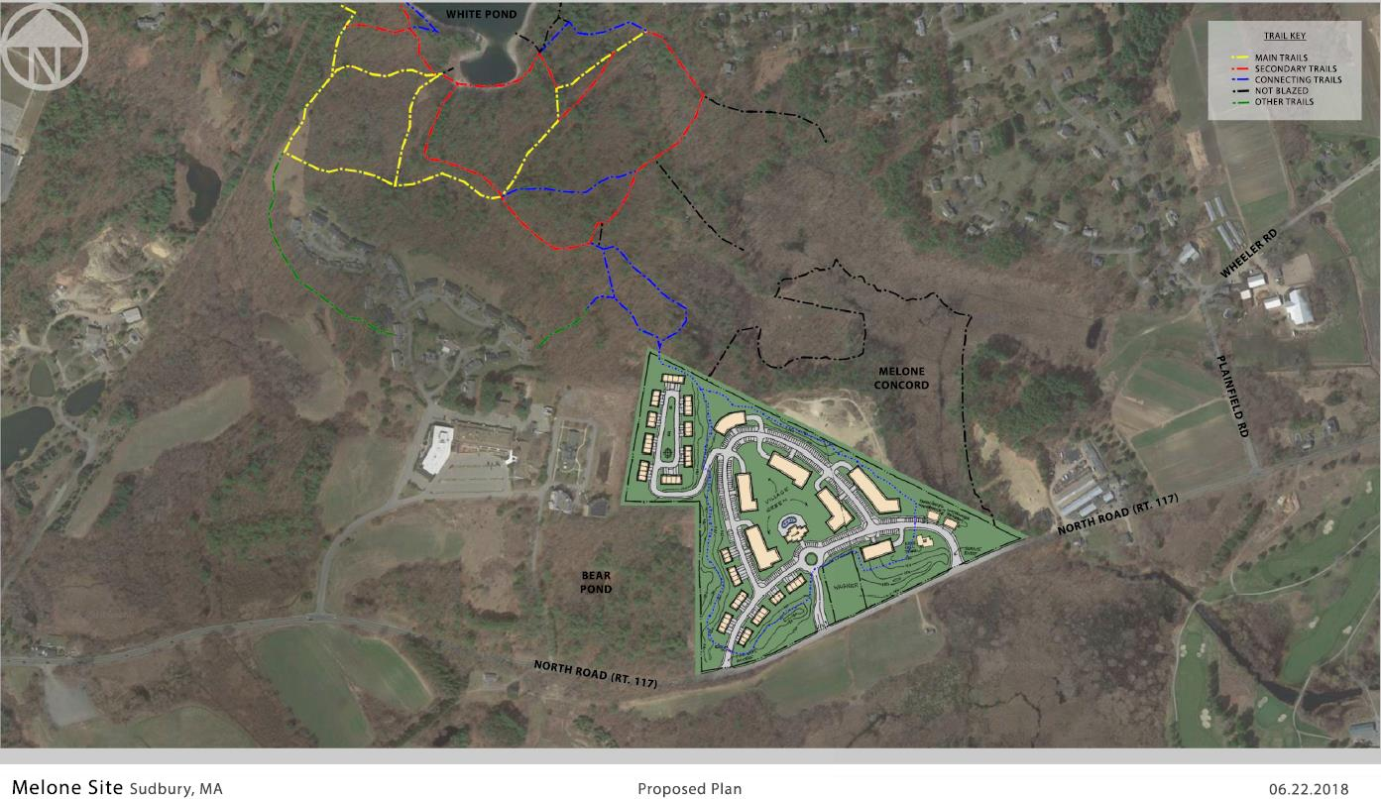
Quarry North-Sudbury: 274 units

Slide 24
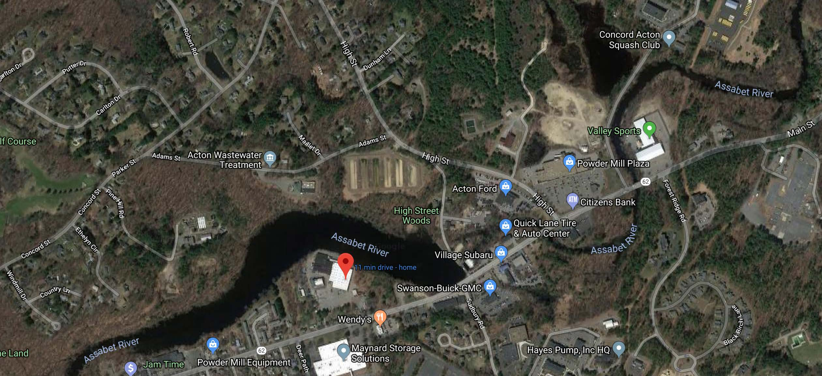
Powder Mill Place-Maynard/Acton: 254 units

Slide 25
Affordable Housing Funding Committee
  36 AHFC Committee Meetings
  4 Quarterly Joint Housing Meetings with the Concord Housing Authority, Concord Housing Foundation, & the Concord Housing Development Corporation
  6 meetings with the Select Board, Finance Committee
  2 Public Hearings
  Articles in the Concord Journal
Notes:
Concord Journal – front page article: 2/14/2019

Slide 26
Conclusion
1) Approving these articles is a first step to reaching residents’ goals.
2) Approving these articles helps residents have more control.
3) Affordable homes help local businesses and town employees.
4) We are not alone. Other communities are also acting proactively and many more will follow.

