Slide 1
Concord Recreation
Budget Presentation FY21
  Mission Statement
  Supporting and promoting community, wellness, and play.
  Core Values
  Dedicated • Innovative • Inclusive • Fun

Slide 2
Concord Recreation
COVID-19 Impact
  Department has taken approach that participants will not bear the financial expense of Facility closures and Program cancellations.
  Offering virtual exercise classes through Beede, assisting with local business when and where possible.
  Administrative team is following local and national resources ACA, MPRA, NPRA, US Swimming, Fitness Club and Pool industry leaders to develop concepts for re-opening in a safe/effective manner.
  Submitted a COVID-19 Impact Study to Town Managers office and Finance Director. Includes Financial impact and recommendations for cost savings for both current status and future forecast

Slide 3
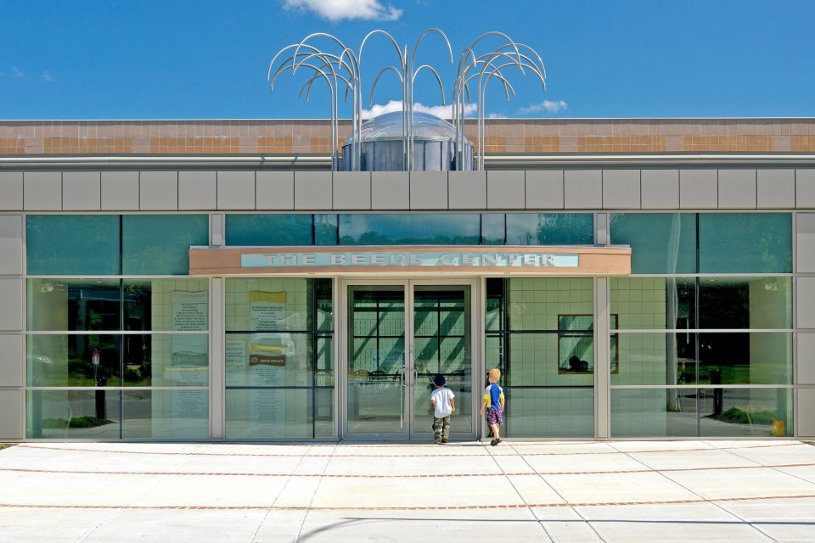
Beede Swim & Fitness
Closed mid-March
Furloughed over 50 Employees
Operating in a non-conventional manner
As of 8/12/20
302 Households Back
Out of Appx. 880

Slide 4
Swim & Fitness Enterprise
Updated FY20 Numbers
FY20 Budget Original Projections Actuals (Pre-Audit)
Operating Revenues $ 2,520,000 $ 1,839,069
Operating Expenses $ 2,141,891 $ 1,785,559*
Depreciation Expense $ 390,932 $ 378,601
Operating Income $ (12,823)
Investment Income $ 35,000 $ 53,963
Net $ 22,177 $ (271,128)
FY19 Fund Balance $ 2,985,725
FY20 Fund Balance $ 2,795,886

Slide 5
Updated FY21 Budget Numbers
Operating Revenues | Original | Adjusted
Initiation Fees | $5,000 | $3,125
Membership Fees | $310,000 | $193,750
Reoccurring Membership Fees | $1,076,000 | $672,500
Group Exercise | $100,000 | $62,500
Rentals | $45,000 | $28,125
Misc. Revenues | $170,000 | $106,250
Swim Program Fees | $430,000 | $268,750
Fitness & Personal Training | $213,000 | $133,125
TOTALS | $2,350,273 | $1,468,125
 | 37.5% Decrease = | ($ 882,148)

Slide 6
Updated FY21 Budget Numbers
Operating Expenses | Original | Adjusted
Administration, Full Time | $362,321 | $327,321
Program Staff, Full Time | $170,859 | $138,861
Limited Status, Part Time | $499,000 | $350,000
Benefits | $99,518 | $85,500
Capital Outlay | $110,000 | $65,000
General Fund Transfers | $87,711 | $0
TOTALS | $1,329,409 | $966,682
 | 27% Decrease = | ($ 362,727)

Slide 7
Swim & Fitness Enterprise
Updated FY21 Numbers
FY21 Budget Original Projection Revised Projection
Operating Revenues $ 2,520,000 $ 1,538,750
Operating Expenses $ 2,543,073 $ 2,347,043
Investment Income $ 50,000 $ 35,000
Beede Endowment $ - $ 20,000
Net $ 26,927 $ (753,343)
FY20 Fund Balance $ 2.8 M
FY21 Projected Fund Bal. $ 2 M

