Slide 1
Concord Recreation
Budget Presentation FY21
  Mission Statement
  Supporting and promoting community, wellness, and play.
  Core Values
  Dedicated • Innovative • Inclusive • Fun

Slide 2
Concord Recreation
COVID-19 Impact
  Department has taken approach that participants will not bear the financial expense of Facility closures and Program cancellations.
  Offering virtual exercise classes through Beede, assisting with local business when and where possible.
  Administrative team is following local and national resources ACA, MPRA, NPRA, US Swimming, Fitness Club and Pool industry leaders to develop concepts for re-opening in a safe/effective manner.
  Submitted a COVID-19 Impact Study to Town Managers office and Finance Director. Includes Financial impact and recommendations for cost savings for both current status and future forecast
Notes:
The Recreation division is one of the most likely to feel a serious impact from COVID-19. Very difficult to project implications as there is just too much uncertainty. We could experience extreme low participation to high demand for programs like Childcare and Health & Wellness.

Slide 3
Concord Recreation by the numbers…….
Beede
104 = unique individuals in Masters swim program
222 = members on the Otters swim team
437 = unique individuals taking learn to swim class
497 = Group exercise registrations
126,373 = total visits to Beede (up 22%)
Hunt
59 = unique individuals in pickle ball
178 = skiers every Tuesday in January & February
519 = unique individuals in camp taking 1857 camp spots
243,000 = calories burned on Zagster bikes

Slide 4
2019 - Department accomplishments
Facility enhancements in 2019
Beede Center upgrades in the Cardio Room
Emerson Playground install of two new glass basketball backboards
White Pond start up with new restroom trailer and Guard House
Emerson Pool install of new Water filtration unit & handicap lift
Rideout Phase II completion (exterior path, batting cages, outdoor exercise)

Slide 5
2019 - Department accomplishments
Program highlights
Upgraded registration software to MyRec
Successful planning & implementation of Little Women week in Concord.
Successful first summer of operation at White’s Pond beach
Transition of the operation of afterschool programming at Willard & Thoreau elementary schools (formerly operating by PTG)

Slide 6
Budgets managed by Recreation
General Fund accounts
  Hunt Gym 0001-631-631
  Visitor Center building 0001-122-671
  55 Church Street 0001-
Capital Accounts
  Rideout Phase II
  White Pond Construction
Programming accounts
  Recreation Revolving 0024-520-630
  Beede Swim & Fitness Enterprise 0064-650-650

Slide 7
Recreation Revolving
Fund balance as of June 30, 2019
$1,098,496

Slide 8
Budget Goals
Recreation Revolving
Increase wages for minimum wage impact
Establish Visitor’s Center/Tourism budget
New staff to manage front desk at 55 Church Street & Hunt Gym
Facility investment at Gerow Park for future program use
KEEP PROGRAMS AFFORDABLE

Slide 9
Budget Driving Factors
Recreation Revolving
  Effects of minimum wage increase - $40,000
  General Fund transfers of $205,292
  Capital projects - $200,000 for Gerow Park Pavilion, $25,000 Emerson Pool, $5,000 for Computers
  Increase from additional Administrative staff - $22,185
  Financial Assistance/Aid of $145,000 ($134,000 in loss revenue)

Slide 10
General Fund Transfers

Slide 11
Concord Recreation Financial Assistance Program
Summer 2019 & School Year 2019/20
Program Cost Amount Paid Discount Amount
$236,570 $91,570 $145,000
74 unique individuals

Slide 12
Town of Concord Employee Discounts
Summer Camp 2018 & 2019
Program Cost Amount Paid Discount Amount
$103,691 $12,936 $90,755
41 unique individuals
26 families

Slide 14
Hunt Operating Bottom line
 | FY18 | FY19 | FY20 budget | FY21 budget
Revenue | $1,954,349 | $2,191,500 | $2,111,000 | $2,340,800
Operating Expense | $1,861,966 | $2,210,163 | $2,235,611 | $2,558,846
Bottom Line | $69,989 | $-18,663 | $-124,611 | $-218,046

Slide 15
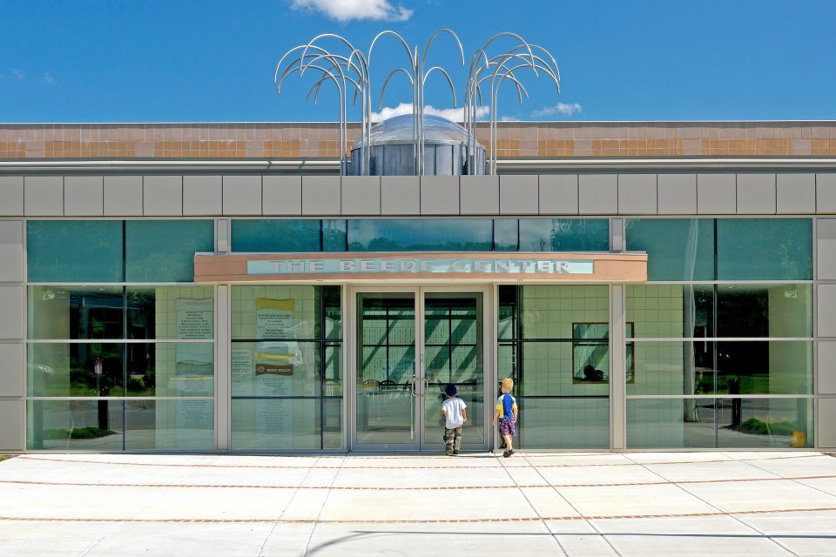
Beede Swim & Fitness

Slide 16
Swim & Fitness Enterprise
Fund balance as of June 30, 2019
$2,795,886

Slide 17
Budget Goals
Swim & Fitness Enterprise
Increase wages for minimum wage impact
Continued facility enhancements in cardio room
Increase membership/New staff focused on marketing & selling memberships
KEEP MEMBERSHIP AND PROGRAMS AFFORDABLE

Slide 18
Budget Driving Factors
Beede Budget
  Effects of minimum wage increase - $25,000
  General Fund transfers of $87,711
  Capital projects - $110,000
  Depreciation expense - $401,182
  Increase in Management team staffing - $70,000

Slide 19
General Fund Transfers

Slide 20
Town of Concord Employee Discounts
Beede 2019
Program Cost Amount Paid Discount Amount
$23,616 $7,200 $16,416
24 unique individuals

Slide 21
CCHS Swim Team Estimated Use Value
Practices
$150/hour x 2 hours/day x 6 days/week x 16 weeks = $28,800

Slide 23
Beede Operating Bottom line
 | FY18 | FY19 | FY20 budget | FY21 budget
Revenue | $2,288,021 | $2,265,975 | $2,349,000 | $2,520,000
Operating Expense | $2,267,102 | $2,325,647 | $2,477,477 | $2,543,073
 | $20,919 | $(59,672) | $(128,477) | $(23,073)
Investment Income | $49,070 | $58,938 | $54,000 | $50,000
Net Income | $69,989 | $(734) | $(74,477) | $26,927

Slide 24
Marketing & Sales Manager
Missed Opportunities
Otters Swim team winter 2019/20; 222 participants of which 135 or 61% are not Beede members
Group exercise winter 2020; 173 participants of 102 or 59% are not Beede members
List of 300 cancelled memberships (2016 to 2018) with no follow ups
2 year goals
Family membership from 265 to 400
  135 x $1,836/year = $247,860

Slide 25
Membership Trends

Slide 26
Concord Recreation
Budget Presentation FY21
  QUESTIONS

