Slide 1
ARTICLE 21: SOLID WASTE DISPOSAL FUND EXPENDITURES
To determine whether the Town will vote that the income from user fees for solid waste disposal services, associated services, and jobbing services by Concord Public Works during the ensuing fiscal year, together with the balance of operating cash in the Solid Waste Disposal Fund, be expended without further appropriation under the direction and control of the Town Manager in accordance with the Motion passed under Article 27 of the 1989 Annual Town Meeting; or take any other action relative thereto.

Slide 2
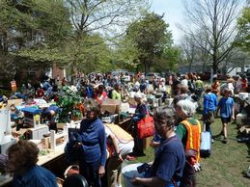
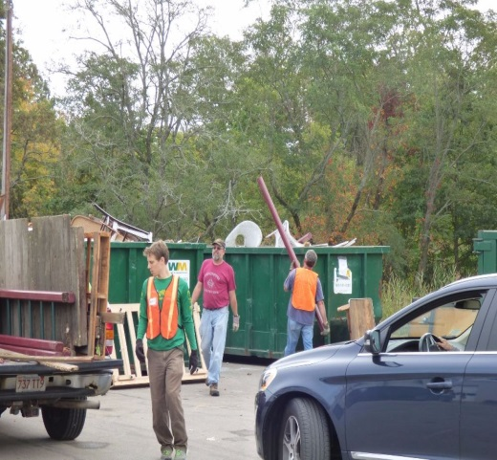

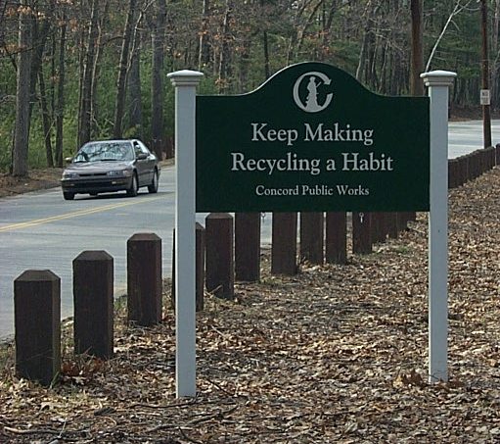
Article 21. Solid Waste Disposal Fund Expenditures
Finance Committee - Enterprise Fund Hearing
May 11, 2021
Alan Cathcart
Director of Public Works
Melissa Simoncini
Environmental Services Program Administrator
Concord Public Works
133 Keyes Road
Concord, MA 01742
978-318-3240

Slide 3

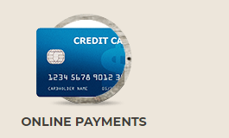
Article 21: Solid Waste Disposal Fund Expenditures
Curbside Program Overview
Weekly Collection
“Pay-as-you-throw”
Dual Stream Recycling
Environmentally Sound
39% Recycling Rate
Household Hazardous Waste Collection
Economical
Semi-annual billing
Online payment
Barrel Stickers & Disposal Tags
Now Available for Purchase Online

Slide 4
Article 21: Solid Waste Disposal Fund Expenditures

Slide 5


Article 21: Solid Waste Disposal Fund Expenditures
FY22 Cost to Subscribers
 | FY20 | FY21 | FY22
Collection Fee | $272.00 | $282.00 | $322.00
Disposal Fee | $1.50/Tag $39.00/Sticker | $1.80/Tag $46.80/Sticker | $1.80/Tag $46.80/Sticker
Average Cost *1.36 bags/barrels per wk | $378.08 | $409.30 | $449.30
Yearly increase per subscriber - $40.00 or 10%
(Based on avg. 1.36 barrels/bags per week)

Slide 6
Article 21: Solid Waste Disposal Fund Expenditures
Annual Cost to Subscribers

Slide 7
Article 21: Solid Waste Disposal Fund Expenditures
59%
FY21
FY22

Slide 8
Article 21: Solid Waste Disposal Fund Expenditures
Dual Stream Recycling

Slide 9

Article 21: Solid Waste Disposal Fund Expenditures
Existing
Long Term Contract
Amendments
China Sword
New contract amendment through Sept 2022
Moving Forward
Community Feedback
Hauler Feedback
Competitive Proposals

Slide 10
Article 21: Solid Waste Disposal Fund Expenditures
Drop Off
Household Hazardous Waste
Spring Event
May 15th, 2021
Fall event
October 16th, 2021
Minuteman/Lexington
April 14, May 15, June 19, July 17, Aug. 21, Sept. 19 (Sun.), Oct. 16, Nov. 6
Batteries, Bulbs & Mercury
Paint Shed
Store safely at home
Call CPW to arrange disposal
Mini collection events
Wed 3:00 pm - 5:30 pm
Sat 9:00 am - 2:30 pm

Slide 11
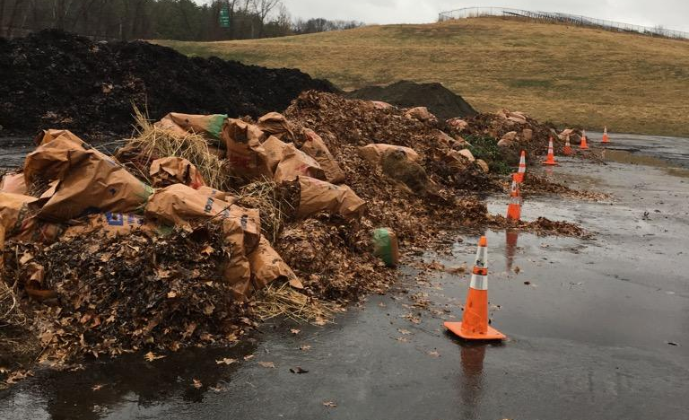
Article 21: Solid Waste Disposal Fund Expenditures
Compost Site: 755 Walden Street
Routine Schedule
Saturdays 9 am - 3 pm &
Wednesdays 3 pm - 6 pm
Paint Shed Available
No Stickers

Slide 12
Article 21
Solid Waste Disposal Fund Expenditures
Questions?
Melissa Simoncini
Environmental Services Program Administrator
Concord Public Works
978-318-3241

Slide 13
ARTICLE 21: SOLID WASTE DISPOSAL FUND EXPENDITURES
To determine whether the Town will vote that the income from user fees for solid waste disposal services, associated services, and jobbing services by Concord Public Works during the ensuing fiscal year, together with the balance of operating cash in the Solid Waste Disposal Fund, be expended without further appropriation under the direction and control of the Town Manager in accordance with the Motion passed under Article 27 of the 1989 Annual Town Meeting; or take any other action relative thereto.

