Slide 1
Article 20
Light Plant Expenditures & Payment in Lieu of Taxes
Notes:
Good Evening my name is DW and I will be presenting Article 20. With me on the meeting tonight is our Financial Manger, Matt Cummings
CHARTS can be copied from … CMLP Operating Forecast <subject year>.xlsx -- Tab: <As noted> and pasted into slides
When inserting Charts, make them all 3.3” tall by 7.5” wide. Charts showing Net income should be 3.6” x 7.0”.
Center them horizontally and try not to move them below the top of the slide number in the footer.
Chart and data sources are noted in the Notes area of each slide.

Slide 2
System Demand
Notes:
The 2021 Forecasted Demand is show as a decrease
2020: 485 degree days
Average: 425 degree days per year so we forecasted a conservative number based on the average
Source: dwood

Slide 3
Light Plant Net Income
Notes:
For 2019 and 2020 you will see that the expenses were higher than the revenue…..
Source: CMLP Operating Forecast <subject year>.xlsx – Tab: PPT Charts – Data Tab: CHART_SUMMARY_Light Plant

Slide 4
Electricity Sales
Notes:
Residential sales represents 42%
Commercial sales represents 51%
Municipal sales represents 7%
Source: CMLP Operating Forecast <subject year>.xlsx – Tab: PPT Charts – Data Tab: SUMMARY_LP Revenue

Slide 5
Power Cost Categories
Notes:
Energy represents: 40%
Forward Capacity: 14%
Transmission: 23%
Fixed & Other: 11% - ISO ancilalary costs, admin fee, fix contracted costs
REC purchases: 12%
Source: CMLP Operating Forecast <subject year>.xlsx – Tab: PPT Charts – Data Tab: LP_Purchased Power Cost ($)

Slide 6
Power Generation Categories
Notes:
Grid Mix: 60%
Hydro: 12%
Landfill: 2%
Solar: 6%
Wind:10%
Nuclear: 10% - new starting in 2020
Source: CMLP Operating Forecast <subject year>.xlsx – Tab: PPT Charts – Data Tab: SUMMARY_LP Revenue

Slide 7
Operating Cost
Notes:
Purchased Power: $19.8 million The increase in PP is based on the increase in projected sales
Operations & MTC: $7.2 Million The increase in expenses from tree trimming & overhead and underground line maintenance Tree trimming $113k, OH $152K, UG $85k
Depreciation: $2 million – The straight line amortization of historical plant assets
Debt Services Interest: $300k
Source: CMLP Operating Forecast <subject year>.xlsx – Tab: PPT Charts – Data Tab: LP_O+M

Slide 8
Capital Outlay
 | 2021 | 2022
Total Capital Outlay | $ 4,036,400 | $ 2,538,000
Funded via …
Depreciation Fund | 1,085,400 | 846,000
Underground Fund | 1,826,000 | 67,000
Borrowing Operating Cash | 750,000 375,000 | 1,250,000 375,000
Notes:
On this slide we have show the 2021 and 2022 capital outlay. For 2021 the total capital outlay is $4 million, 36 thousand and 4 hundred dollars.
Using depreciation funds we will upgrading some field switches and reclosures and field switches and direct buried upgrade projects on Bartkus Farm and Wright Farm. The 1.8 million in the underground fund is allotted for the conversion of Cambridge Turnpike from OH to UG and some other roads such as Thoreau Street from Sudbury to Walden Street.
The planned borrowing is budgeted for our metering upgrade project.
2021
Source: CMLP Operating Forecast <subject year>.xlsx – Tab: HISTORY_Plant; Cells (AQ58:BB62)

Slide 9
Gross Margin
 | 2020 | 2021
Net Income | ($ 327,232) | $ 1,272,911
 | (1.16 %) | 4.10 %
Total Revenue | 28,128,893 | 31,023,878
Total Expenses | 28,456,125 | 29,750,967
Notes:
Source: CMLP Operating Forecast <subject year>.xlsx – Tab: ExecSumm_Rate of Return; Lines 2 and 1 – Tab: SUMMARY_LP Revenue; Line 27 (w/o Unbilled)

Slide 10
Payment in Lieu of Taxes
The Payment in Lieu of Taxes for the fiscal year will be $474,500
The funds will be transferred from the Operating Fund of the Light Plant to be used by the Assessors to reduce the tax levy for the fiscal year ending June 30, 2022
Notes:
For this fiscal year the Payment in Lieu of Taxes is $474,500. This number is based on a formula derived by myself and the CFO and ultimately approved by the Town Manager. The formula used the audited finacials kwh sold in 2019 multiplied by 2.75 mils of $2750 million per kwh sold.

Slide 11
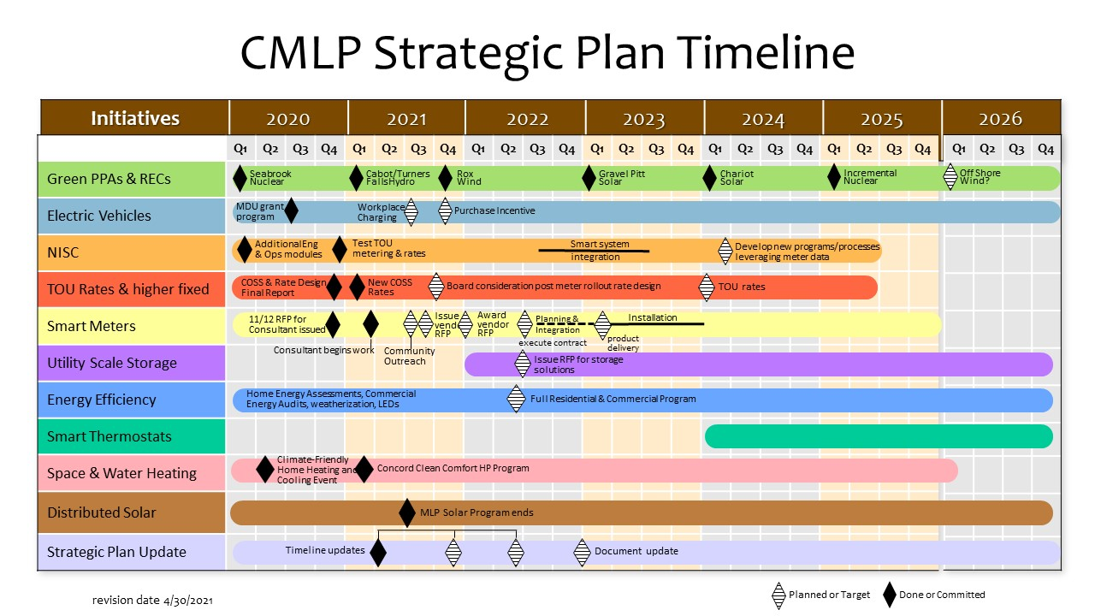
Strategic Plan

Slide 12
Telecommunications

Slide 13
Internet Service Offering
Offered to residents and businesses since 2014
35 to 400 Mbps for Residential Service
1 Gbps Business Service now available
Over 1700 customers connected in January 2021
Rates compare favorably to other suppliers
Details at www.concordma.gov/broadband
Notes:
Source: Telecom Manager

Slide 14
2020 Results
Subscriptions & Revenue
Subscriptions grew about 10% from 2019
Financial Results
Estimated 2020 Revenue $1,362,689 and Net Income $341,262
Organizational changes in 2020 – Hired Director of Telecom and added two Field Technicians
60% Increase in network bandwidth capacity
Notes:
Source: Telecom Manager

Slide 15
Revenue Sources
Notes:
Residential: $1.2 million
Commercial: $198k
Municipal: $3k
Other Revenue: $154k M&J and installation fees prior to 2019 the installation fee was allocated differently and not broken out.
Source: Telecom Manager

Slide 16
2021 Forecast Plans
Revenue increase about 27%
2021 Revenue $1,579,985 and Net Income $323,589
Hire an additional Network Engineer
Hire a fourth Telecommunications Technician
Add a vehicle and tools as needed to expand support
Increase vendor diversity to support 10G service upgrade to increase redundancy
Notes:
Source: Telecom Manager

Slide 17
Telecom Net Income (Loss)
Notes:
Source: CMLP Operating Forecast <subject year>.xlsx – Tab: PPT Charts – Data Tab: CHART_TC_SUMMARY Overview

Slide 18
Article 20
Questions?
Notes:
Source: Copy of Slide #2

