Slide 1
Article 24: Water System Expenditures
To determine whether the Town will vote that the income from user fees, special service fees, and jobbing services by the Water and Sewer Division of Concord Public Works during the ensuing fiscal year, together with the balance of operating cash in the Water Fund, be expended without further appropriation under the direction and control of the Town Manager in accordance with the Motion passed under Article 38 of the 1974 Annual Town Meeting, or take any other action relative thereto.

Slide 2
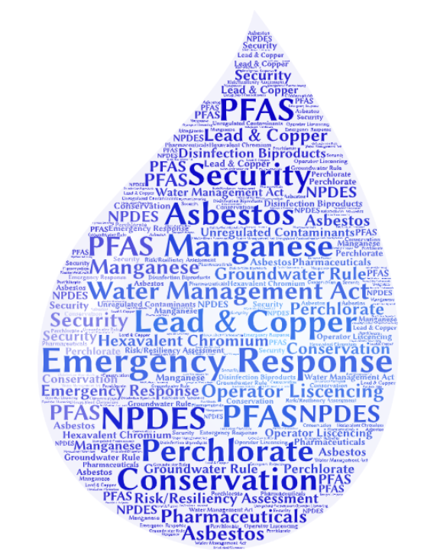
Article 24: Water System Expenditures
Current Challenges
State Regulations
Federal Regulations
Emerging Contaminants
Cyber Security
Revised Lead & Copper Rule
Notes:
Regulations are constantly evolving and many have unknown costs like the new requirements with the Water Management Act Regulations and PFAS

Slide 3
Article 21: Water System Expenditures

Slide 4
Article 24: Water System Expenditures
Annual Water Demand (MG)

Slide 5
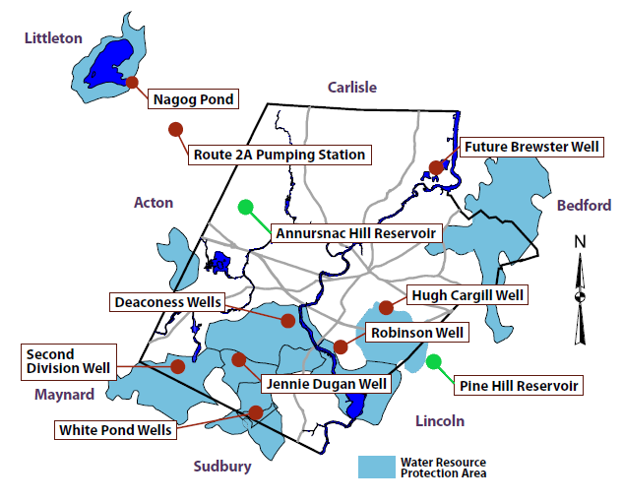
Water System Infrastructure Assets = $23.2 Million
Article 24: Water System Expenditures
1 - Surface Water
6 - Ground Water Supplies
7 - Pumping Stations
2 - Advanced Treatment Facilities
2 - Reservoirs (7.5 MG Storage)
134 - Miles of Distribution Mains
1,328 - Hydrants

Slide 6
FY22 – Operations & Maintenance
Article 24: Water System Expenditures
Proposed Expenditures – $ 4,835,956
$ 2,773,767 – Pumping, Treatment,
Distribution & Storage
$ 1,352,891 – Depreciation
$ 709,298 – General Fund
Services

Slide 7
10 Year Operating Projections
Article 24: Water System Expenditures
Notes:
Capital Plan

Slide 8
Article 24: Water System Expenditures
FY22 – Capital Improvement Plan (major components)
Proposed Expenditures – $ 6,102,000
$ 1,600,000 - Nagog Treatment
Phase I Intake & Final Design
$ 2,680,000 - PFAS Mitigation
$ 222,000 - Main Replacement
$ 320,000 - Reservoir Rehabilitation
$ 250,000 - Meter Reading Upgrade (Phase I)

Slide 9
10 Year Capital Plan
Article 24: Water System Expenditures
Notes:
Capital Plan

Slide 10
Article 24: Water System Expenditures
Customer Class Profile

Slide 11
Article 24: Water System Expenditures
Residential Gallons Per Capita Day (RGPCD)

Slide 12
Article 24: Water System Expenditures
Seasonal Water Demand

Slide 13
Article 24: Water System Expenditures
FY22 – Residential Rates
Proposed Adjustment (FY 21 to FY 22):
1st Step* - $0.0651/cubic foot (+10.0 %)
2nd Step - $0.1367/cubic foot (+10.0 %)
3rd Step - $0.1725/cubic foot (+10.0 %)
Impact on Avg. Residential Customer ~ $ 53.10/year
* Discount Rate: Savings up to $291/Year

Slide 14
Article 24: Water System Expenditures

Slide 15
Article 24: Water System Expenditures
To determine whether the Town will vote that the income from user fees, special service fees, and jobbing services by the Water and Sewer Division of Concord Public Works during the ensuing fiscal year, together with the balance of operating cash in the Water Fund, be expended without further appropriation under the direction and control of the Town Manager in accordance with the Motion passed under Article 38 of the 1974 Annual Town Meeting, or take any other action relative thereto.

Slide 16
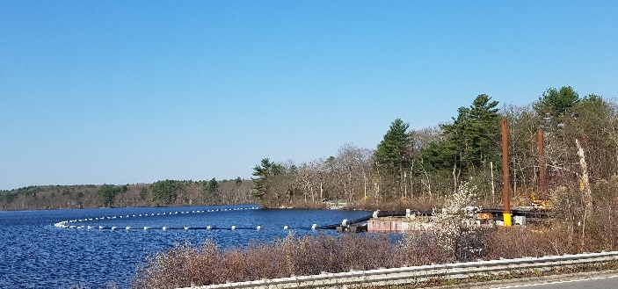
Photo of new Nagog floating intake pipe
Article 24: Water System Expenditures

Slide 18
Article 24: Water System Expenditures

Slide 19
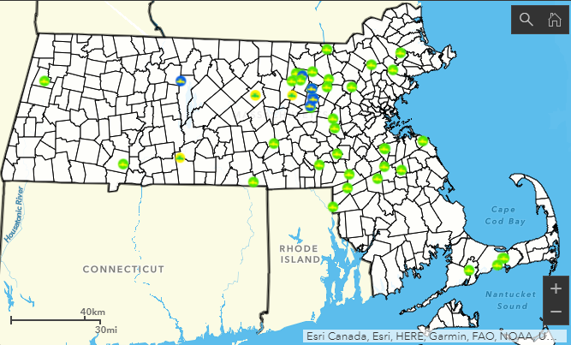
Current Challenges
MassDEP 4/30/21
PFAS
New Standard - 20 parts per trillion for any 1 or comb. of 6 PFAS compounds
Very low detection levels
Sampling accuracy
Sample costs (ongoing annual costs)
From MassDEP website 4/30/21 –
47 Public Water Systems have detections over 20 ppt – Data reporting on state site is about 3 weeks behind - results from April are still coming in and being verified and confirmed
Notes:
Add health language

Slide 20
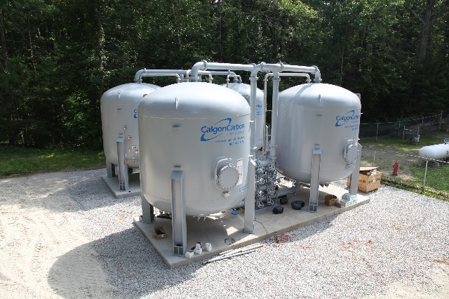
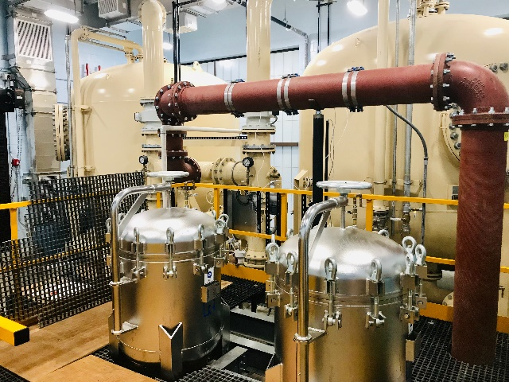
PFAS
Treatment costs can be substantial
Ayer - $3.6 million – Grove Pond Source
Hudson - $4.3 million – Chestnut St. Source
Mansfield - $4.2 million – Cate Spring Source
Acton Water District - $6.9 million – North Acton Treatment Plant
Westfield - $12.2 million – Dry Bridge Rd. Treatment Plant
Notes:
PFAS will extend wastewater and other.

Slide 21
Current Challenges
From MassDEP website 4/30/21 –
47 Public Water Systems have detections over 20 ppt – Data reporting on state site is about 3 weeks behind - results from April are still coming in and being verified and confirmed
PFAS
Recently promulgated standards for PFAS in drinking water (Maximum Contaminant Level of 20 parts per trillion for any one or combination of six PFAS compounds
PFAS is not naturally occurring – it is a manufactured product introduced into the environment
PFAS Ubiquitous – other sources unregulated
Initial sampling:
January 2021 for largest water systems
April 2021 for medium water systems
October 2021 small systems will begin.
Analytical Issues
Very low detection levels
Sampling accuracy
Sample costs (ongoing annual costs)
Public Notice Language:
“Some people who drink water containing PFAS6 in excess of the MCL may experience certain adverse effects. These could include effects on the liver, blood, immune system, thyroid, and fetal development. These PFAS6 may also elevate the risk of certain cancers.”
“Consumers in a sensitive subgroup (pregnant or nursing women, infants and people diagnosed by their health care provider to have a compromised immune system) are advised not to consume, drink, or cook with water when the level of PFAS6 is above 20 ng/L.”
Notes:
Add health language

Slide 22
10 years
FY 23-32
82,261,870
1,535,350
83,797,220
42,780,045
26,015,997
68,796,043
15,001,177
766,711
81,525
9,349,442
348,200
382,298
5,606,423
5,606,423
26,015,997
31,622,420
34,820,000
34,098,000
1,032,000
14,093,170
34,820,000
50,595,250
54,489,150
FY 2032
9,998,987
158,035
10,157,022
4,881,720
2,976,373
7,858,093
2,298,929
58,367
0
0
1,045,811
0
0
1,311,485
1,311,485
2,976,373
4,287,858
0
0
0
1,924,997
0
2,362,861
2,385,900
4,200,974
2,362,861
2,385,900
4,177,935
4,177,935
FY 2031
9,553,987
157,035
9,711,022
4,736,356
2,898,358
7,634,714
2,076,308
58,367
0
0
1,122,811
0
0
1,011,865
1,011,865
2,898,358
3,910,222
0
0
0
1,924,997
0
1,985,225
2,252,900
4,468,649
1,985,225
2,252,900
4,200,974
4,200,974
FY 2030
9,133,987
156,035
9,290,022
4,595,434
2,856,452
7,451,886
1,838,136
58,367
0
0
1,199,811
0
0
696,693
696,693
2,856,452
3,553,145
0
0
0
1,924,997
0
1,628,148
2,189,000
5,029,501
1,628,148
2,189,000
4,468,649
4,468,649
FY 2029
8,730,987
155,035
8,886,022
4,458,811
2,815,631
7,274,442
1,611,580
58,582
0
0
1,276,811
0
0
393,351
393,351
2,815,631
3,208,983
0
0
0
1,924,997
0
1,283,986
2,164,700
5,910,216
1,283,986
2,164,700
5,029,501
5,029,501
FY 2028
8,343,987
154,035
8,498,022
4,326,348
2,806,670
7,133,018
1,365,004
60,438
0
0
1,353,811
40,000
40,000
-8,369
-8,369
2,806,670
2,798,301
4,000,000
0
0
1,924,997
4,000,000
873,304
2,183,750
7,220,661
873,304
2,183,750
5,910,216
5,910,216
FY 2027
7,973,987
153,035
8,127,022
4,197,914
2,811,464
7,009,377
1,117,645
64,357
0
1,550
1,262,811
44,880
48,880
-176,119
-176,119
2,811,464
2,635,345
4,488,000
4,000,000
155,000
1,724,997
4,488,000
4,755,348
6,046,400
8,511,713
4,755,348
6,046,400
7,220,661
7,220,661
FY 2026
7,620,987
152,035
7,773,022
4,073,378
2,713,140
6,786,518
986,504
73,200
0
8,300
1,143,314
144,740
149,228
-385,879
-385,879
2,713,140
2,327,261
14,474,000
4,488,000
215,000
1,500,597
14,474,000
5,099,664
5,035,800
8,447,849
5,099,664
5,035,800
8,511,713
8,511,713
FY 2025
7,282,987
151,035
7,434,022
3,952,619
2,417,421
6,370,039
1,063,983
85,999
0
14,995
595,430
106,260
120,734
312,562
312,562
2,417,421
2,729,983
10,626,000
14,474,000
217,000
776,897
10,626,000
16,210,086
15,250,800
7,488,563
16,210,086
15,250,800
8,447,849
8,447,849
FY 2024
6,962,987
150,035
7,113,022
3,835,515
2,023,485
5,859,000
1,254,022
104,450
0
23,315
180,214
5,100
15,726
1,134,117
1,134,117
2,023,485
3,157,602
510,000
10,626,000
220,000
245,597
510,000
13,318,005
11,524,900
5,695,458
13,318,005
11,524,900
7,488,563
7,488,563
FY 2023
6,658,987
149,035
6,808,022
3,721,951
1,697,005
5,418,956
1,389,066
144,583
0
33,365
168,618
7,220
7,730
1,316,716
1,316,716
1,697,005
3,013,721
722,000
510,000
225,000
220,097
722,000
3,078,624
5,455,000
8,071,835
3,078,624
5,455,000
5,695,458
5,695,458
FY 2022
6,363,987
148,035
6,512,022
3,483,066
1,352,891
4,835,956
1,676,066
187,660
0
49,435
147,098
36,300
37,022
1,593,871
1,593,871
1,352,891
2,946,762
3,630,000
722,000
373,000
183,997
3,630,000
3,111,765
6,102,000
11,062,070
3,111,765
6,102,000
8,071,835
8,071,835
FY 2021
5,815,987
147,035
5,963,022
3,563,435
1,202,648
4,766,083
1,196,939
215,517
0
68,385
1,998
0
3,630
1,338,443
1,338,443
1,202,648
2,541,091
0
3,630,000
485,000
2,497
2,175,000
3,508,594
4,576,000
12,129,476
3,508,594
4,576,000
11,062,070
11,062,070
FY 2020
5,507,291
146,035
5,653,326
3,296,661
1,046,939
4,343,600
1,309,726
166,814
28,620
120,445
0
0
0
1,384,715
1,384,715
1,046,939
2,431,654
3,000,000
0
485,000
0
3,000,000
15,242
1,931,412
1,353,078
12,101,839
1,931,412
1,353,078
-550,697
12,129,476
12,129,476
LESS: Interest Expense Existing Debt Future Debt
Bond Anticipation Notes (BANs) Issuance expense (Premium)
LESS: Principal repayments Existing Debt
New Debt
BAN Repayment Amort of bond premium
Net Available for Capital Purposes
Water Fund: Plan and Projection
ADD: Interest Income
Other Non-Operating Income
Available Resources from:
Net income Depreciation expense
subtotal Bond proceeds Loan proceeds
LESS: Planned Capital Changes in assets & liabilities Ending balance
Operating Revenue
User Fees Other Subtotal
Operating Expense
O & M Depreciation Subtotal
Operating Income
Cash Position
Beginning balance
ADD: Net available
ending cash balance
Net Income
Capital Plan
Town of Concord – FY22 Proposed Enterprise Budget

Slide 23
Article 24: Water System Expenditures
$ Residential Use/246 gpd

Slide 24
Article 24: Water System Expenditures
Program Objectives
Comply with Regulatory and Statutory Requirements
Achieve a High Level of Customer Satisfaction
Provide Sufficient Supply for the Current and Future Needs of Concord

Slide 25
Article 24: Water System Expenditures
Program Objectives
Well Maintained & Operated Facilities and Infrastructure
Reasonable and Competitive Rates through Sound Investments and Planning
Hire, Retain and Train Professional Workforce
Notes:
America’s economic future depends on clean and safe water, yet our water, wastewater and stormwater systems are old and in critical need of repairs, upgrades and replacements. The American Society of Civil Engineers gives these systems only a “C-” letter grade.

