Slide 1
CMS Solar Project
Goal: Net Zero Building or generating as much energy as being used on site
Cost will be separate from proposed article
CMLP is leading the design and financing

Slide 2
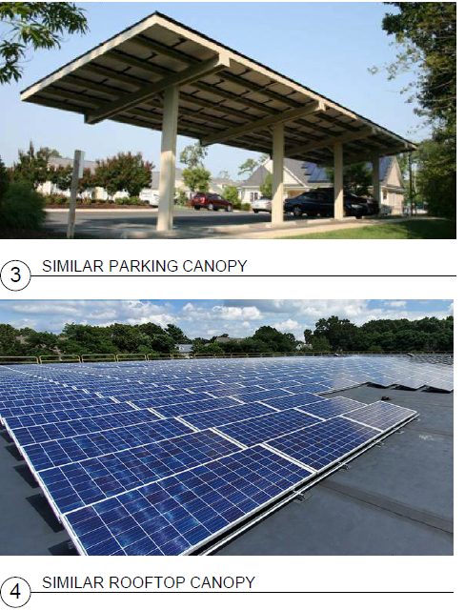
CURRENT STATUS
CMLP hired a consultant to assist
Completed feasibility study of maximum installation
Rooftop and ground canopies are possible

Slide 3
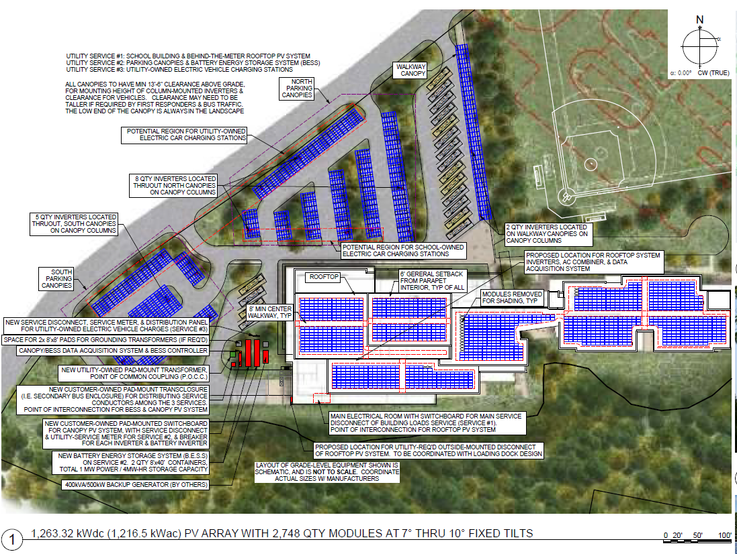

Slide 4
CMSBC AND CMLP COORDINATION
Designers have been collaborating
CMLP has met with CMSBC on several occasions
Project has been presented to the Light Board
Estimated energy use intensity (EUI) < CCHS
CCHS approximately uses less than 1 MW
Max capacity is approximately 4MW so even if half are installed, we should be able to meet need

Slide 5
CMLP NEXT STEPS
If the CMS warrant article is approved:
CMLP consultant will work with CMS designers to design a system meeting or exceeding energy needs
With size and capacity numbers, CMLP will determine the financing to ensure equitable benefits to customer base

Slide 6
TIMING OF SOLAR
Will aim to work in tandem with CMSBC timeline:
1.5 of design and bid
1.5 years of construction
Exact timing of construction will need to be assessed during future design phase

Slide 7
COST ESTIMATES OF SOLAR
Rooftop Panels $1,900,000
Canopy +$2,000,000
Total for Solar $3,900,000
Battery $4-6 million (depending upon size)

