Slide 1


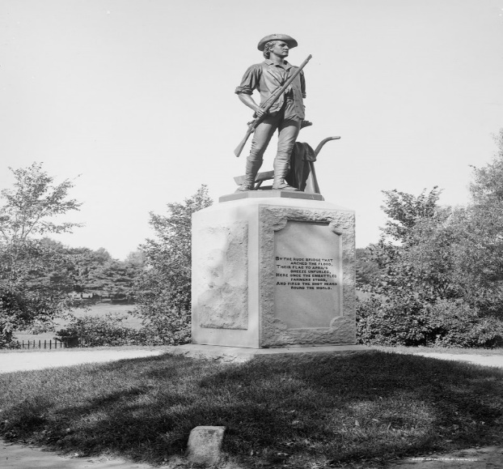
Town of Concord
FY23 RECERTIFICATION/
REVALUATION YEAR
TOWN CLASSIFICATION HEARING
FISCAL YEAR 2023
November 28, 2022
Presented by:
The concord board of assessors
David Karr Chairman
Meredith stone Town Assessor & Staff

Slide 2
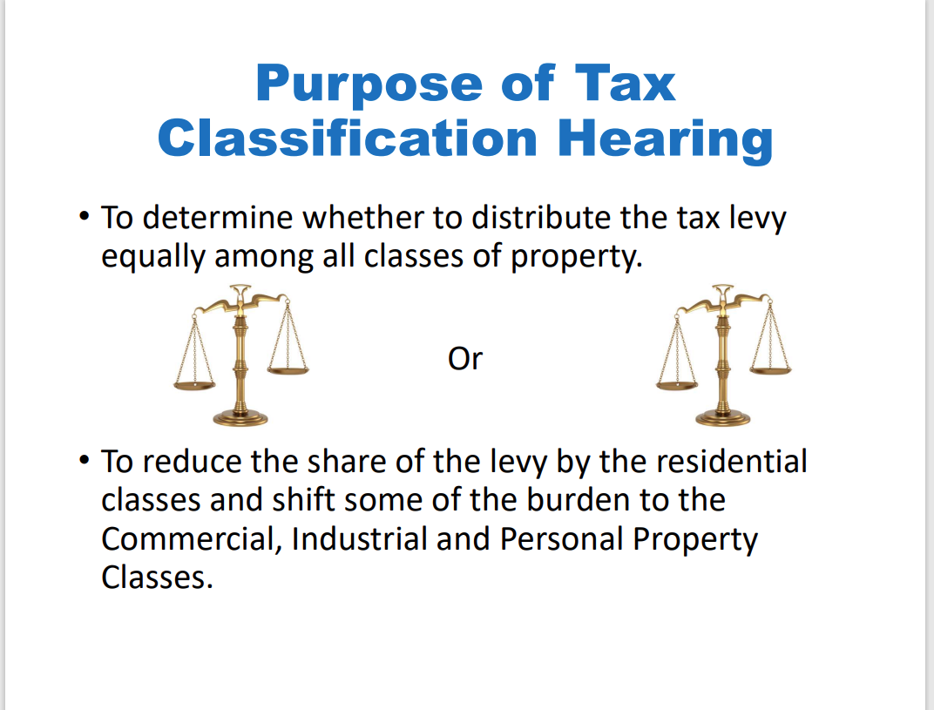

Slide 3
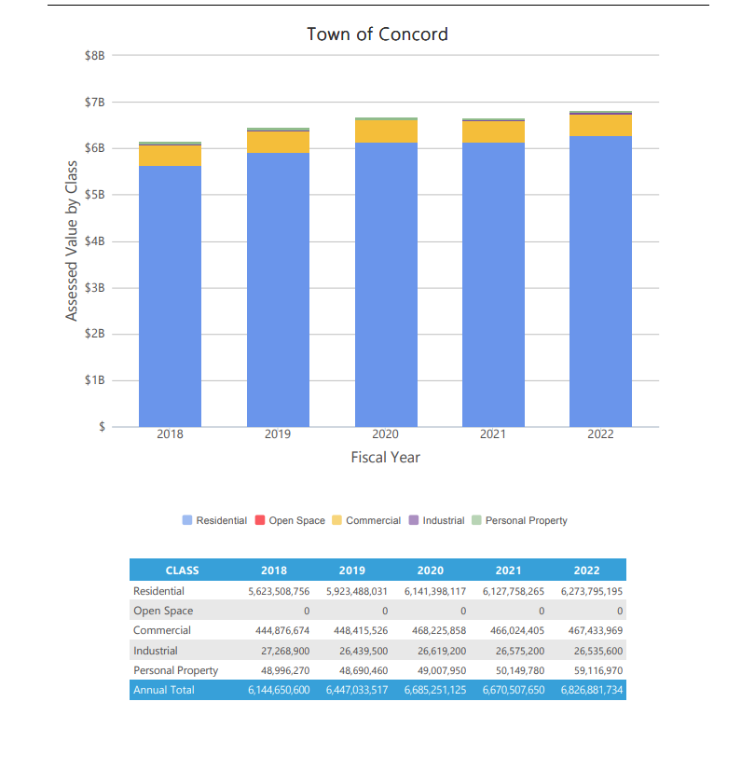
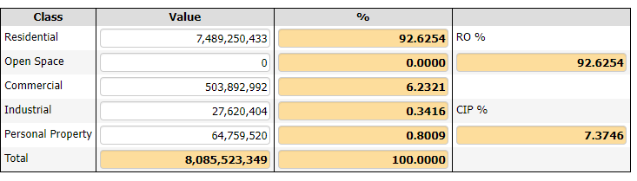
Assessed Values by Class historical with graph vs. current

Slide 4
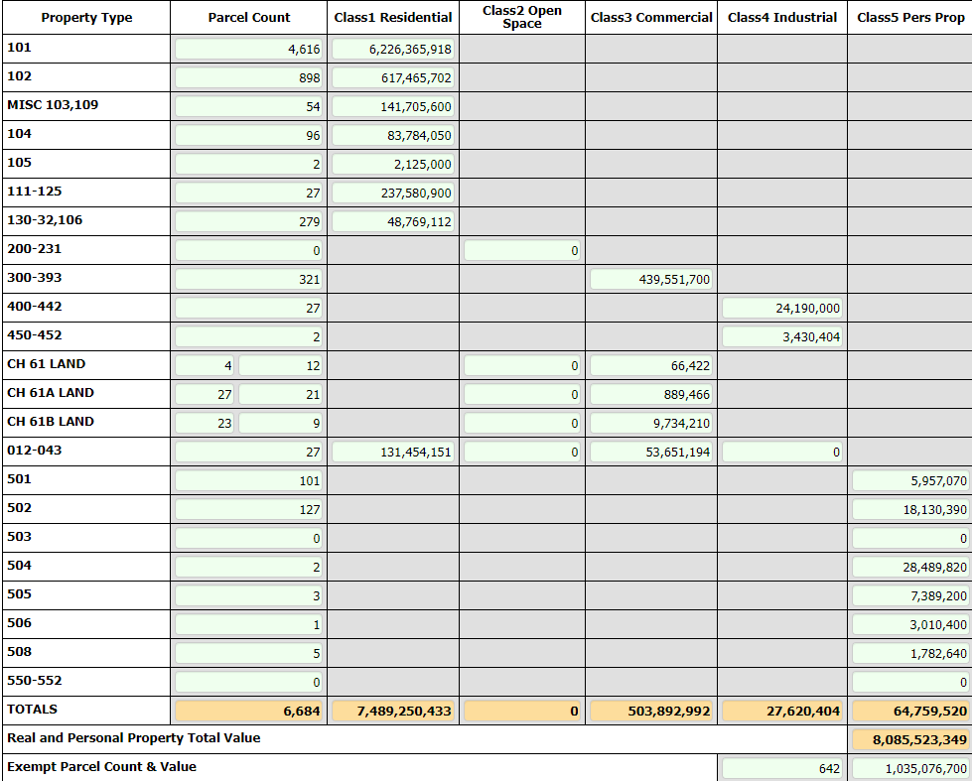
FY 2023 Property tax Levy FY 2023 Town Taxable Valuation
CALCULATING THE SINGLE TAX RATE
FY 23 Proposed Levy divided by Town’s Taxable Value
104,788,383
8,085,523,349
Single Tax Rate =$12.96
PER 1,000 OF ASSESSED VALUE IF A
FACTOR OF 1 IS SELECTED (NO SHIFT)

Slide 5
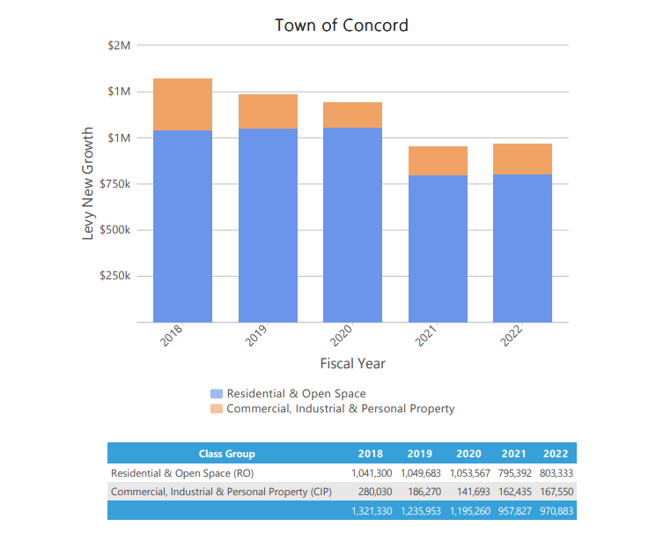
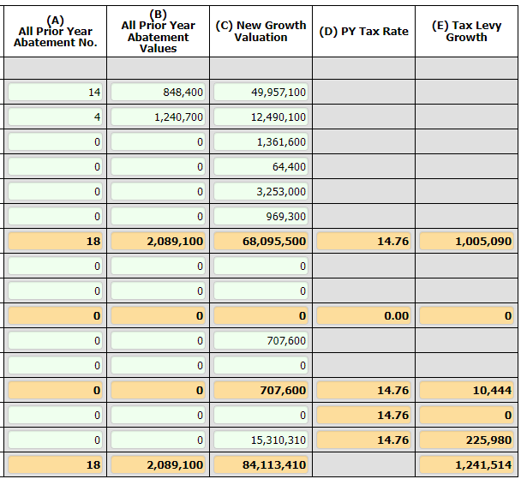


Slide 6
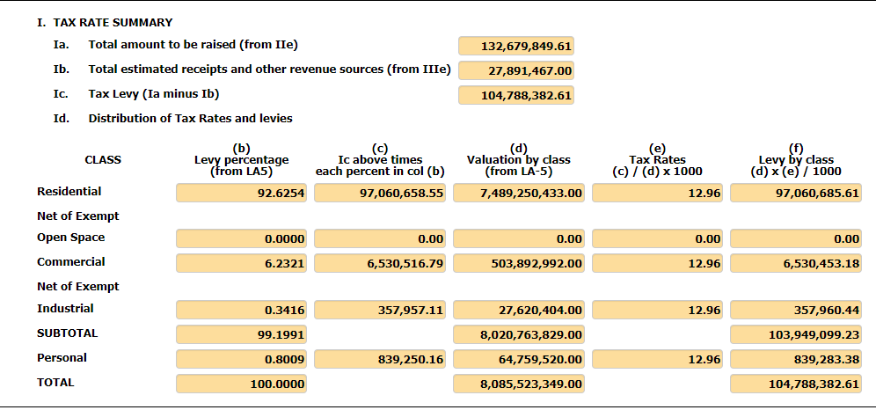

Slide 7
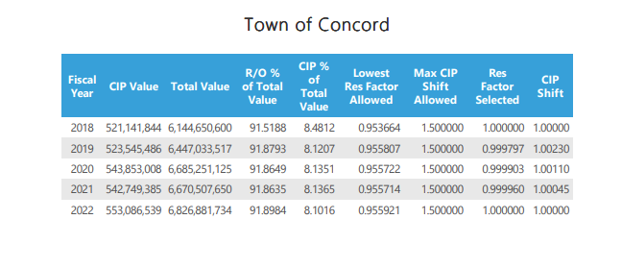
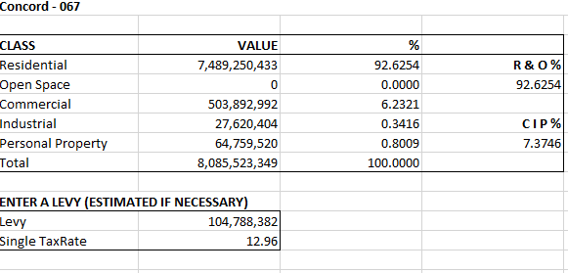
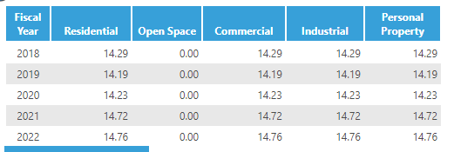
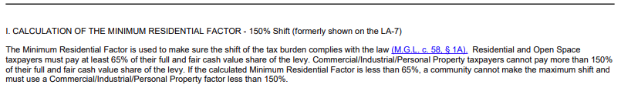

Slide 8
Tax Rate Calculation
Recommended FY2023 Tax Rate is $12.96/$1,000
FY2023 Property Tax Levy
$104,788,382
Town Taxable Valuation
8,085,523,349
or
$12.96 per thousand dollars of assessed value
FY22 FY23
Average Assessed Value 101-Single Family: $1,125,400 $1,348,866
Median Assessed Value 101-Single Family: $971.200 $1,169,500
Average Assessed Value 102-Condominium: $587,400 $687,601
Median Assessed Value 102-Condominium: $488,600 $529,850

Slide 9
What is a Split Tax Rate?
Communities decide to tax Residential and Commercial, Industrial & Personal Property (CIP) differently.
Statute allows an increase in CIP’s share of the tax levy up to 50% higher than residential
Does not generate new revenue; reallocates levy burden
Concord has used a uniform tax rate since 1998. A Tax Rate Split has been adopted in the Town of Concord before.

Slide 10
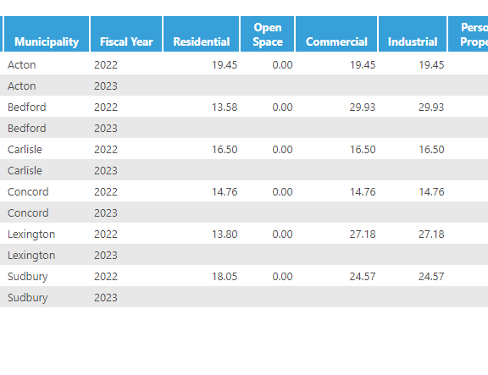
Tax Single and Split Rates
ACTON-SINGLE
BEDFORD-SPLIT
CARLISLE-SINGLE
CONCORD-SINGLE
LEXINGTON-SPLIT
SUDBURY-SPLIT
CIP SPLIT RATE SHIFTS LARGE BURDEN OF LEVY

Slide 11
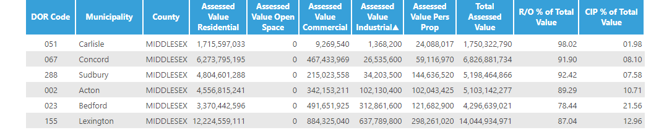

Slide 12
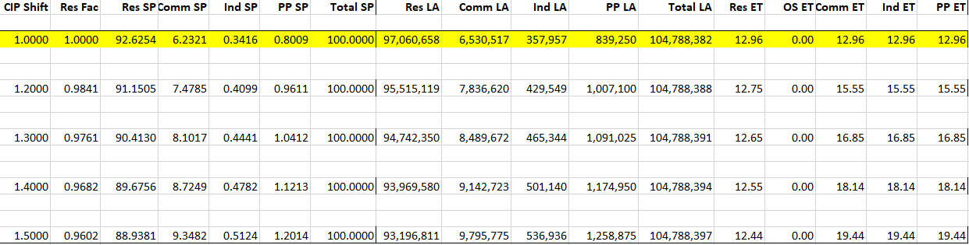
SHIFTING THE TAX RATE OPTIONS

Slide 13
OPEN SPACE DISCOUNT
During the State mandated Classification Hearing, the Select Board must vote on the following in order to establish a tax rate:
OPEN SPACE DISCOUNT:
Open space is land maintained in an open or natural condition which contributes significantly to the benefit and enjoyment of the public and which is not
Subject to a permanent conservation restriction;
Held for the production of income;
Taxable under the provisions of
Chapter 61 (forest land)
Chapter 61A (farm land)
Chapter 61B (recreation land).
The Select Board may discount up to 25% of the Open Space share of taxes.

Slide 14
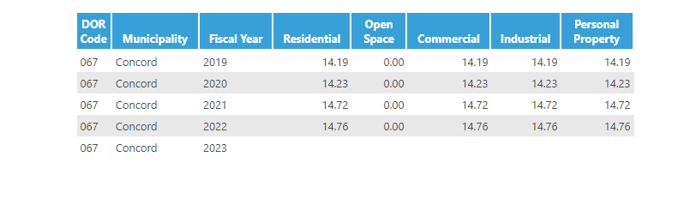
Historical tax rate has been a single rate

Slide 15
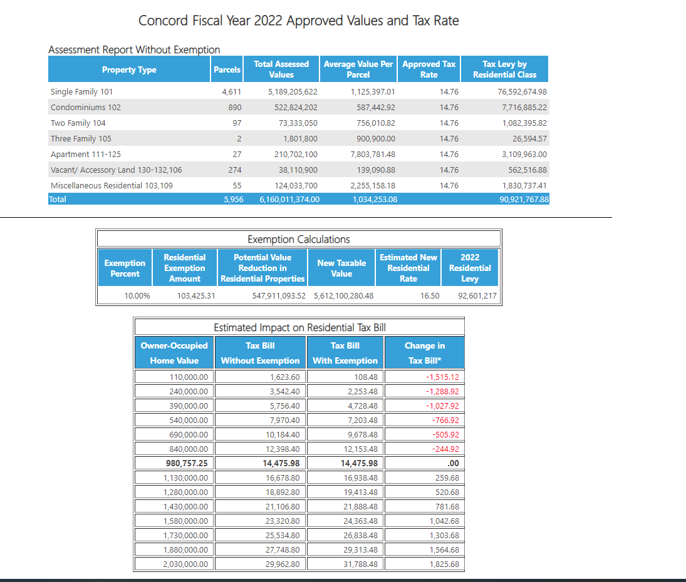
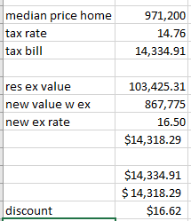
median home value receives credit of $16.62 in exemption tax dollars

Slide 16

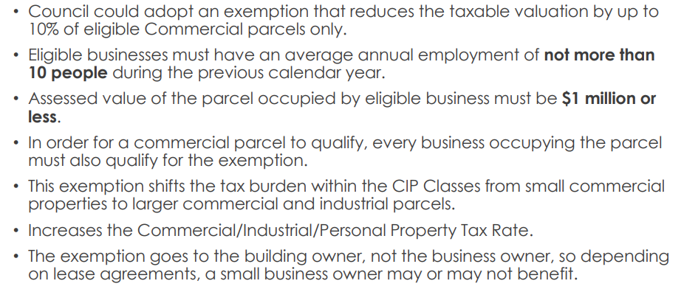
Concord has not historically adopted this exemption

Slide 17
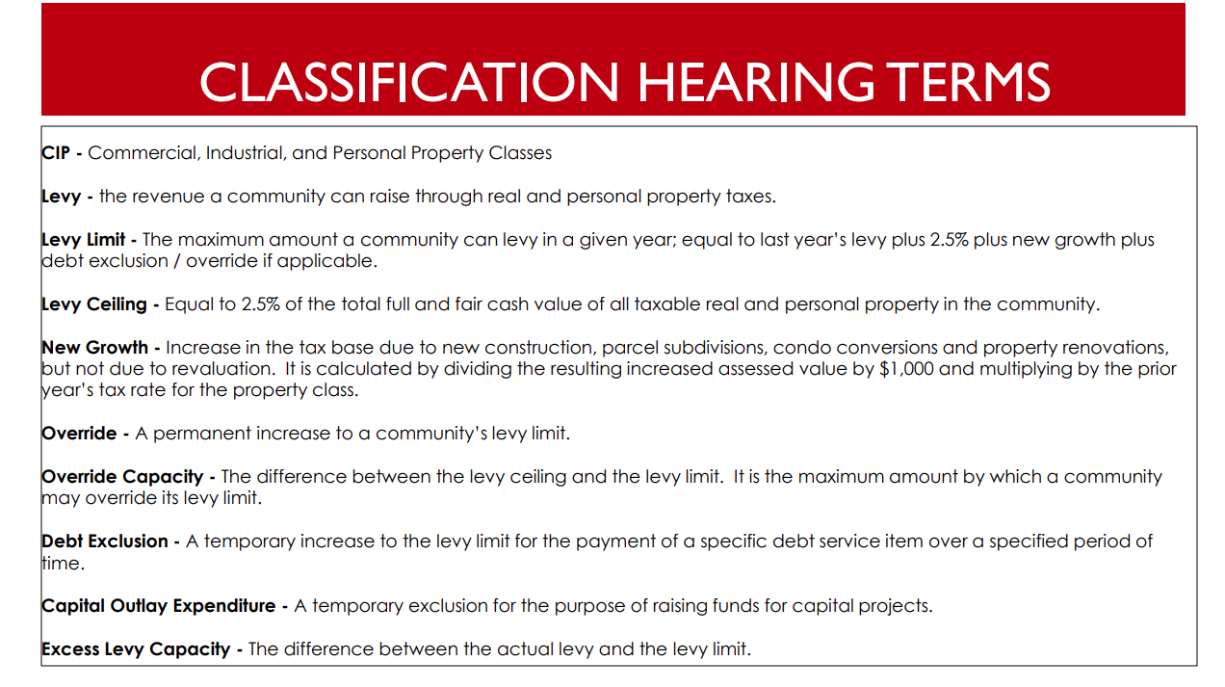
Add a Slide Title - 5

Slide 18
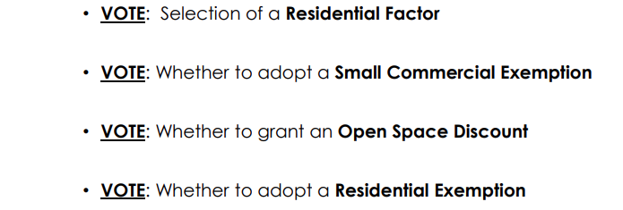
Select Board’s Role
Selection of a Minimum Residential single or split
Selection of an Open Space Discount-or not
Granting of a Residential Exemption or not
Granting of a Small Commercial Exemption or not

Slide 19


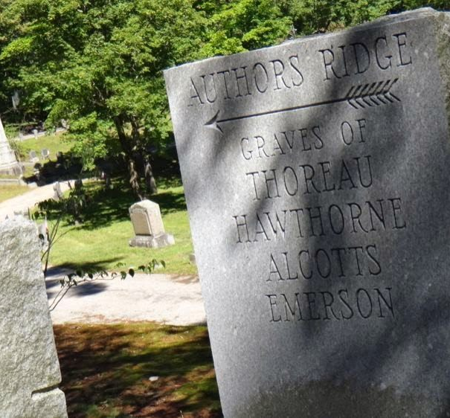
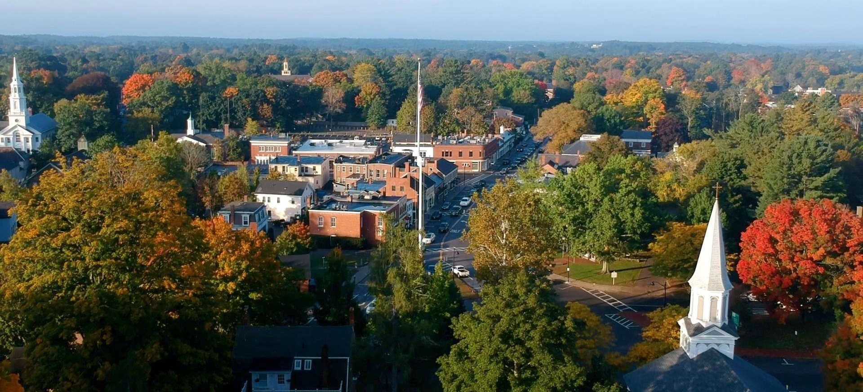
Town of Concord Massachusetts
Classification Hearing
FY23 Revaluation
Board of Assessors
David Karr Chairman
Brendan O’Neill Kemeza
Yanni Konstantions Tsitsas
Mera K Tilley
Arry Charles
Office Staff
Meredith Stone Town Assessor
Lee Phalen
Carolyn Dee
Michael Gibbons
11-28-2022
Notes:
Concord Assessors Office 24 Court Lane Concord Massachusetts 01742

