Slide 1
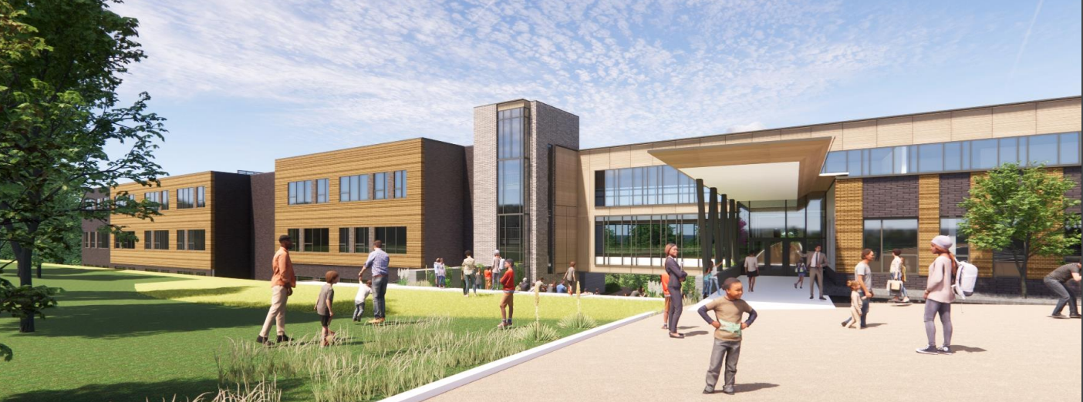
ARTICLE 5. Middle School Building Project

Slide 2
ARTICLE 5: Middle School Building Project
Ms. Guarriello moves that the meeting take affirmative action on Article 5 as printed in the warrant to appropriate the amount of $7,200,000 for the purposes stated in Article 5 and authorize the Treasurer with the approval of the Select Board to raise such amount by borrowing, subject to an affirmative debt exclusion vote of the Town, all as set forth in Article 5.

Slide 3
A Year in Review: Costs
ARTICLE 5: Middle School Building Project
Detailed Design (DD)
Phase
Construction Document (CD)
Phase
2022 |  |  |  |  |  |  |  |  |  |  |  | 2023
Jan | Feb | Mar | Apr | May | Ju | Jul | Aug | Sep | Oct | Nov | Dec | Jan
Ballot Passed
VE -$1,879,261
VE -$110,931
90% CD Estimate
$109,795,813
STM Approved
$102,816,000
(DD) Estimate
$108,415,174
60% CD Estimate
$108,783,060

Slide 4
Breakdown of Additional Funding Request
ARTICLE 5: Middle School Building Project
Project Cost | Cost @ STM ‘22 | Current Cost | Variance
Const. Cost | $80,772,477 | $87,420,207 | $6,647,730
Soft Cost | $12,599,080 | $12,599,080 | 0
FF&E / Tech | $2,625,000 | $2,625,000 | 0
Contingency | $4,799,828 | $5,132,214 | $332,386
Sub-Total | $100,796,385 | $107,776,501 | $6,980,116
Bid Contingency *Only if needed | $2,019,312 | $2,019,312 | 0
Total | $102,815,697 | $109,795,813 | $6,980,116

Slide 5
What has changed in the last year?
ARTICLE 5: Middle School Building Project
Building Design? NO
Economy? YES
  Inflation * Supply Chain * Workforce Challenges

Slide 6
Budget Deficits in Other Public School Projects
ARTICLE 5: Middle School Building Project
District | Type | Budget | Bid /Estim. | % Over | Pass
Andover | Elem | $119.2M | $136.3M | +14.3% | Yes
Groton | Elem | $61.0M | $70.5 | +15.6% | Yes
Westwood | Elem | $70.0M | $74.0M | +5.7% | Yes
Swampscott | Elem | $76.5M | $79.7M | +4.1% | Yes
Somerset | Middle | $69.0M | $79.0M | +14.5% | No
Nauset | High | $104.7M | $134.4 | +28.4% | Yes
Stoneham | High | $189.6M | $214.6M | +13.1% | Yes

Slide 7
ARTICLE 5: Middle School Building Project
Concord Middle School Building Committee Priorities:
  Educational Plan Implementation
  Net-zero Ready Design
  Enlarged Gym+ Auditorium as shared educational and community spaces
  Durability and Maintenance

Slide 8
ARTICLE 5: Middle School Building Project
Concord Middle School Building Committee Value Engineering/Value Management :
  $6,184,098 in construction cost savings
  +80 items considered over 24 hours of deliberations and CMSBC meetings

Slide 9
Impact of “YES” Vote
ARTICLE 5: Middle School Building Project
Project goes out to Bid (March 2023)
Construction Begins (April 2023)
School Opens (Feb 2025)
Demo Sanborn + Field Completion (Sept 2026)

Slide 10
ARTICLE 5: Middle School Building Project
Impact of “NO” Vote
1. Educational impact to current and future CMS Students
2. Increase cost to the Town
  a. Re-Design to $102.8
    Delays will Occur (6-9mo minimum)
    Major Scope Reductions (estimated at $12.4M in scope)
        Uncertain but assume: Reduced Program Spaces, Smaller Gym, Smaller (or no) Auditorium, and Reduced Fields and Landscape
  b. Put “in Drawer” for future project
    Annual Escalation assumed at 7% or $7M/annually on $100m
3. Unknown Maintenance and Emergency costs at Sanborn + Peabody

Slide 11
Preliminary Tax Impact Analysis:
ARTICLE 5: Middle School Building Project
Additional Funding Request $7.2 million
Estimated Cost/Year Per $100,000 valuation $6.28 per $100,000
Estimated Average Cost/Year increase
for the median home valued at $1,169,500 $73.44

Slide 12
ARTICLE 5: Middle School Building Project
Ms. Guarriello moves that the meeting take affirmative action on Article 5 as printed in the warrant to appropriate the amount of $7,200,000 for the purposes stated in Article 5 and authorize the Treasurer with the approval of the Select Board to raise such amount by borrowing, subject to an affirmative debt exclusion vote of the Town, all as set forth in Article 5.

