Slide 1
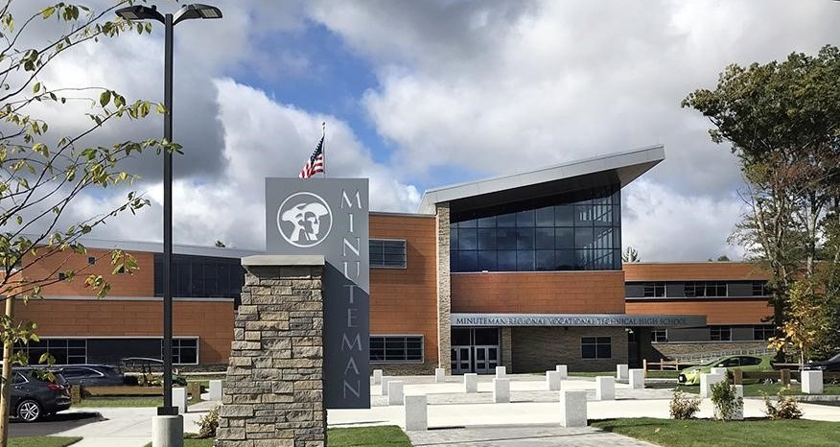
Mr. Steve Ledoux, Vice-Chair
School Committee
Dr. Kathleen A. Dawson
Superintendent
FY24 Superintendent
Recommended Budget
March 2023
Notes:
Greetings, my name is Dr. Kathleen Dawson and I am the superintendent of Minuteman Regional Vocational Technical School District and here with me tonight are Mr. Steve LeDoux, Concord SC member and Vice-Chair, and Ms. Nikki Andrade, Minuteman’s Business Manager.
We are here tonight to present to you the Fiscal Year 2024 Budget Recommendation for Minuteman Regional Vocational Technical School District.
At the end of the presentation, we will do our best to answer all questions.

Slide 2

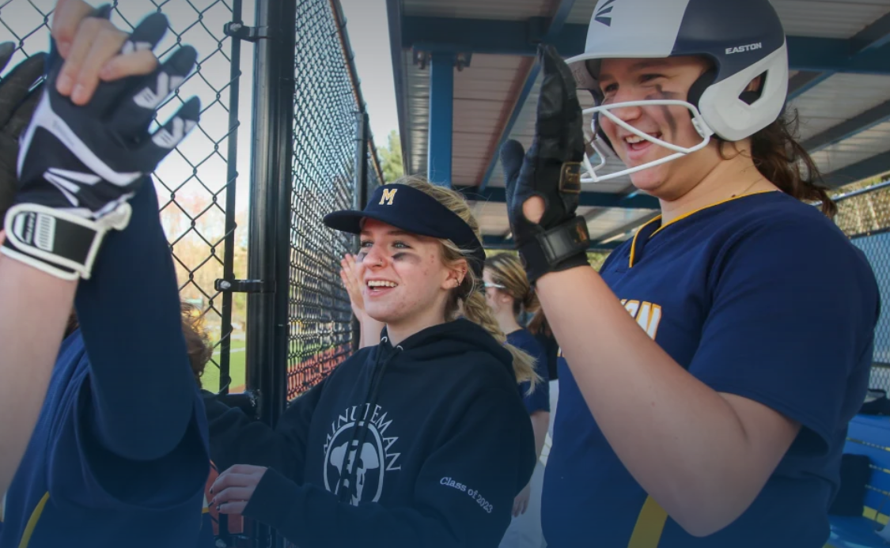


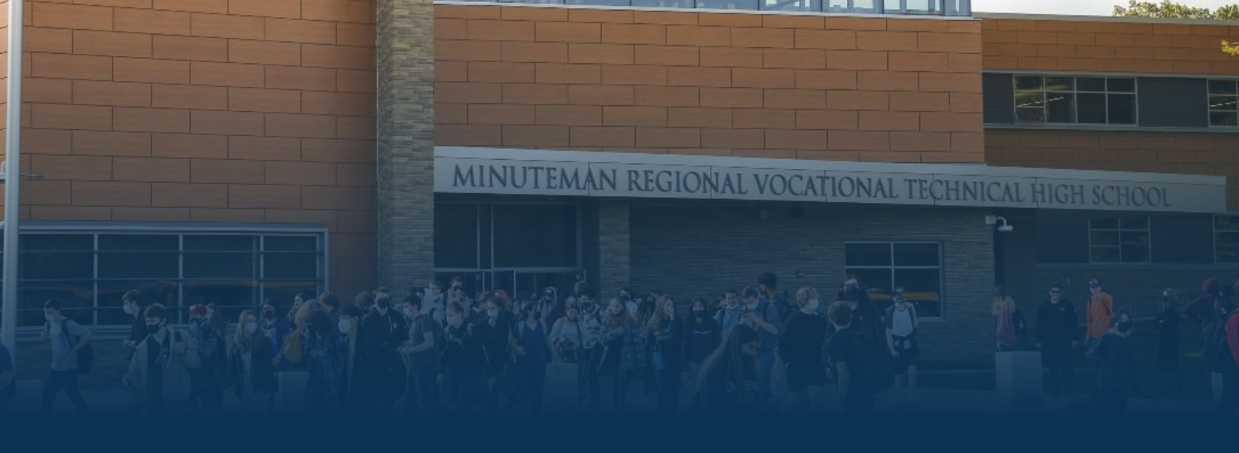

Minuteman’s Budget – Behind The Numbers
Our Budget Priorities Reflect Our Values
Notes:
Tonight, we present to you a budget focused on supporting our students and our staff. The budget supports our purpose of ensuring our students have highly qualified professionals and that our staff is equipped to provide relevant and rigorous learning opportunities with the most up-to-date technologies and curriculum. This budget supports the academic, social, emotional, and mental health needs of our students so they can develop into their best selves.
Our budget reflects our values and priorities—our students and our staff.

Slide 3
School Wide Goals 2022 - 2023
Content | Goal
Core Content—Math | Based on the analysis of the current sophomores’ 8th grade MCAS data, we will increase the percentage of High Needs students scoring proficient or above on the Math MCAS by at least 5% by June 2023.
Core Content—English Language Arts (ELA) | Based on the analysis of the current sophomores’ 8th grade MCAS data, we will increase the percentage of High Needs students scoring proficient or above on the ELA MCAS by at least 4% by June 2023.
Career Technical Education (CTE) | We will increase the Co-Op placement (both paid and unpaid) percentage of eligible seniors from 37% to at least 50% by May 2023.
Social and Emotional Learning (SEL) | We will create a plan including a timeline for implementation of the Multi-Tiered System of Supports (MTSS) framework focusing on social and emotional teaching and learning by June 2023.
Notes:
Our budget is grounded in improving teaching and learning for ALL our students. These are our school-wide goals for this year.

Slide 4
Overall Budget Summary
FY24 Operating & Capital Request
$30,316,325
4.50% above FY23
Notes:
To support us in accomplishing these goals, Minuteman’s FY24 Operating and Capital Budget Request overall is up only 4.5% compared to our FY23 Budget.

Slide 5
FY24 District Budget Objectives
1. To Protect Student and Staff Health
Critical to addressing social, emotional, and mental health learning needs
2. To Deliver and Promote High-Quality Career Vocational Technical Education
3. To Advance the Minuteman Academy Model
Expand transdisciplinary integration through increased project-based learning
Notes:
Our District Budget Objectives Follow Along with Our School Priorities & Goals: The Top 3 Objectives are the safety of our Students & Staff, the quality of education, and the professional development of our staff.

Slide 6
FY24 District Budget Objectives
4. To Increase the Enrollment Capacity of our Facility
5. To Capitalize on Athletic Fields Operations and Management
6. To Increase Campus Facilities Use & Rental Revenue
7. To Close out the Massachusetts School Building Authority (MSBA) Project (August 2023)
Notes:
Additional objectives include:
Increasing access to what Minuteman has to offer by expanding the enrollment capacity of the facility
Capitalizing on the potential use and expansion of the Athletic Fields for the benefit of our students and communities thus also increasing revenue potential
Lastly, successfully closing out the MSBA School Building Project.

Slide 7
FY24 Operating Budget Drivers
1. Teacher Contract in Negotiation plus Steps and Lanes Changes
2. Three Additional Teacher Full-Time Equivalents (FTEs) Due To Increased Enrollment & Students’ Academic Needs
3. Health Insurance (10% Projected Increase + FTEs)
4. CTE Supply and Material Cost Increases
Notes:
Some of the major drivers in the FY24 Budget include:
Contract negotiations with our teachers.
The need for 3 new Full-time Teachers due to increased enrollment and the academic needs of our students.
Minuteman’s participation in a Health Trust with 4 other Regional Vocational Schools. They have not set their final rates for FY24, but they recommend that all Schools within the Trust carry a 10% Increase at this point in our Budgeting.
And the impact of inflation on the prices of supplies and materials needed, mainly for our CTE instruction required to meet industry standards.

Slide 8
FY24 Operating Budget Drivers
5. Transportation Increase (5% CPI Increase)
6. Building Utilities and Heating (8% Projected Increase)
7. Other Post Employment Benefit (OPEB) Contribution
($230,000 = $110,000 Increase)
8. Stabilization ($500,000 = Consistent with FY23 Funding)
Notes:
Additional drivers are:
5/6. The increase in costs for Transportation and Building Utilities/Heating, etc. due to inflation.
7. The increase of the OPEB contribution based on the recommendation of the OPEB Study Committee
8. The continued funding of our Capital Stabilization Fund which will support some of the strategies for increasing Enrollment Capacity.

Slide 9
Budget Summary
FY24 Operating Request = $23,458,597
6.18% above FY23
FY24 Capital Request = $1,238,240
0.21% above FY23
FY24 Building Project Debt = $5,619,488
1.11% below FY23
Notes:
Just to break out the FY24 Budget a bit more:
Minuteman’s Operating Expenses are up about 6.18%.
Minuteman’s Operating Capital, which includes our ESCO Lease Payment (an energy-saving project started prior to the new building), Athletic Field Lighting Debt, and Capital Stabilization Funding, is fairly consistent at 0.21%. (The last year of the ESCO Lease Payment is FY25.)
Minuteman’s Capital Building Project Debt (MSBA) is slightly lower in FY24 than in FY23. This is an important breakout as 7 of our 9 Member Towns voted a Debt Exclusion on the School Building Project.

Slide 10
Concord: Preliminary Assessment
Minimum Required Contribution $ 612,477
Transportation Assessment $ 34,082
Operating Assessment $ 506,292
Debt and Capital Assessment $ 80,851
Sub-Total $ 1,233,702
Building Project – Debt Service* $ 407,993
Total Assessment $ 1,641,695
*Debt Service excluded from Prop 2 ½ Limitation
Notes:
The Total Preliminary Assessment for Concord, including the Building Project- Debt Service (that is excluded from Prop 2 ½) is approximately $1.64 Million.
The Preliminary Assessment for Concord without the Building Project Debt is approximately $1.23 Million.

Slide 11
Overall Enrollment as of October 1
Notes:
A major factor impacting the operating budget is our enrollment.
With the plans for the new school building came the plans for increasing in-district student enrollment.
As noted here, we are successfully meeting that objective.
Enrollment from our member towns are increasing as the enrollment from the non-member towns are matriculating out with each graduating class.

Slide 12
Shift in Enrollment
Enrollment is Shifting to In-District
Out of District Enrollment is Decreasing
Out of District Tuition Revenue is Decreasing
Out of District Capital Fee Revenue is Decreasing
Resulting in a Significant Increase in Overall Assessments to Member Towns
Per Pupil Assessment will Remain Consistent
Notes:
As enrollment shifts, Minuteman’s Out of District Revenue is Decreasing, Both from Tuition and Capital Fee (Set by the State).
As a result, Member Towns are responsible for more of the cost (and soon all the cost) associated with Operating and Capital Budget through their Assessments.

Slide 13
Non-Member Tuition & Capital Fee Reduction and Increasing Member Enrollment
Non-Member Tuition is set annually by the DESE Commissioner based on 125% of Statewide Foundation Vocational Rate.
Non-Member Tuition may include an incremental Special Education Fee per Student, if applicable.
Non-Member Capital Fee is based on average per pupil cost of Debt Service (New Building Only).
The Fee varies depending on if Cities/Towns have less than (Type A) or more than (Type B) five Chapter 74 Programs.
Notes:
Here we will show the comparison of changes in enrollment to the changes in revenue.
The purple line across the top is our School Designed Enrollment of 628 at 85% capacity.

Slide 14
Non-Member Tuition & Capital Fee Reduction and Increasing Member Enrollment
Non-Member Tuition is set annually by the DESE Commissioner based on 125% of Statewide Foundation Vocational Rate.
Non-Member Tuition may include an incremental Special Education Fee per Student, if applicable.
Non-Member Capital Fee is based on average per pupil cost of Debt Service (New Building Only).
The Fee varies depending on if Cities/Towns have less than (Type A) or more than (Type B) five Chapter 74 Programs.
Notes:
The tri-colored bar graph includes the Total, Member, and Non-Member Enrollment compared to the 85% School Capacity indicated by the purple line.
As the graph shows, we are over 85% capacity.

Slide 15
Non-Member Tuition & Capital Fee Reduction and Increasing Member Enrollment
Non-Member Tuition is set annually by the DESE Commissioner based on 125% of Statewide Foundation Vocational Rate.
Non-Member Tuition may include an incremental Special Education Fee per Student, if applicable.
Non-Member Capital Fee is based on average per pupil cost of Debt Service (New Building Only).
The Fee varies depending on if Cities/Towns have less than (Type A) or more than (Type B) five Chapter 74 Programs.
Notes:
Here the Yellow Line represents the Non-Member Tuition, and the Light Blue Line represents the Capital Fee Revenue available to reduce Member Assessments.
As you can see these are trending in the opposite direction of increasing member enrollment.

Slide 16
Increase in Four-Year Rolling Average Enrollment vs Increase in Assessments
Notes:
Here we show the Percent Change in Four Year Rolling Average of Enrollment (Blue Column) with the Percent Change in Assessment (Red) for all our Member Towns. For most of our Member Towns, these correspond, and track together closely, as spelled out in our Regional Agreement.
It is important to note that the 4-Year Rolling Average will eventually even out over the next few years as enrollment becomes more typical of full freshman classes of Member Town Students.
For Concord, you can see there was a 10% increase in 4 Year Rolling Average, but a 9% increase in Total Assessment.

Slide 17
Concord: Comparison of Assessment
 | FY24 | FY23 | Difference | % Change
Enrollment | 36 | 33 | 3 | 9.1%
Enrollment- 4 Year Rolling Average | 29.75 | 27 | 2.75 | 10.2%
% Share Operating | 6.1% | 6.3% | (0.2%) | (3.6%)
% Share Capital | 7.5% | 7.9% | (0.4%) | (4.0%)
Minimum Required Contribution | $612,477 | $562,427 | $50,050 | 8.9%
Transportation | $34,082 | $33,653 | $429 | 1.3%
Operating | $506,292 | $415,407 | $90,885 | 21.9%
Debt & Capital – Operating | $80,851 | $84,036 | ($3,185) | (3.8%)
Debt – Building Project | $407,993 | $413,021 | ($5,028) | (1.2%)
Total Assessment | $1,641,695 | $1,508,544 | $133,151 | 8.8%
Notes:
You can see year over year the changes in the components of the Assessment. Minuteman uses the 4 Year Rolling Average of Enrollment to determine Assessments, as noted in the Regional Agreement.
As seen in the graph on the prior slide, Concord’s 4 Year Rolling Average has increased by 10.2%, compared to the total Assessment increasing 8.8%.

Slide 18
Concord: Per Pupil Assessment
Concord | Operating Assessment | October 1 Enrollment Count | Per Pupil Assessment
Est. FY24* | $ 1,152,850 | 36 | $32,024
FY23 | $ 1,011,487 | 33 | $30,651
FY22 | $ 839,269 | 25 | $33,571
FY21 | $ 866,644 | 25 | $34,666
FY20 | $ 778,353 | 25 | $31,134
*Est. FY24 Per Pupil Assessment = FY24 Proposed Operating Assessment / Oct 1, 2022 Enrollment Count
Notes:
Despite the increase in Operating Assessment, the Per Pupil Assessment remains relatively consistent with the past 5 years.
The current breakout for Concord is:
Grade 9: 18 students,
Grade 10: 8 students,
Grade 11: 5 students
Grade 12: 5 students.

Slide 19
Overall Budget Summary
FY24 Assessment to Members
$25,481,911
13.78% above FY23
Notes:
So as presented, it is the shifts in enrollment that are increasing the assessments for each member town. The increase is paying for more of your students to have access to a choice in the type and quality of a career technical education.

Slide 20
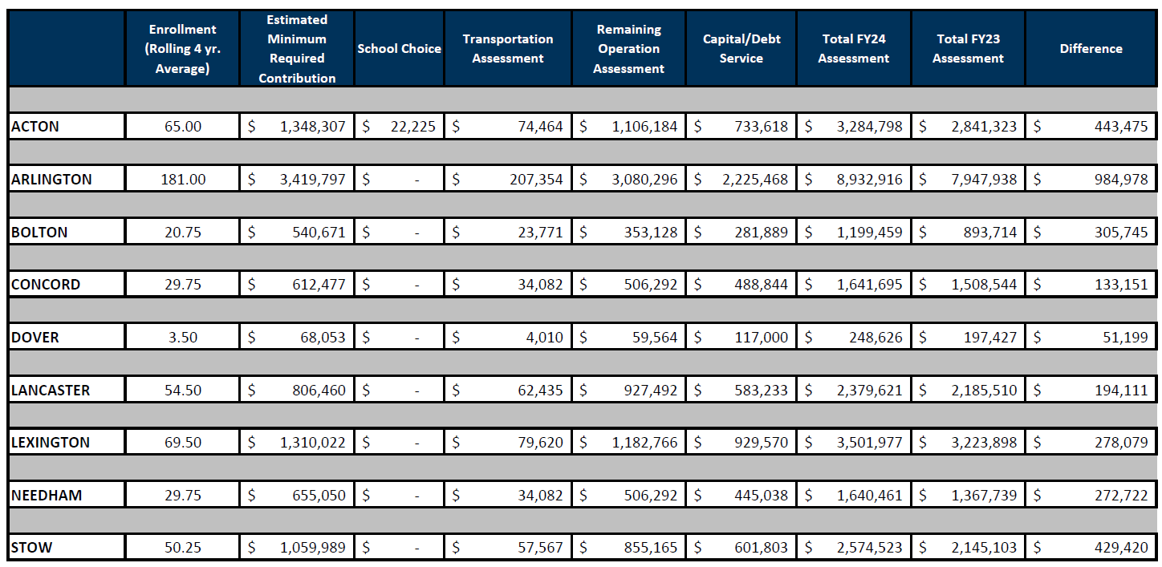
PRELIMINARY FY24 ASSESSMENT TO MEMBER TOWNS
Notes:
This represents the preliminary FY24 assessments to all member towns.

Slide 21
Applications and Enrollment
Class of | 2023 | 2024 | 2025 | 2026 | 2027
Total Applications | 333 | 390 | 323 | 425 | 412*
Member Towns | 233 | 252 | 261 | 309 | 329*
Non-Member Towns | 100 | 138 | 62 | 116 | 83*
 |  |  |  |  | *As of 2/15/2023
- As of 2/15/2023, Member Town Freshman Class Applications are up 8.5% from a year ago.
- Continued increase in enrollment since FY2019 (Last Year of the Old Building):
- 34% Increase in Total Enrollment
- 19% Increase in Member Town Enrollment (FY2023 88% vs FY2019 69%)
- Class of 2026- 100% from Member Towns
Notes:
Where are we now for next year? The Enrollment Trends are Continuing and going strong.
The Class of 2027 is the 8th graders applying to come to Minuteman in the Fall of 2023- 412 applicants with 329 from Member Towns and 83 from Non-Member Towns. Of the total 329 Member Towns, Concord makes up 27 of Student Applications. The cap for the Freshman Class is approximately 189 Students.
February 15th was the close of the application window. As of February 27th, Concord had 23 qualified applicants. The slot allocation for Concord is 15 students and 15 were offered admission, which leaves 8 on the waiting list. Students have until March 8th to respond to their offer.

Slide 22
FY24 Staffing Additions
Funded Positions
1.0 FTE Animal Science Teacher
1.0 FTE Math Teacher
1.0 FTE Engineering & Robotics Teacher
Total: 3.0 FTE (Full Time Equivalent) Teachers
Additional Positions Needed
1.0 FTE Paraprofessional – Reading & Media Center
1.0 FTE Paraprofessional – Math/CTE
1.0 FTE Paraprofessional – All CTE The positions are necessary to support the 44% of students on IEPs
1.0 FTE Co-Op Coordinator (Currently Grant Funded)
1.0 FTE Nurse
1.0 FTE IT Network Analyst
1.0 FTE Business Office
1.0 FTE Grant Writer
Total: 8.0 FTE Positions
Notes:
The increase in enrollment is requiring 3 additional full-time Teachers.
Being cautious of our Budget and Assessments’ impact on our Member Towns, Minuteman is not requesting funding for all the positions we need to provide the standard of service that will meet our expectations. There is still quite a bit of need for Minuteman, however, we will have to figure out how to cover these needs from within, even if it will cause a strain on our existing staff.

Slide 23
FY2023 Grants
Grant Name | Type | Award Amount | Description
ASOST-Q (Afterschool and Out-of-School Time) | State | $ 45,000 | Summer Programming
Perkins | Federal | $ 39,610 | Program Improvement and Equipment
Skills Capital Grant | State | $ 354,000 | Welding Machines and Truck
Comm Corp - Round 6 | State | $ 900,000 | Workforce Development
Title I | Federal | $ 57,008 | Supplement Instructional Services
Title IIA | Federal | $ 12,917 | Framework Implementation & Educator Effectiveness PD
Title IV | Federal | $ 10,000 | Academic Support & Personalized Learning
CVTE Equitable Access | Federal | $ 88,641 | Translation & transportation services, supplies for Girls in STEM, stipends for IDEA liaison, support for Girls in STEM, & culture survey data analysis team
Individuals with Disabilities Education Act (IDEA) | Federal | $ 263,016 | To support students with disabilities
Perkins | Federal | $ 218,472 | Co-op director, summer work staff, Library Asst., 1st Robotics Coach, materials for PLTW, STEM program, NOCTI Testing, OSHA, Drinkwater, Hazpower & Wastewater, course certifications, job board software and Skills participation fees, Conferences
SEL & Mental Health Grant | Federal | $ 140,000 | Supporting students' social emotional learning, behavioral & Mental Health and Wellness through multi-tiered systems of supports
Skills Capital Grant | State | $ 500,000 | Technology and Equipment for Animal Science Program
Comm Corp – Round 7 | State | $ 360,000 | Carpentry, Plumbing, and Welding
Total |  | $ 2,988,664 | And Counting! (Approximately 10.3% of the FY2023 Budget)
Notes:
We do not solely rely on our member towns to fund all the district’s needs.
We work diligently to apply for and receive grant funding. As you can see, without these grants, it would have required the district to request from the member towns an additional $3 million dollars for the FY23 Budget. In essence, the grant funding saved the member towns over 10% this current year.
The district uses these grants to fund positions, curriculum, CTE programming, student programs, the purchase of instructional equipment, and summer programming to name a few. Grant funding is starting to support the Minuteman Technical Institute, our post-secondary program, almost in its entirety, and it will not rely on member town funding to operate next year.
Another way we were able to reduce the FY24 budget request to 4.5% was in part due to the $500K Capital Skills grant for the expansion of the Animal Science program.

Slide 24
Building Enrollment Beyond the Design Capacity of 628
Goal: Increase Capacity to Accommodate Member
Town Enrollment with no increase in debt.
Strategy #1: Consistently Fund Capital Stabilization Account
Capacity Building Project: Increase Capacity by 32 students over 4 years
North Metal Fab Shop: $825,000 - Opening Fall 2023
Strategy #2: Leverage Strategic Partnerships and Grants
East Campus Building Renovation: In Progress
Notes:
As previously shared, our enrollment has exceeded the building’s capacity. The plan is to meet this growth and look to expand as much as our facilities will allow, WITHOUT ANY ADDITIONAL DEBT.
Strategy #1 – Is to continue contributing a portion of the budget to Fund the Capital Stabilization Account. This will allow us to support the current and new projects. We have one Capacity Building Project currently in Progress (North Metal Fab Shop).
Strategy #2 – Is to leverage Strategic Partnerships and Grants to put dormant buildings to use such as the East Campus Building.

Slide 25
Capital Stabilization Account
Account established in 2016
12/31/2022 Balance is $2,468,609
FY2024: Add $500,000 to Account
Voted $1,250,000 to Athletic Fields Budget
Spent $404,282 To Date
Voted $650,000 to North Building Project (Metal Fab Shop)
Spent $140,792 To Date
Notes:
To provide more context on Strategy #1, Back in 2016, the School Committee established the Capital Stabilization Account to be prepared for capital needs that may come up. The Balance of just under $2.5 Million is due to this strategic planning and funding. The School Committee votes to approve how these funds will be applied.
Within the FY24 budget, Minuteman is proposing continuous funding of $500,000 to this account.

Slide 26
OPEB: Estimated Liability as of June 30, 2022
$20,850,743
12/30/2022 OPEB Trust Fund Balance = $519,745
An OPEB Advisory Subcommittee was appointed in Fall
2021 to implement a long-term funding strategy. The
Plan was submitted to the School Committee and
approved in Winter 2021.
Notes:
As the Capital Stabilization Account is one of the major drivers of the FY24 budget, so is the School Committee’s responsibility for maintaining the funding for OPEB Liability - Other Post Employment Benefit (OPEB).
This requires a long-term strategy recommended by the OPEB Advisory Subcommittee.
Currently, the fund balance is slightly over $500K. We will need to drastically increase our yearly contribution if we are to meet the liability amount of over 20 million dollars.

Slide 27
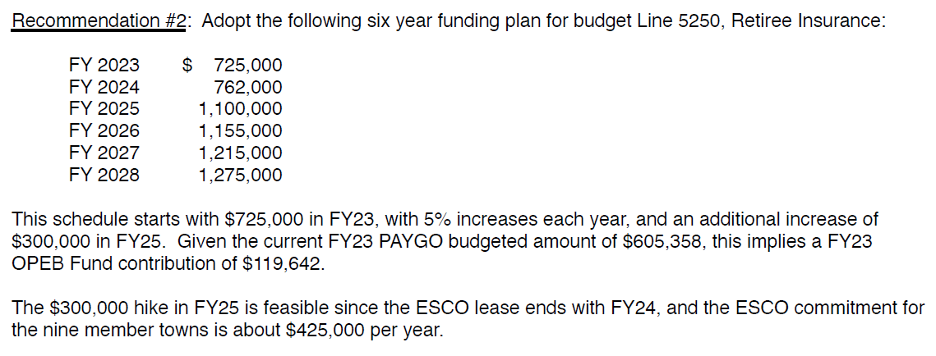
OPEB: Strategic Components
OPEB Advisory Subcommittee recommended a long-term funding strategy to the Minuteman School Committee
Notes:
Here is the long-term strategy. The increase in future years is reasonable due to the ESCO Lease ending in FY2025. The amount that is currently being allocated to the ESCO lease will be allocated toward the OPEB payment after the lease ends.
This total is broken out between Active Retiree Health Insurance and the OPEB Contribution.
Minuteman is also following the recommendation of adding $10,000 per new FTE (3 x $10,000).

Slide 28
FY24 Operating and Capital
Budget | FY23 | FY24 | Difference | % Change
Operating Budget | 22,092,652 | 23,458,597 | 1,365,945 | 6.18%
Capital Equipment/Leases/Athletic Fields (2) | 1,235,608 | 1,238,240 | 2,632 | 0.21%
Subtotal | 23,328,260 | 24,696,838 | 1,368,578 | 5.87%
Building Project - Debt Service (1) | 5,682,363 | 5,619,488 | -62,875 | -1.11%
Total Operating & Capital Budget | 29,010,622 | 30,316,325 | 1,305,703 | 4.50%
(1) A debt exclusion override was voted on this debt in the following towns: Acton, Arlington, Bolton, Concord, Dover, Lancaster, and Stow.
(2) Annual ESCO Lease assessments include the proportionate share due from the 6 towns that withdrew from the district effective July 1, 2017, and Belmont withdrawal effective July 1, 2020. This also includes the payment on a 10 year note for the field lighting.
Notes:
As we start to bring the budget presentation to a close, this is a summary of our Operating and Capital Budget and the Breakouts, with a total Operating and Capital Budget Request increase of only 4.5%.

Slide 29
FY24 Non-Assessment Revenue
Non-Assessment Revenue | FY23 | FY24 | Difference | % Change
Chapter 70 Aid | 2,028,744 | 2,197,552 | 168,808 | 8.32%
Chapter 71 Reg. Transportation Reimb. | 1,029,441 | 807,615 | -221,826 | -21.55%
Prior Year Tuition | 1,367,364 | 805,817 | -561,547 | -41.07%
Current Year Tuition | 950,000 | - | -950,000 | -100.00%
Certified E & D | 650,000 | 650,000 | - | 0.00%
Current Year Nonresident Capital Fee | 300,000 | - | -300,000 | -100.00%
Prior Year Nonresident Capital Fee | 289,332 | 373,430 | 84,098 | 29.07%
Total Non-Assessment Revenue | 6,614,881 | 4,834,414 | -1,780,467 | -26.92%
Required Member Town Assessments | 22,395,741 | 25,481,911 | 3,086,169 | 13.78%
Notes:
The Operating and Capital Budget is supported mainly by member town assessments. But the Non-Assessment Revenue which does not come from member towns offsets a portion of the overall budget.
We are being conservative with our State Aid estimates, and the main point to be made here is that Minuteman is losing almost $1.8 Million Dollars, primarily from decreases in the Out of District Tuition and Capital Fee revenue discussed in earlier slides.
This loss is being picked up by our Member Towns.

Slide 30
Assessment Components
Assessment Allocation by Category | FY23 | FY24 | Difference | % Change
Minimum Required Contribution (set by the State) | 8,864,054 | 9,820,826 | 956,772 | 10.79%
Transportation Budget | 538,453 | 577,385 | 38,932 | 7.23%
ESCO Lease Assessment | 550,408 | 566,290 | 15,882 | 2.89%
Capital Equipment/Leases/Athletic Fields | 685,200 | 671,950 | -13,250 | -1.93%
Assessments over Minimum Contribution | 6,664,596 | 8,599,402 | 1,934,806 | 29.03%
Building Project - Debt Assessment | 5,093,031 | 5,246,058 | 153,027 | 3.00%
Total Assessments | 22,395,741 | 25,481,911 | 3,086,169 | 13.78%
Notes:
These are the components of the Assessments that will be included in our Budget Book.

Slide 31
Overall Budget Summary
FY23 Operating & Capital Request = $29,010,622 4.96% above FY22 | FY24 Operating & Capital Request = $30,316,325 4.50% above FY23
FY23 Operating Request = $22,092,652 6.57% above FY22 | FY24 Operating Request = $23,458,597​ 6.18% above FY23
FY23 Capital Request = $1,235,608 8.89% above FY22 | FY24 Capital Request = $1,238,240​ 0.21% above FY23​
FY23 Building Project Debt = $5,682,363 1.60% below FY22 | FY24 Building Project Debt = $5,619,488​ 1.11% below FY23
Notes:
Lastly, our overall Budget Request in comparison to FY23 is less than the prior year’s requests in all categories.

Slide 32

OUR WHY
Notes:
And in closing, we return to our values—our students and their learning.
We recommend the FY24 Budget that will support the needs of our students and their teachers.
Thank you for your support.
At this time, our Business Manager, Ms. Nikki Andrade, will join me to answer any questions.

Slide 33
Thank you. Questions?
Notes:
LOOK FOR ANY QUESTIONS

