Slide 1
Article 38:
Solid Waste Disposal Fund Expenditures
To determine whether the Town will vote that the income from user fees for solid waste disposal services, associated services, and jobbing services by Concord Public Works during the ensuing fiscal year, together with the balance of operating cash in the Solid Waste Disposal Fund, be expended without further appropriation under the direction and control of the Town Manager in accordance with the Motion passed under Article 27 of the 1989 Annual Town Meeting; or take any other action relative thereto.

Slide 2
Article 38:
Solid Waste Disposal Fund Expenditures
The mission of the Solid Waste Division is to provide an efficient, environmentally sound, and cost-effective solid waste collection, disposal and recycling program for subscribers to the Town's curbside program.

Slide 3
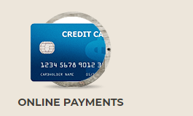
Article 38: Solid Waste Disposal Fund Expenditures
Curbside Program Overview
Weekly Collection
“Pay-as-you-throw”
Environmentally Sustainable
Economical
Household Hazardous Waste Collection
Semi-annual billing
Online payments
Barrel Stickers & Disposal Tags
Available for Purchase at Retail Vendors and Online

Slide 4
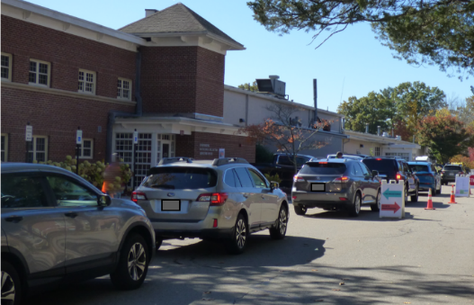
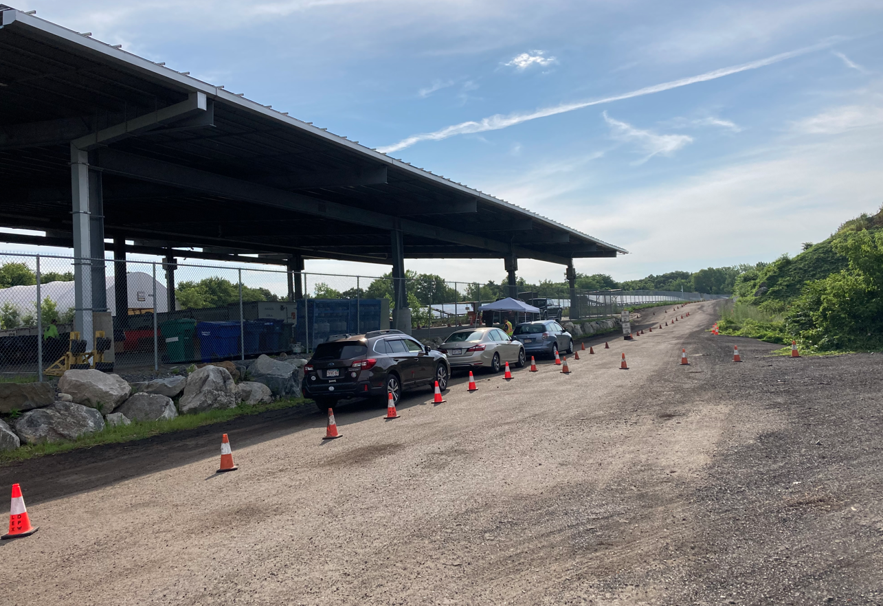
Article 38: Solid Waste Disposal Fund Expenditures
Additional Disposal Opportunities for Residents
DropOff/SwapOff-Zero Waste Day Household Hazardous Waste
Spring Event: May 20, 2023 Minuteman/Lexington
Fall Event: September 30, 2023 April-November

Slide 5
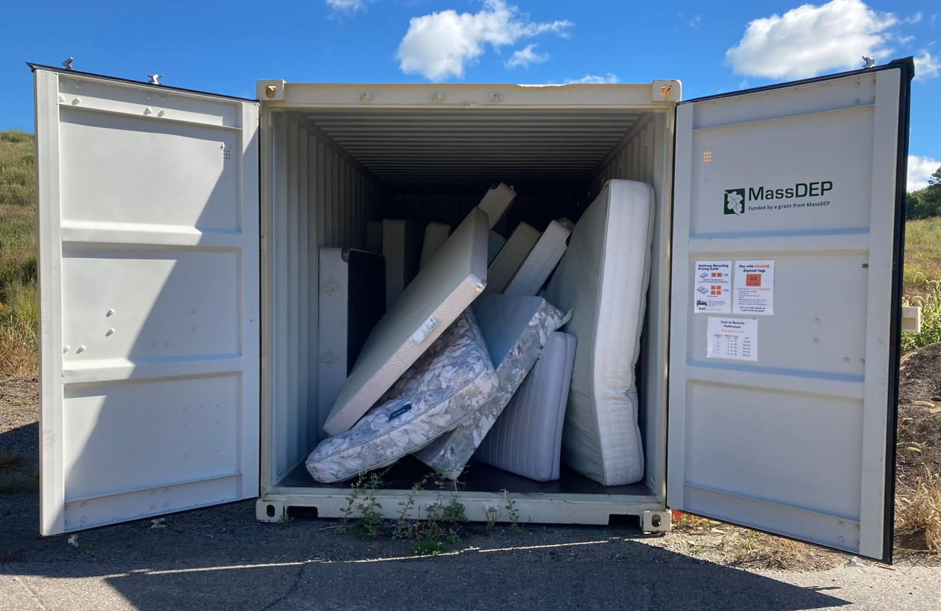
Article 38: Solid Waste Disposal Fund Expenditures
Mattress Recycling
Residents call CPW to make an appointment to bring mattresses to the Compost Site.
Batteries, Bulbs & Mercury
Accepted at CPW, 133 Keyes Road
Monday-Thursday 8-4, Friday 8-12

Slide 6
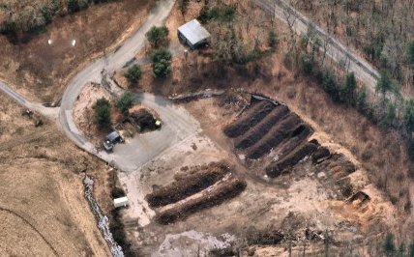
Article 38: Solid Waste Disposal Fund Expenditures
Compost Site: 755 Walden Street
Routine Schedule
Wednesdays 3:00 pm – 6:00 pm
Saturdays 9:00 am – 3:00 pm
Paint Shed Available
Wednesday 3:00 pm-5:30 pm
Saturday 9:00 am-2:30 pm

Slide 7
Article 38: Solid Waste Disposal Fund Expenditures
Curbside Program Expenditures
Curbside Collection Contract | $1,410,539
Contracted Disposal Services | $278,711
Recycling Processing Fees | $264,239
General Fund Services | $142,547
Personnel Services | $114,442
Purchased Services | $100,171
Supplies and Materials | $10,170
Other Charges and Expenses | $2,855
Total Solid Waste Costs | $2,323,674

Slide 8
Article 38: Solid Waste Disposal Fund Expenditures
Curbside Program Revenue
Subscription Fees (collection) | $1,284,224
Disposal Fees (tags & stickers) | $416,556
Schools | $155,202
Town Facilities | $80,000
Business Recycling Program | $10,300
Compost Bins | $3,300
Recycling Bins/Lids | $1,100
Total Solid Waste Revenue | $1,950,683

Slide 9


Article 38: Solid Waste Disposal Fund Expenditures
FY24 Cost to Subscribers - Solid Waste & Recycling
 | FY22 | FY23 | FY24 - Proposed
Collection Fee | $322.00 | $322.00 | $355.00
Disposal Fee | $1.80/Tag $46.80/Sticker | $1.80/Tag $46.80/Sticker | $1.80/Tag $46.80/Sticker
Average Cost *1.36 bags/barrels per wk | $449.30 | $449.30 | $482.30
Yearly increase per subscriber - $33.00

Slide 10
Article 38: Solid Waste Disposal Fund Expenditures
FY24 Cost to Subscribers-Recycling Only
 | FY22 | FY23 | FY24 - Proposed
Recycling Only | $162.00 | $162.00 | $178.00
Yearly increase per subscriber – $16.00

Slide 11
Article 38:
Solid Waste Disposal Fund Expenditures

Slide 12
Article 38:
Solid Waste Disposal Fund Expenditures
To determine whether the Town will vote that the income from user fees for solid waste disposal services, associated services, and jobbing services by Concord Public Works during the ensuing fiscal year, together with the balance of operating cash in the Solid Waste Disposal Fund, be expended without further appropriation under the direction and control of the Town Manager in accordance with the Motion passed under Article 27 of the 1989 Annual Town Meeting; or take any other action relative thereto.

Slide 13
Supplemental Information

Slide 14
ARTICLE 38: SOLID WASTE DISPOSAL FUND EXPENDITURES
 | Recycle Processing Costs | Paper Revenue
FY13 | $15,621 | $4,981
FY14 | $17,891 | $5,904
FY15 | $18,908 | $2,046
FY16 | $21,762 | $480
FY17 | $25,209 | $19,524
FY18 | $29,631 | $5,941
FY19 | $45,091 | $0
FY20 | $47,606 | $0
FY21 | $71,489 | $0
FY22 | $117,696 | $0
FY23 | $210,889 | $0
FY24 | $264,239 | $0

Slide 15
Article 38: Solid Waste Disposal Fund Expenditures

Slide 16
Article 38: Solid Waste Disposal Fund Expenditures
Disposal Costs for Solid Waste & Recycling

Slide 17

Article 38: Solid Waste Disposal Fund Expenditures
Existing
2-Year Contract, expires 9/30/24
Volatile recycling market
Moving Forward
Review Collection Alternatives
Negotiate new contract
Enhanced opportunities at the compost site

Slide 18
Article 38: Solid Waste Disposal Fund Expenditures
Curbside Program Overview
Subscribers as of December 31
Year | Number of Subscribers | Recyclables collected(tons) | Trash collected (tons) | Recycling Rate
2018 | 3,679 | 1,665 | 2,599 | 39%
2019 | 3,679 | 1,577 | 2,609 | 38%
2020 | 3,587 | 1,693 | 2,623 | 38%
2021 | 3,657 | 1,592 | 2,505 | 38%
2022 | 3,622 | 1,462 | 2,162 | 40%
Current Subscribers as of 2/28/23 - 3,644

