Slide 1
Article 41:
Water System Expenditures
To determine whether the Town will vote that the income from user fees, special service fees, and jobbing services by the Water and Sewer Division of Concord Public Works during the ensuing fiscal year, together with the balance of operating cash in the Water Fund, be expended without further appropriation under the direction and control of the Town Manager in accordance with the Motion passed under Article 38 of the 1974 Annual Town Meeting, or take any other action relative thereto.

Slide 2
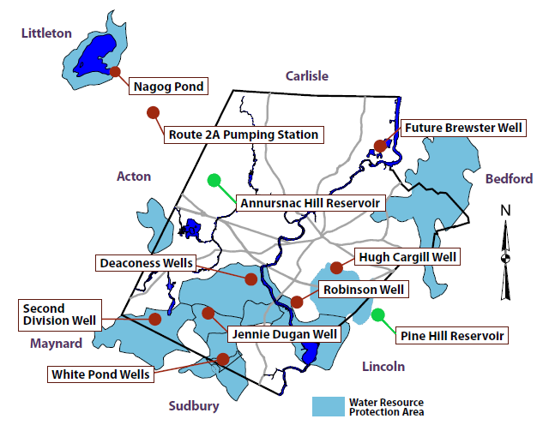
Public Water System
Infrastructure Assets = $25.8 Million
Article 41: Water System Expenditures
    1 - Surface Water
    6 - Ground Water Supplies
    7 - Pumping Stations
    2 - Advanced Treatment Facilities
    2 - Reservoirs (7.5 MG Storage)
    134 - Miles of Distribution Mains
    1,339 - Hydrants

Slide 3
FY24 – Operations & Maintenance
Article 41: Water System Expenditures
  Proposed Expenditures – $ 5,503,198
  $ 3,277,582 – Pumping, Treatment,
  Distribution & Storage
  $ 1,454,274 – Depreciation
  $ 771,342 – General Fund
  Services

Slide 4
Article 41: Water System Expenditures
FY24 – Capital Improvement Plan
Total Proposed Expenditures | $5,593,500
Water Main Replacement | $1,900,000
Nagog Filtration Improvements | $1,660,000
Water System Improvements | $1,000,000
Meter Reading/Billing Upgrade | $250,000
Source Protection Integrated Water Resources Plan | $250,000
Vehicle Replacement | $217,500
Station Structures & Equipment | $125,000
Reservoir Improvements | $100,000
Other Miscellaneous Equipment & Improvements | $60,000
Hydrant Replacement | $31,000

Slide 5
Article 41: Water System Expenditures
FY24 – Residential Rates
  Proposed Adjustment (FY 23 to FY 24):
  1st Step* - $0.0770/cubic foot (+12.5 %)
  2nd Step - $0.1617/cubic foot (+12.5 %)
  3rd Step - $0.2041/cubic foot (+12.0 %)
  Impact on Avg. Residential Customer about $ 77.40/year
  * Discount Rate $.0385: Savings up to $277/Year

Slide 6

Article 41: Water System Expenditures
Regulatory Drivers/Challenges
Safe Drinking Water Act
  PFAS
  Bromate
  Revised Lead & Copper Rule
Water Management Act
Cyber Security

Slide 7
Article 41:
Water System Expenditures
To determine whether the Town will vote that the income from user fees, special service fees, and jobbing services by the Water and Sewer Division of Concord Public Works during the ensuing fiscal year, together with the balance of operating cash in the Water Fund, be expended without further appropriation under the direction and control of the Town Manager in accordance with the Motion passed under Article 38 of the 1974 Annual Town Meeting, or take any other action relative thereto.

Slide 8
Supplemental Information

Slide 9
10 Year Operating Projections
Article 41: Water System Expenditures

Slide 10
10 Year Capital Plan
Article 41: Water System Expenditures

Slide 11
Water Fund: Plan and Projection | Actual |  |  |  |  |  |  |  |  |  |  |  | 10 years
 | FY 2022 | FY 2023 | FY 2024 | FY 2025 | FY 2026 | FY 2027 | FY 2028 | FY 2029 | FY 2030 | FY 2031 | FY 2032 | FY 2033 | FY 24-33
Operating Revenue
User Fees | 5,694,545 | 6,667,038 | 7,464,038 | 7,811,038 | 8,166,038 | 8,538,038 | 8,933,038 | 9,346,038 | 9,775,038 | 10,229,038 | 10,701,038 | 11,197,038 | 92,160,384
Other | 134,931 | 135,931 | 136,931 | 137,931 | 138,931 | 139,931 | 140,931 | 141,931 | 142,931 | 143,931 | 144,931 | 145,931 | 1,414,315
Subtotal | 5,829,477 | 6,802,970 | 7,600,970 | 7,948,970 | 8,304,970 | 8,677,970 | 9,073,970 | 9,487,970 | 9,917,970 | 10,372,970 | 10,845,970 | 11,342,970 | 93,574,699
Operating Expense
O & M | 3,360,658 | 3,687,850 | 4,048,924 | 4,312,173 | 4,443,443 | 4,578,785 | 4,718,329 | 4,862,213 | 5,010,577 | 5,163,566 | 5,321,332 | 5,484,031 | 47,943,372
Depreciation | 1,352,891 | 1,385,043 | 1,454,274 | 1,870,881 | 2,507,692 | 2,837,795 | 2,857,885 | 2,887,702 | 2,923,102 | 2,965,590 | 3,034,149 | 3,086,707 | 26,425,777
Subtotal | 4,713,549 | 5,072,893 | 5,503,198 | 6,183,054 | 6,951,135 | 7,416,579 | 7,576,214 | 7,749,915 | 7,933,678 | 8,129,156 | 8,355,481 | 8,570,738 | 74,369,149
Operating Income | 1,115,928 | 1,730,076 | 2,097,772 | 1,765,916 | 1,353,835 | 1,261,391 | 1,497,756 | 1,738,055 | 1,984,292 | 2,243,814 | 2,490,489 | 2,772,232 | 19,205,550
ADD: Interest Income | 13,733 | 144,583 | 104,450 | 85,999 | 73,200 | 64,357 | 60,438 | 58,582 | 58,367 | 58,367 | 58,367 | 58,368 | 680,496
Other Non-Operating Income | 0 | 0 | 0 | 0 | 0 | 0 | 0 | 0 | 0 | 0 | 0 | 0
LESS: Interest Expense
Existing Debt | 136,299 | 156,115 | 130,565 | 106,995 | 85,050 | 6,200 | 16,000 | 0 | 0 | 0 | 0 | 1 | 344,811
Future Debt | 0 | 105,742 | 204,208 | 293,475 | 1,077,741 | 1,822,008 | 1,726,274 | 1,630,541 | 1,534,807 | 1,439,074 | 1,343,340 | 1,247,607 | 12,319,075
Bond Anticipation Notes (BANs) | 0 | 3,526 | 26,000 | 25,000 | 200,000 | 200,000 | 0 | 0 | 0 | 0 | 0 | 0 | 451,000
Issuance expense (Premium) | 353 | 5,126 | 28,500 | 45,000 | 220,000 | 200,000 | 0 | 0 | 0 | 0 | 0 | 0 | 493,500
Net Income | 993,009 | 1,604,150 | 1,812,948 | 1,381,445 | -155,757 | -902,460 | -184,081 | 166,096 | 507,852 | 863,108 | 1,205,516 | 1,582,993 | 6,277,661
Available Resources from:
Net income | 993,009 | 1,604,150 | 1,812,948 | 1,381,445 | -155,757 | -902,460 | -184,081 | 166,096 | 507,852 | 863,108 | 1,205,516 | 1,582,993 | 6,277,661
Depreciation expense | 1,352,891 | 1,385,043 | 1,454,274 | 1,870,881 | 2,507,692 | 2,837,795 | 2,857,885 | 2,887,702 | 2,923,102 | 2,965,590 | 3,034,149 | 3,086,707 | 26,425,777
subtotal | 2,345,900 | 2,989,193 | 3,267,222 | 3,252,326 | 2,351,936 | 1,935,335 | 2,673,804 | 3,053,798 | 3,430,953 | 3,828,698 | 4,239,665 | 4,669,699 | 32,703,437
Bond proceeds | 0 | 352,630 | 2,600,000 | 2,500,000 | 20,000,000 | 20,000,000 | 0 | 0 | 0 | 0 | 0 | 0 | 45,100,000
Loan proceeds | 352,630 | 2,600,000 | 2,500,000 | 20,000,000 | 20,000,000 | 0 | 0 | 0 | 0 | 0 | 0 | 0 | 42,500,000
LESS: Principal repayments
Existing Debt | 714,500 | 570,000 | 557,000 | 522,000 | 520,000 | 155,000 | 80,000 | 80,000 | 80,000 | 0 | 0 | 0 | 1,994,000
New Debt | 120,705 | 138,337 | 268,337 | 393,337 | 1,393,337 | 2,393,337 | 2,393,337 | 2,393,337 | 2,393,337 | 2,393,337 | 2,393,337 | 2,393,337 | 18,808,368
BAN Repayment | 0 | 352,630 | 2,600,000 | 2,500,000 | 20,000,000 | 20,000,000 | 0 | 0 | 0 | 0 | 0 | 0 | 45,100,000
Amort of bond premium
Net Available for Capital Purposes | 1,863,325 | 4,880,856 | 4,941,885 | 22,336,989 | 20,438,599 | -613,002 | 200,467 | 580,461 | 957,617 | 1,435,361 | 1,846,328 | 2,276,362 | 54,401,069
Capital Plan | 1,790,735 | 5,499,100 | 5,593,500 | 21,875,250 | 21,484,750 | 1,685,500 | 1,741,800 | 1,868,800 | 1,943,500 | 2,055,800 | 2,168,200 | 2,280,800 | 62,697,900
Cash Position
Beginning balance | 12,236,977 | 12,262,671 | 10,736,033 | 10,084,419 | 10,546,158 | 9,500,007 | 7,201,505 | 5,660,173 | 4,371,834 | 3,385,951 | 2,765,512 | 2,443,640 | 66,695,233
ADD: Net available | 1,863,325 | 4,880,856 | 4,941,885 | 22,336,989 | 20,438,599 | -613,002 | 200,467 | 580,461 | 957,617 | 1,435,361 | 1,846,328 | 2,276,362 | 54,401,069
LESS: Planned Capital | 1,790,735 | 5,499,100 | 5,593,500 | 21,875,250 | 21,484,750 | 1,685,500 | 1,741,800 | 1,868,800 | 1,943,500 | 2,055,800 | 2,168,200 | 2,280,800 | 62,697,900
Changes in assets & liabilities | -46,895 | -908,394
Ending balance | 12,262,671 | 10,736,033 | 10,084,419 | 10,546,158 | 9,500,007 | 7,201,505 | 5,660,173 | 4,371,834 | 3,385,951 | 2,765,512 | 2,443,640 | 2,439,202 | 58,398,402
ending cash balance | 12,262,671 | 10,736,033 | 10,084,419 | 10,546,158 | 9,500,007 | 7,201,505 | 5,660,173 | 4,371,834 | 3,385,951 | 2,765,512 | 2,443,640 | 2,439,202 | 58,398,402

Slide 12
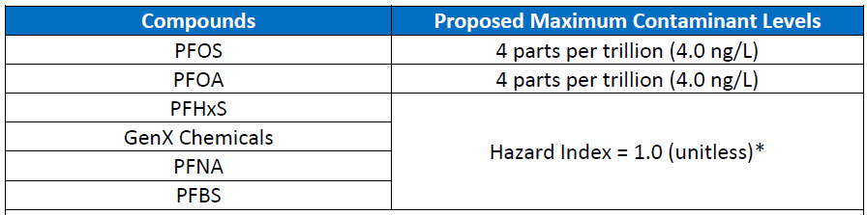
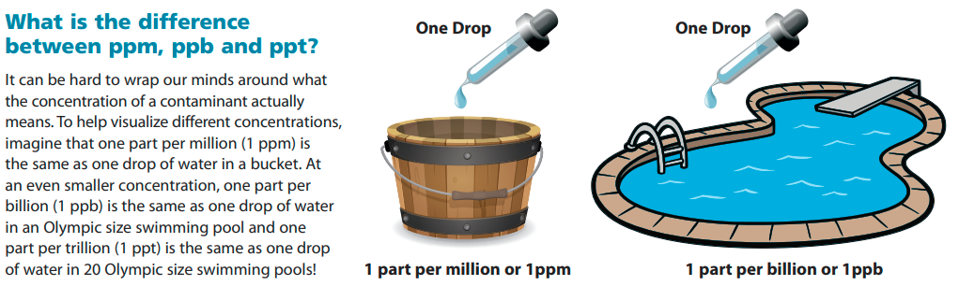
Article 41: Water System Expenditures
PFAS - EPA Proposed MCL

Slide 13
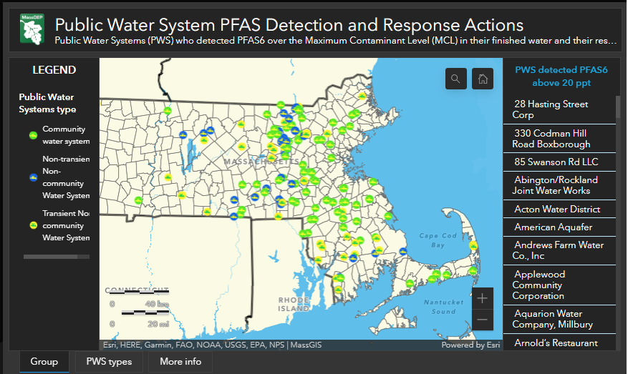
Article 41: Water System Expenditures
PFAS - EPA Proposed MCL
National Primary Drinking Water Regulation
March 14, 2023 – Public Notice Issued
60 days to provide comments
May 4, 2023 – EPA Public Hearing
Late 2023 – Rule Finalized
Initial Monitoring
Compliance Monitoring
Public Notice
Compliance

Slide 14
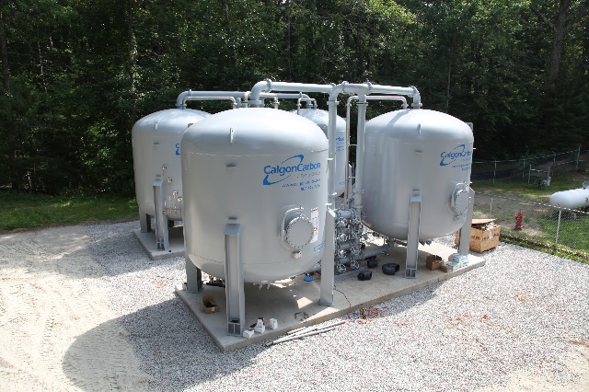
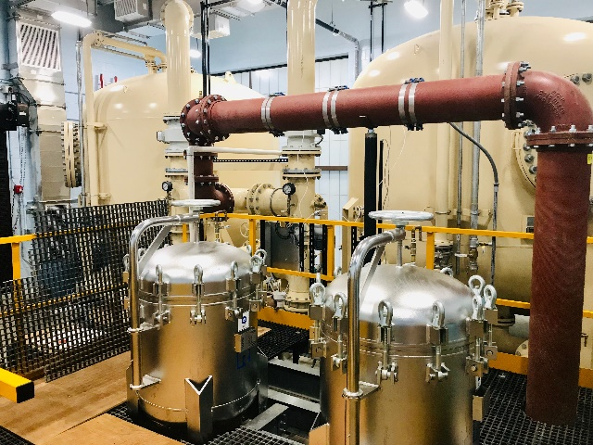
PFAS treatment upgrades
  Ayer (Grove Pond Source) $3.6 M
  Hudson (Chestnut St. Source) $4.3M
  Mansfield (Cate Spring Source) $4.2M
  Acton Water District (North Acton Treatment Plant) $6.9M
  Westfield (Dry Bridge Rd. Treatment Plant ) $12.2M

Slide 16
Article 41: Water System Expenditures
Customer Class Profile

Slide 17
Article 41: Water System Expenditures
Annual Water Demand (MG)

Slide 18
Article 41: Water System Expenditures
Residential Gallons Per Capita Day (RGPCD)

Slide 19
Article 41: Water System Expenditures
Seasonal Water Demand

Slide 20
Article 41: Water System Expenditures

Slide 21
Article 41: Water System Expenditures

Slide 22
Article 41: Water System Expenditures

