Slide 1
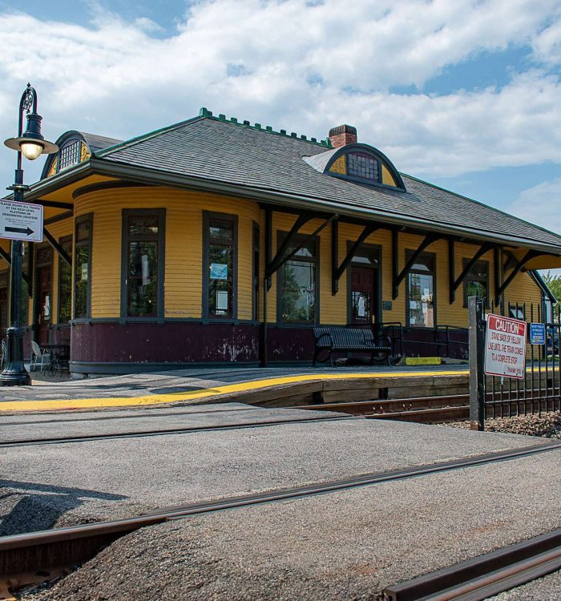
Concord MBTA Communities Public Discussion
Zoning Standards
August 23, 2023

Slide 2
Presentation
  MBTA Communities Refresher
  Zoning and Zoning Policy for MBTA Communities Districts
  Results of public survey to date
Small Group Break Outs: Provide your thoughts on height, affordable housing & incentives. Facilitators will compile any questions to discuss with the full group.
Full group discussion
Agenda

Slide 3
Sec. 3A of MGL c. 40A – Reminder . . .
MBTA Communities must have at least one zoning district in which multi-family housing is permitted by right (which can include Site Plan Review) and . . .
Minimum gross density of 15 units per acre (average across the district(s))
Located not more than 0.5 miles from a transit station, if applicable
No age restrictions and suitable for families with children, i.e. no bedroom or occupancy caps
Parity with other uses – multi-family housing cannot be required to meet higher standards than other permitted uses

Slide 4
Requirements for Concord
Commuter Rail Community
Deadline: December 31st, 2024
Minimum Land Area: 50 acres
Developable Station Area: 519 acres
Minimum Multifamily Unit Capacity: 1,094 (15% of Concord’s 2020 housing stock)
% of District to be located in Station Area (1/2 mile radius around the stations): 50%

Slide 5
Affordable Housing
On top of the targets for housing density, the guidelines limit the amount of affordable housing that can be required
No more than 10% of units can be affordable
Targeted to no less than 80% area median incomes (AMI)
But! Can be increased up to 20% in conjunction with a 40R district
Or by conducting an Economic Feasibility Analysis (which the Town plans to do)
Notes:
The Town has received a grant to have a consultant conduct a Economic Feasibility Analysis which will be done once the draft zoning bylaw has been developed.

Slide 6
Reminder: Our Process
HW will help the Town test zoning scenarios for compliance
Step 1: Determine district boundaries. Where might multi-family residential be appropriate? Focus on the areas ½ mile around the two MBTA stations, but 50% can be elsewhere.
Step 2: Determine dimensional requirements. How tall should buildings be in this district? What setbacks? What density?
Step 3: Ensure all zoning policy for the district complies with the law (affordable housing, policies that would limit family-sized units, etc.)
Step 4: Enter this data into the Compliance Model and “test” different iterations.

Slide 7
What does Concord allow today?
Currently, multi-family residential is not allowed ANYWHERE in Concord by right.
The only major option for multi-family residential is a Planned Residential Development that can be proposed in many different zoning districts with a special permit.

Slide 8
What is an overlay district?
A potential approach for Concord’s MBTA zoning . . .
Superimposes an additional set of regulations over an existing zoning district or multiple zoning districts.
Particularly helpful when you want to maintain a lot of the standards of several underlying zones, but “overlay” some common standards over all of them.
For example, an MBTA Communities overlay could . . .
  Allow multi-family development by right – an average of at least 15 units per acre across the district(s)
  Set dimensional regulations specific to multi-family housing
  While maintaining existing standards for other uses

Slide 9
What is Site Plan Review?
A regulatory tool for communities to control the aesthetics and environmental impacts of land use under zoning that could be applied to multi-family residential by right.
Town can adopt Rules & Regulations for Site Plan Review
Can condition approvals on these standards
However! Denials can generally only be made when there are direct violations of the Zoning Bylaw

Slide 10
What is Site Plan Review?
Concord considers the following matters in Site Plan Review
Negative impacts on adjoining premises (drainage, noise, light, etc.)
Safe vehicular and pedestrian passage
Waste removal and management
Adequacy of parking and loading
Adequacy of lighting
Site layout in relation to existing buildings and the natural landscape
Impact on Town utilities and services (water, sewer, fire, streets, etc.)
Sustainability and resiliency principles

Slide 11
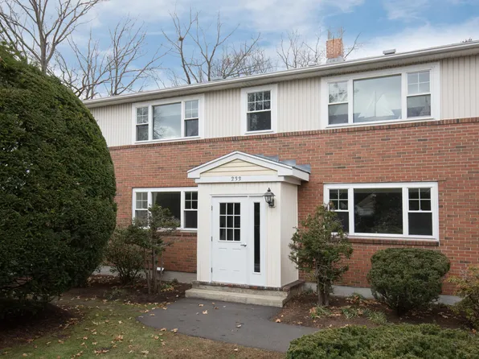
Zoning Standards
CAN set standards for . . .
  Building Height
  Setbacks
  Open Space
  Parking
  Affordable Housing up to 10%
CANNOT set standards for . . .
  Size of units
  Number of bedrooms
  Extensive design guidelines
  Requiring mixed-use or ground floor commercial
  But! A separate mixed-use district can be used to offset up to 25% of the MBTA Community district’s unit capacity
Elsinore Street Apartments

Slide 12
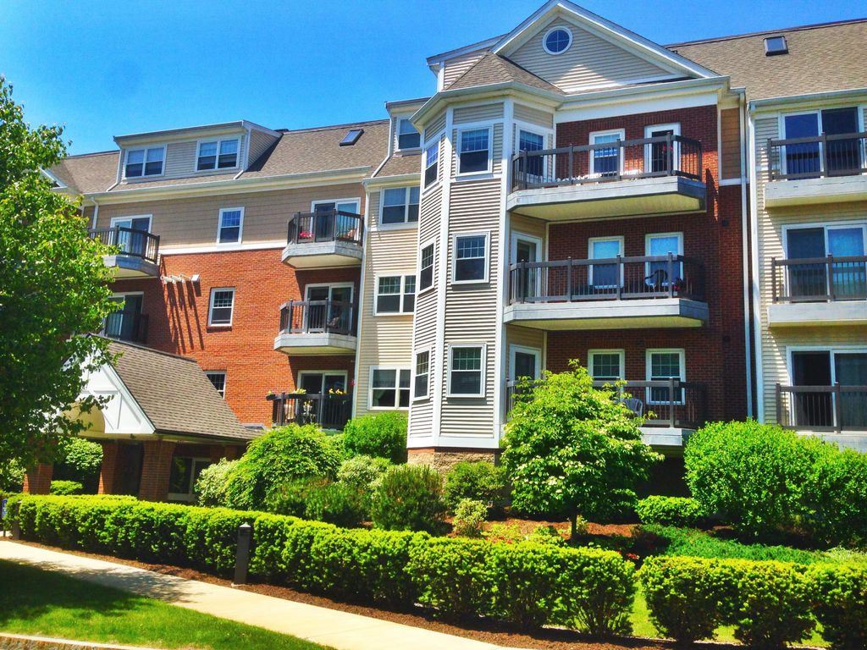
Zoning Standards
What building height should be allowed?
Should the Town use incentives to get developments that go beyond what is allowed by right?
  Example: If 2-story buildings are allowed by right, allow 3 stories with a special permit in exchange for providing . . .
    Ground floor commercial/mixed-use (if needed)
    Public green space
    Public realm improvements
    Affordable housing > 10%, etc.
    Building design aesthetics
Other thoughts/concerns?
Warner Woods

Slide 13
Online Survey
Reminder! This is not your only chance to provide feedback.
To take Concord’s MBTA Communities Survey, visit:
https://concordma.gov/3292/MBTA-Communities
This includes questions on:
Preferred locations for multi-family residential
Building height
Use of incentives
Open through September 4

Slide 14
Online Survey
As of 8/16/23, 116 individuals have completed the online survey
Emerging themes from respondents:
~65% agreed/strongly agreed that the MBTA Communities district/s should be located as much as possible within ½ mile of an MBTA station
~54% agreed/strongly agreed that the MBTA Communities district/s should be located approximately evenly between West Concord and Concord Center
~64% indicated that incentives should be allowed in the MBTA Communities district/s

Slide 15
Online Survey
Emerging themes from respondents, cont.:
~50% adding mixed use/first floor commercial for a higher allowable height should be an incentive
~56% disagreed/strongly disagreed that the MBTA Communities district/s should avoid areas where ground floor commercial uses are desired (32% unsure/need more information)
~65% disagreed/strongly disagreed that the MBTA Communities district/s should avoid areas where naturally affordable (i.e., not subsidized) housing exists today, such as 2-family homes, rental units, etc.

Slide 16
Online Survey
Areas needing additional discussion:
Maximum building height
  ~15% preference to maintain current building height
  ~29% preference to align with height of adjacent structures
  ~3% preference of 1 story
  ~16% preference of 2 stories
  ~34% preference of 3 stories
  ~28% preference of more than 3 stories

Slide 17
Online Survey
Areas needing additional discussion:
Whether MBTA Communities district/s should be located where multi-family housing exists today
  ~39% agreed/strongly agreed
  ~39% disagreed/strongly disagreed
  ~22% unsure/need more information

Slide 18
Online Survey
Specific sites/parcels respondents thought might be appropriate for multi-family housing by right…
29 individuals provided written suggestions in the online survey
1,749 “pins” dropped on the interactive map
High level of support for locations within ½ mile radius of the two MBTA station areas
Some support for locations immediately outside of ½ mile radius (e.g., parcels on Elm Street near the Rt 2 rotary and on Lowell Road leading into Concord Center)

Slide 19
Breakout Room Discussions
Each group will have a facilitator to help you discuss . . .
Building Height
What are your general opinions on building height?
Should different heights be allowed at different locations?
Should different heights be allowed in different parts of a property, such as closer or farther from property lines, or depending on the abutting zoning or use (commercial, residential, conserved open space, etc.)?
Please explain why you feel the way you do.
Reminder! The maximum building height in all residential districts is currently 35 feet (~ 3 stories)

Slide 20
Breakout Room Discussions
Each group will have a facilitator to help you discuss . . .
Incentives
What are your general opinions on using incentives to get things we can’t require by right?
Please explain why you feel the way you do.
Reminder! Incentives can include bonus height/density, tax breaks, reduction in parking, etc., in exchange for . . .
Ground floor commercial/mixed-use (if needed)
Public green space
Public realm improvements
Affordable housing > 10%, etc.
Building design aesthetics

Slide 21
Breakout Room Discussions
Each group will have a facilitator to help you discuss . . .
Affordable Housing
How much of a priority is it to include housing affordability requirements?
Should the Town require more than 10% affordable units?
What incomes should the Town target? (Less than 80% Area Median Income (AMI)? 60% AMI?)
Please explain why you feel the way you do.
Reminder! The Town is pursuing an Economic Feasibility Analysis (EFA) to petition the state for greater than 10% affordable housing within the MBTA Communities district(s).

Slide 22
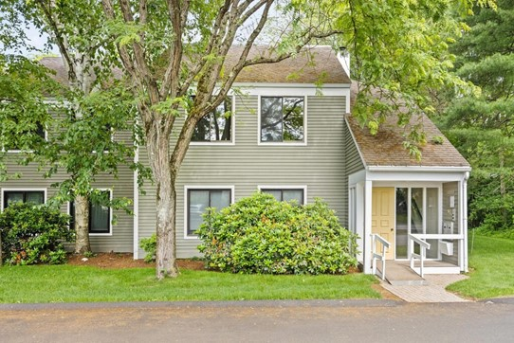
Breakout Room Discussions
See you back in the main room!
Concord Greene

Slide 23
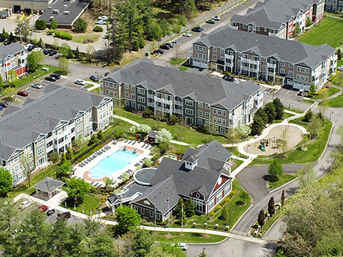
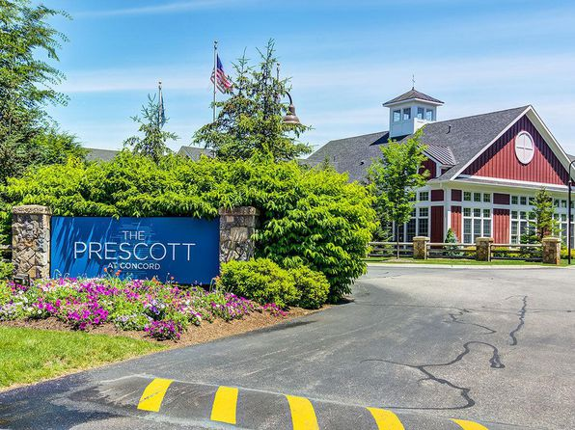
Full Group Discussion
What were the top two takeaways from your group? One minute per group!
What questions do you have for the full group?
The Prescott at Concord

Slide 24
Next Steps
Discussion for September 20: Zoning Scenarios
Town staff and the consultant team will prepare at least 3 zoning scenarios that reflect what we’ve heard from the community AND meet state law
Boundary options that reflect the different priorities of the community
Different standards for building height, parking, residential density, etc.
Let’s discuss together the trade-offs of each scenario and see if we can find a preferred alternative.

