Slide 1

Concord Planning Board Meeting
September 26, 2023

Slide 2
Bottomline Results
Concord can comply with MBTA requirements to establish zoning for transit – oriented, multi-family housing by right.
This can be achieved using existing residential zoning standards.
If near parity between the two town commuter rail stations is the goal:
  Different densities between each transit station area, and,
  The addition of overlay districts outside of the ½ mile radius of the stations will be required.
Reduced parking requirements should be considered to support open space and sustainability goals, and reduce traffic.
Mixed-use incentives don’t provide much added unit capacity and add risk to preserving commercial areas.

Slide 3
Scenario 1--mixed use Scenario 2 – stations Scenario 3-- stations++
WC=West Concord
CC=Concord Center
ELM=Elm Street
2229/NP=2229 Main Street and 1 Nathan Pratt Road
BMR=Barrett’s Mill Road

Slide 4
Feedback from mbta multi-family housing community forum September 20, 2023
Parity in the mix of multi-family housing between town centers (Concord, West Concord)

Slide 5
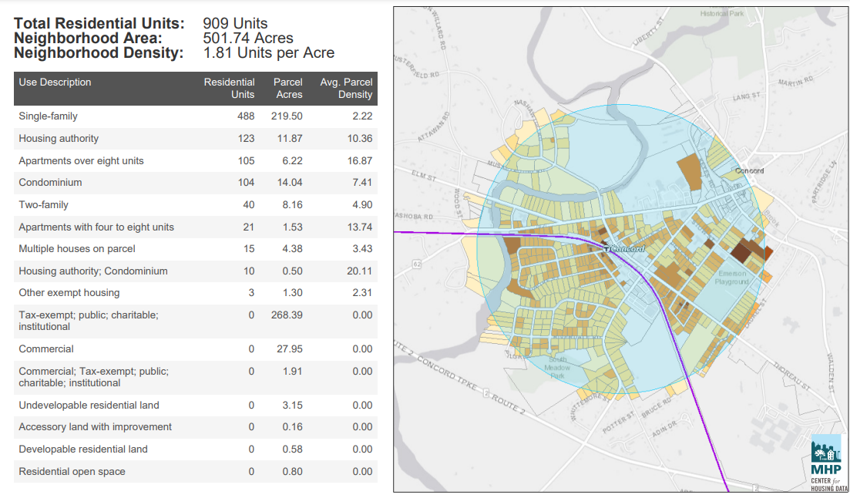
Notes:
This highlights the land around Concord Station

Slide 6
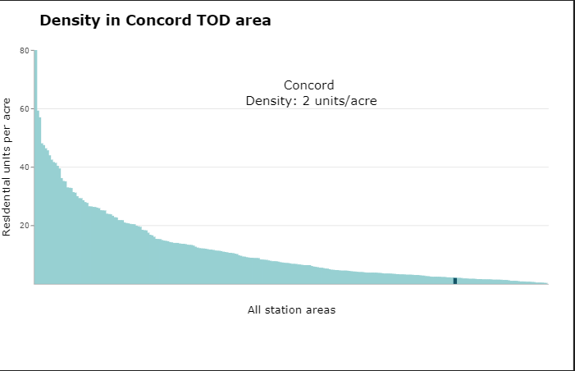
Source: TODEX
Notes:
With its current density of 2 units/acre compared to other station areas in the state

Slide 7
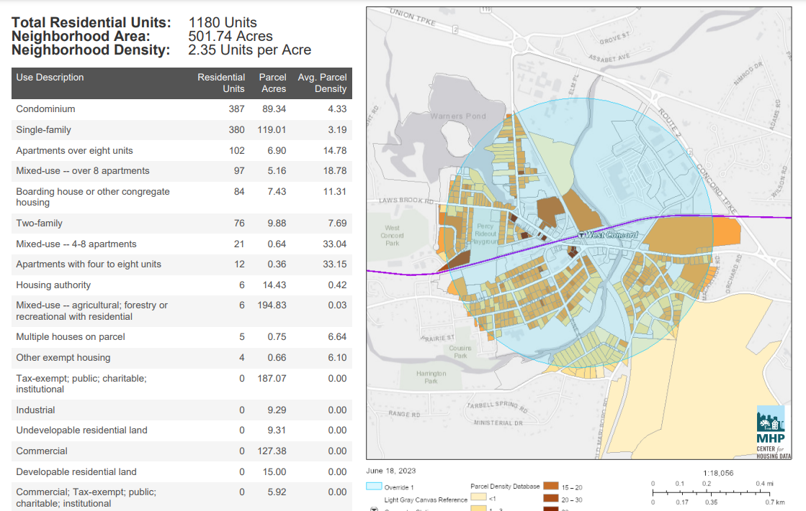
Notes:
This highlights land around the West Concord Station …

Slide 8
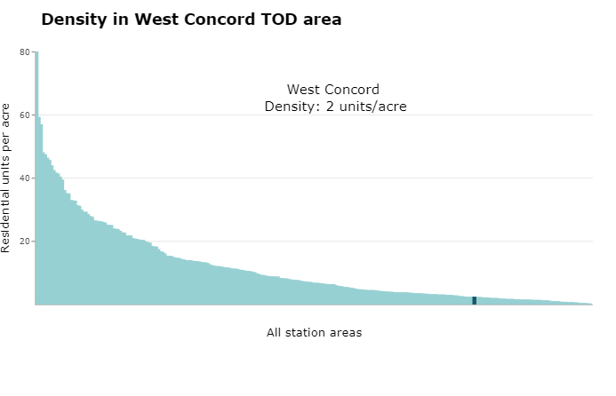
Source: TODEX Density
Notes:
As well as Its current density of 2 unit/acre compared to other station areas in the state

Slide 10
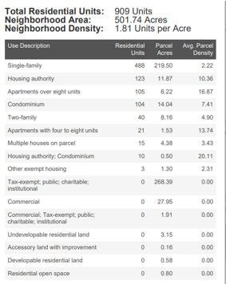
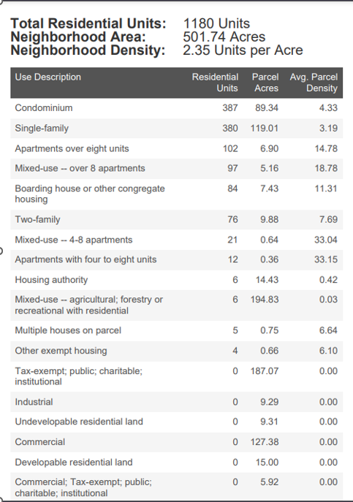
CONCORD CENTER WEST CONCORD

Slide 11
Feedback from mbta multi-family housing community forum September 20, 2023
Parity in the mix of multi-family housing between town centers (Concord, West Concord)
Parity in the mix of multi-family housing between town centers and residential areas outside of town centers

Slide 12
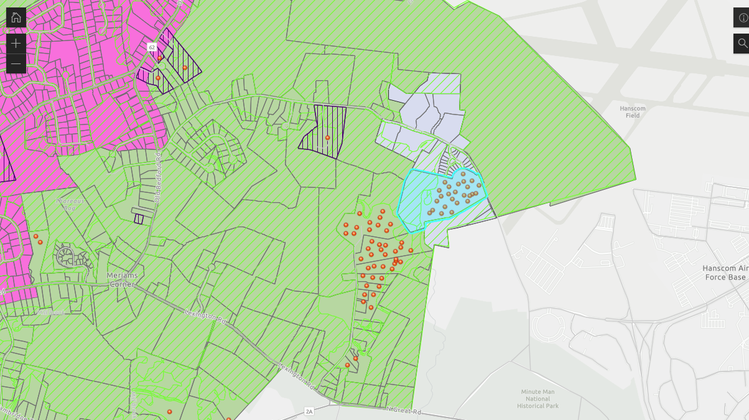
Dunbar Way and Virginia Road--example
Notes:
This represents 490, 521, 530, 561, 575 and 696 Virginia Road which are General Office Buildings and a charitable service. It also is an area of housing on Dunbar Way.

Slide 13
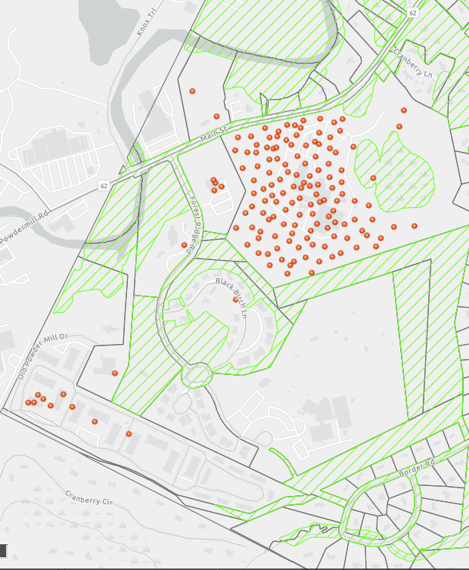
THE PRESCOTT AT CONCORD) (1 Nathan Pratt Drive, Concord Mews) AND 375 FOREST RIDGE ROAD -example

Slide 14
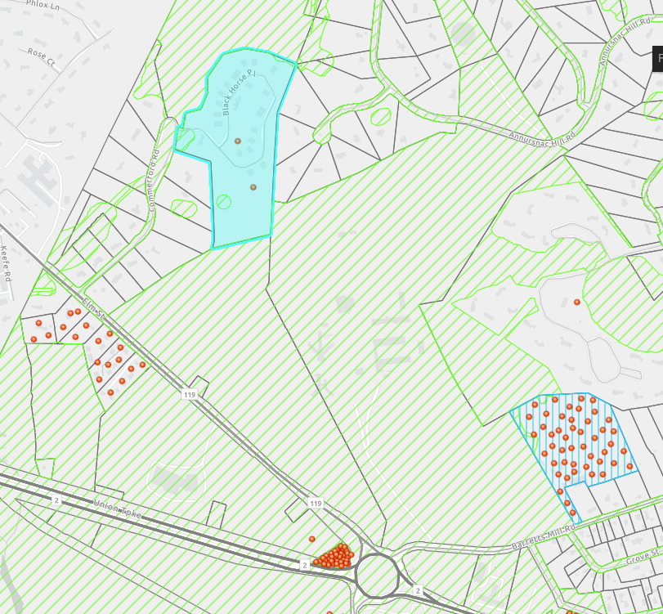
100 BLACK HORSE PLACE AND 874 BARRETTS MILL ROAD example

Slide 15
Feedback from mbta multi-family housing community forum September 20, 2023
Parity in the mix of multi-family housing between town centers (Concord, West Concord)
Parity in the mix of multi-family housing between town centers and residential areas outside of town centers
Existing dimensional requirements – height, setback, frontage were desired
Parking reductions would be considered acceptable and perhaps desired to reduce traffic, increase open space and enhance sustainability
A gradual increase in density of building in town is desired

Slide 16
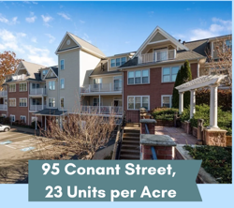
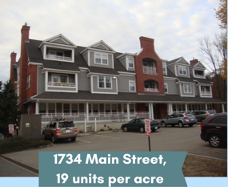
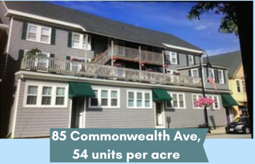
Density examples
Notes:
But Here, are a number of examples of multi-family housing density in Concord that would achieve this overall density goal. Remember, this is a District-wide requirement in zoning, not building.
And, it is a district-wide requirement where subdistricts of variable amounts of density by subdistrict could be defined.

Slide 17
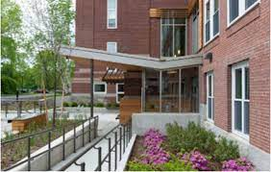
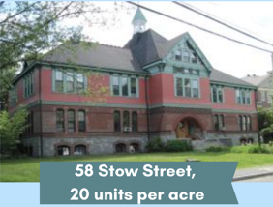
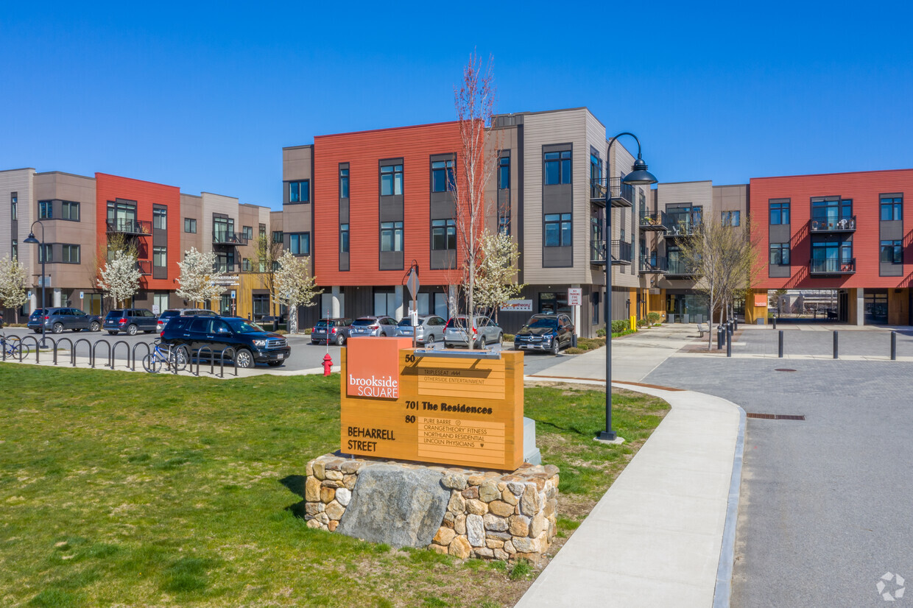
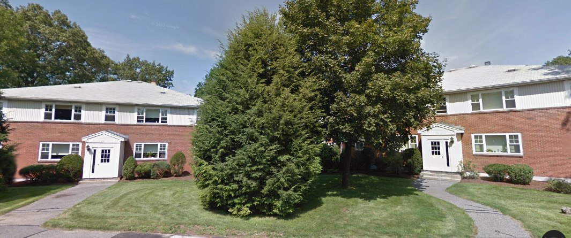
Density examples
115 Stow Street,
34 units per acre
70 Beharrell Street
18 units per acre
235 Elsinore Street
16 units per acre

Slide 18
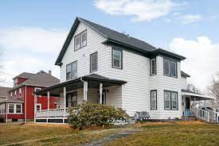
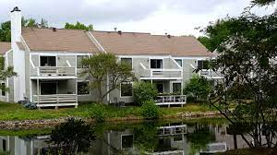
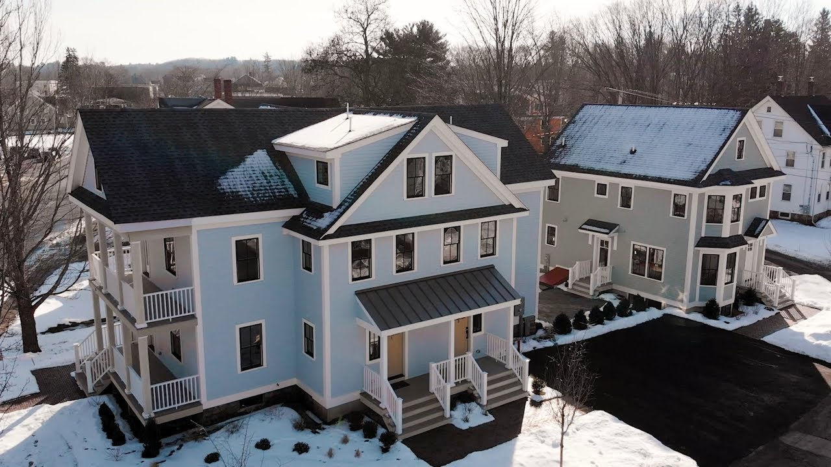
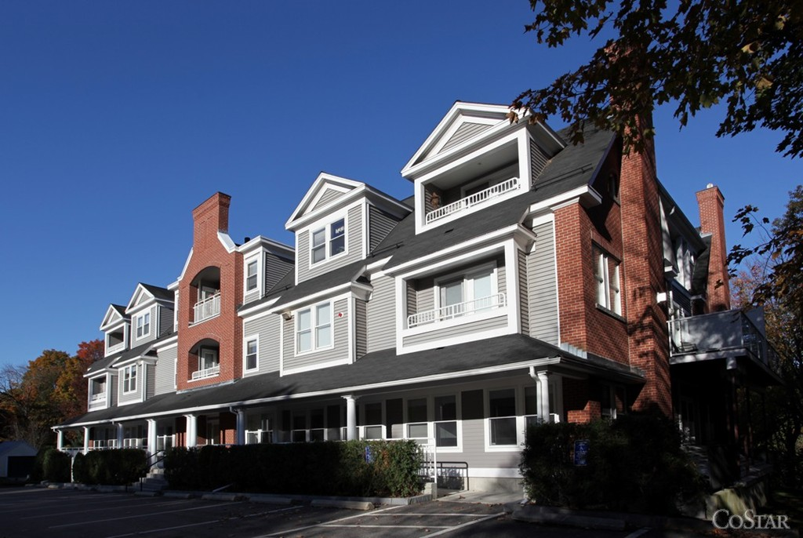
Density examples
238 Commonwealth Avenue
24 units per acre
808 Concord Greene
26 units per acre
1732 Main Street
16 units per acre
17 Laws Brook Road & 15 Maple Streets
40 and 18 units per acre

Slide 19
Feedback from mbta multi-family housing community forum September 20, 2023
Parity in the mix of multi-family housing between town centers (Concord, West Concord)
Parity in the mix of multi-family housing between town centers and residential areas outside of town centers
Existing dimensional requirements – height, setback, frontage were desire
Parking reductions would be considered acceptable and perhaps desired to reduce traffic, increase open space and enhance sustainability
A gradual increase in density of building in town is desired
Mass of multi-family buildings in the Baker Avenue/ area was undesirable

Slide 20
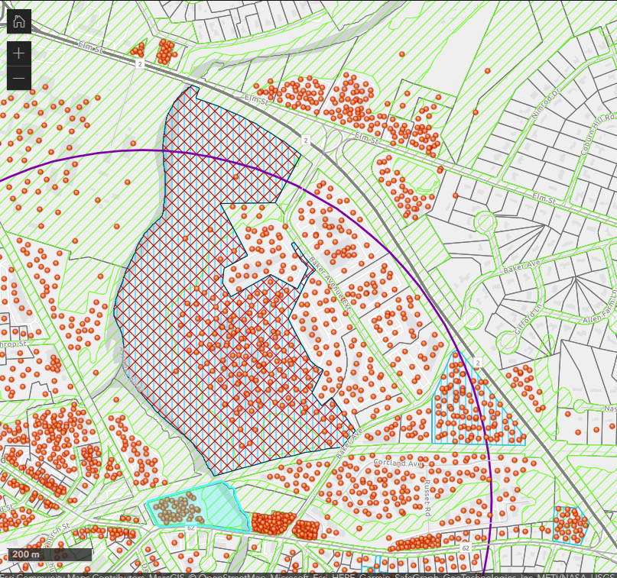
BAKER AVENUE AND JUNCTION VILLAGE - example

Slide 21
Feedback from mbta multi-family housing community forum September 20, 2023
Parity in the mix of multi-family housing between town centers (Concord, West Concord)
Parity in the mix of multi-family housing between town centers and residential areas outside of town centers
Existing dimensional requirements – height, setback, frontage were desire
Parking reductions would be considered acceptable and perhaps desired to reduce traffic, increase open space and enhance sustainability
A gradual increase in density of building in town is desired
Mass of multi-family buildings in the Baker Avenue/ area was undesirable
Mixed-use is desired, but confusing and difficult to attain with MBTA requirements
Incentives with development is also confusing, and may be difficult to achieve

Slide 22
NEXT STEPS
Train Town staff to “test” the GIS model for compliance
Planning Board review of overlay districts with public input
  October through December meetings: 10-10, 10-24, 11-14, 11-28, 12-12
  Each Multi-family housing overlay district as outlined in draft Zoning Map
  Zoning elements— Dimensional requirements (density, setbacks, height restrictions)
  Incentives to optimize open space and recreation, sustainability, economic vitality, transit use and walkability
Planning Department and Town Counsel create draft zoning ordinance
Affordability options pursued with additional consultant

