Slide 1

Fiscal Year 2025
TAX RATE CLASSIFICATION HEARING
A Review of the Fiscal Year 2025 Property Tax Levy and Classification Options.
Town of Concord
November 18, 2024

Slide 2






Timeline
Annual Town Meeting
Property Valuation Completed
Tax Classification Hearing
Spring
September
Final Rate Certification (State Approval)
December
Tax Bills Issued
December
Abatement Period
January 1-February 3
RTE Forum
September
November

Slide 3
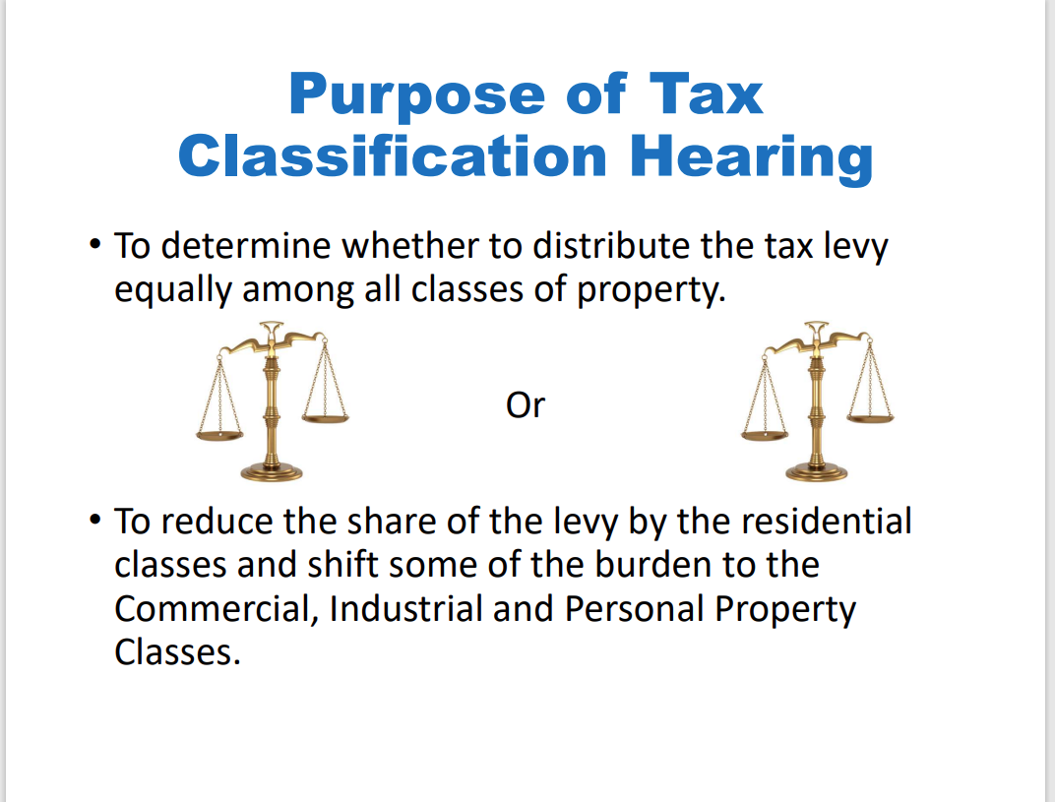

Slide 4
Select Board’s Role
The Select Board will consider four key decisions for tax classification:
Vote: Selection of a Minimum Residential Factor, Single or Split Tax Rate
Vote: Whether to Grant an Open Space Discount
Vote: Whether to Adopt a Residential Exemption
Vote: Whether to Adopt a Small Commercial Exemption
Selection of a Minimum Residential Factor, Single or Split Tax Rate
Selection of an Open Space Discount-or not
Granting of a Residential Exemption or not
Granting of a Small Commercial Exemption or not

Slide 5
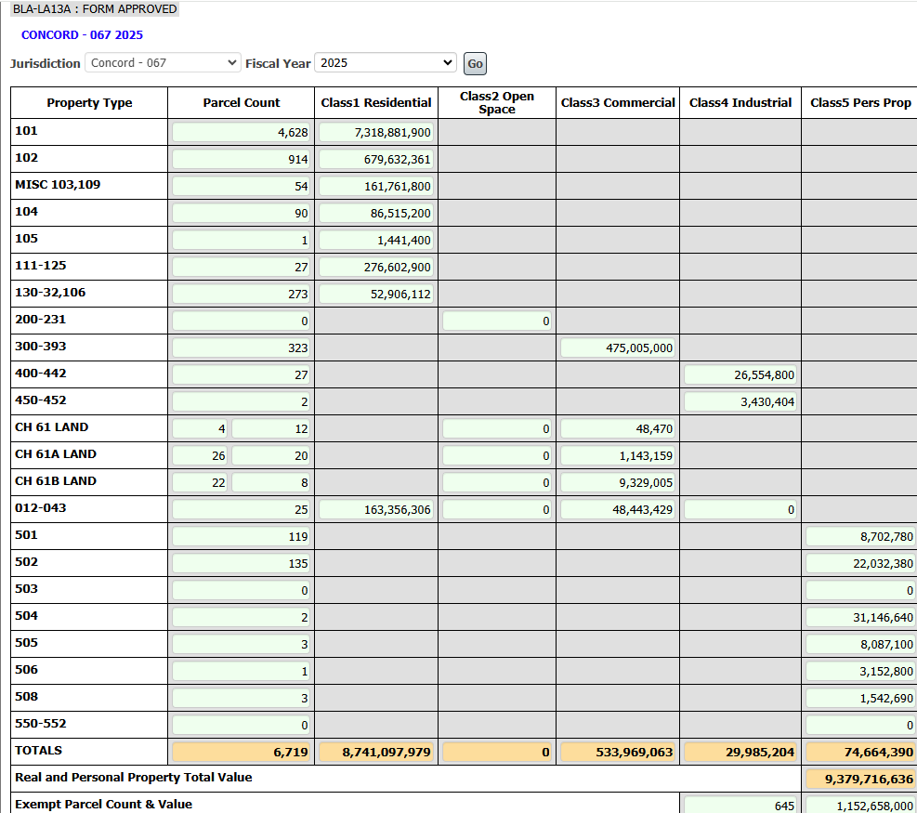
CERTIFIED VALUES—FISCAL YEAR 2025
* See Addendum #1 for historical data regarding Town Levy
PROPOSED TAX RATE = LEVY/CERTIFIED VALUES
$116,237,779 (LEVY)
9,379,716,636 (VALUES)
Single Tax Rate =$12.39
IF A FACTOR OF 1 IS SELECTED
(NO SHIFT)

Slide 6
Tax Rate Calculation
Single Rate, with no shift, the Tax Rate would be $12.39/$1,000 of assessed value
=
FY2025 Property Tax Levy
$116,237,779
$12.39 per thousand dollars of assessed value
Town Taxable Valuation
$9,379,716,636
 | FY24 | RE Taxes | FY25 | RE Taxes
Average Assessed Value 101-Single Family: | $ 1,554,227.00 | $ 20,407.00 | $1,581,435.00 | $ 19,593.98
Median Assessed Value 101-Single Family | $ 1,303,250.00 | $ 17,111.67 | $1,331,300.00 | $ 16,494.81
Average Assessed Value 102-Condominium | $ 731,154.00 | $ 9,600.05 | $743,580.00 | $ 9,212.96
Median Assessed Value 102-Condominium | $ 629,950.00 | $ 8,271.24 | $639,587.00 | $ 7,924.48

Slide 7
Breakdown of Taxable Property Classes

Slide 8
SELECTION OF A MINIMUM RESIDENTIAL FACTOR, SINGLE OR SPLIT TAX RATE
VOTE 1

Slide 9
What is a Split Tax Rate?
Communities decide to tax Residential, Commercial, Industrial & Personal Property (CIP) differently.
Statute allows an increase in CIP’s share of the tax levy up to 50% higher than Residential
Does not generate new revenue; reallocates levy burden
Concord has used a single tax rate since 1998

Slide 10
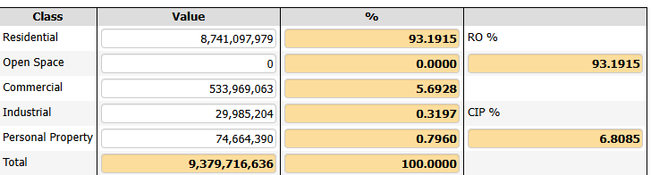
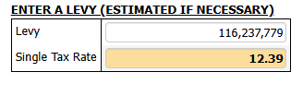
Minimum Residential Factor Comparison
Estimated Tax Rates with CIP Shift from 1.0-1.50
Since 1998 the Town has not shifted the tax burden to Commercial, Industrial, and Personal Property (CIP).

Slide 11
WHETHER TO GRANT AN OPEN SPACE DISCOUNT
VOTE 2

Slide 12
OPEN SPACE DISCOUNT
During the State mandated Classification Hearing, the Select Board must vote on the following in order to establish a tax rate:
OPEN SPACE DISCOUNT:
Open space is land maintained in an open or natural condition which contributes significantly to the benefit and enjoyment of the public and which is not
Subject to a permanent conservation restriction;
Held for the production of income;
Taxable under the provisions of
Chapter 61 (Forestry Land)
Chapter 61A (Agricultural/Horticultural Land)
Chapter 61B (Recreational Land).
The Select Board may discount up to 25% of the Open Space share of taxes.
Historically, the Town of Concord has not adopted an Open Space Discount.

Slide 13
WHETHER TO ADOPT A RESIDENTIAL EXEMPTION
VOTE 3

Slide 14
What Is It?
MGL c.59, sec. 5C
Enacted in 1979, the Residential Tax Exemption is an option under property tax classification MGL c.59, sec. 5C that shifts the tax burden within the residential class from owners of moderately valued residential properties to the owners of vacation homes, higher valued homes and residential properties not occupied by the owner, including apartments and vacant land.

Slide 15
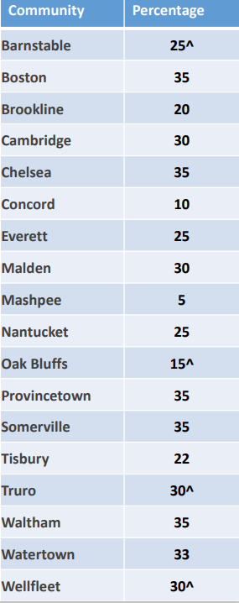
Residential Tax Exemption
• The Residential Exemption Factor can be 1% up to 35% of the total average residential parcel value
• The property must be the "primary domicile" of the owner as used for income tax purposes
• This option exempts value only within the Residential Class of property & does not change the levy amount or impact Commercial, Industrial, or Personal (CIP) Property
The Select Board can authorize up to a 35% Residential Exemption.
18 communities, out of 351 in MA, chose to adopt in FY23-FY25.
The Residential Exemption is a fixed value reduction off the assessment for qualified taxpayers, meaning all qualified taxpayers receive the same amount subtracted from their assessed value.
The assessed value for the exemption is a percentage of the average residential value of the community.
* ^ Indicates RTE percentage increased for FY2025

Slide 16
How Is It Calculated?
A = Total Residential Value = $8,741,097,979
B = Total Residential Parcel Count = 6056
C = Average Residential Value = $1,443,378.00
D = Selected Residential Exemption % = 10%
E = Residential Exemption = $144,338.00
F = Number of qualifying Residential Parcels = 3,870
G = Total Residential Exemption Value = $558,588,060
H =Total Residential Value-Exemption =$8,182,509,919
Break Even Point A divided By F =$2,258,682.00

Slide 20
Options for Residential Exemption
(Example Calculation of 10%)

Slide 21
WHETHER TO ADOPT A SMALL COMMERCIAL EXEMPTION
VOTE 4

Slide 22
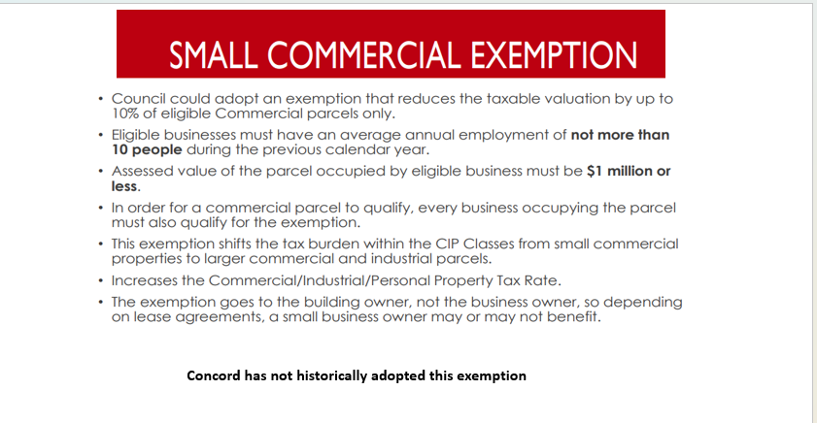

Slide 23


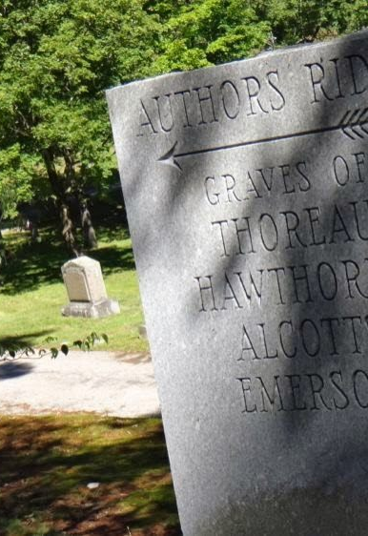

Town of Concord
Board of Assessors
Dr. Mera Tilley, Chair Yannis Tsitsas, Vice Chair Brendan Kemeza Arry Charles Shriram Bharath Assessing Division Meredith Stone- Town Assessor Michael Gibbons-Assistant Town Assessor Carolyn Dee-Office Administrator Lee Phalen-Data Lister Samantha Perry-Administrative Specialist
Notes:
Concord Assessors Office 24 Court Lane Concord Massachusetts 01742

Slide 24
ADDENDA
ADDENDUM #1—Historical Levy Data
ADDENDUM #2—Classification Hearing Terms
ADDENDUM #3—LA-4 Comparison FY24 to FY25

Slide 25
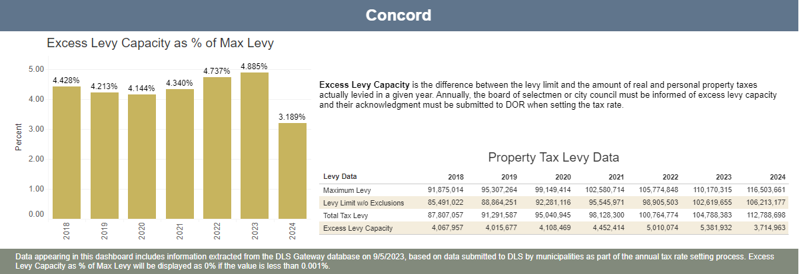
ADDENDUM #1
History of Town Levy 2018-Present
FY25 PROJECTED LEVY $116,237,779

Slide 26
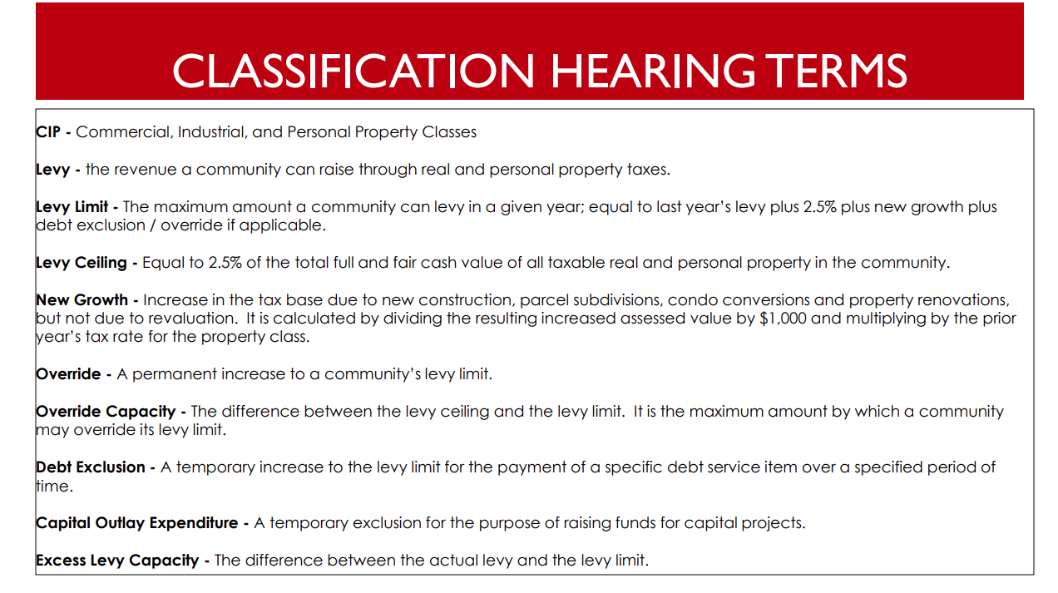
Add a Slide Title - 5
ADDENDUM #2

Slide 27
ADDENDUM #3

