Slide 1
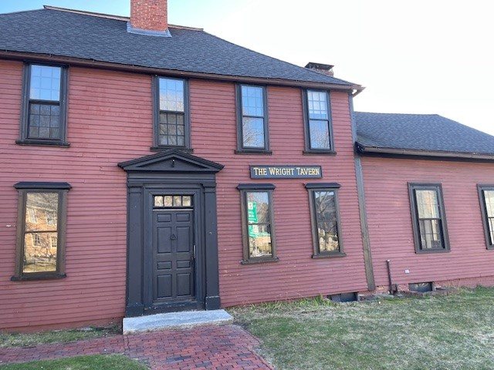

Status and Plans of the
Wright Tavern for the
Concord Historical Commission
“Let’s Meet at the Wright Tavern”

Slide 2
Outline of Our Status and Plans
Review of Our Vision, Mission and Accomplishments
Strategic Overview of Our Plans
Review Key Plans and Priorities
Building rehabilitations
Interior “Visitor Experience”
Programs and Services
Modifications Needing CHC Review
Priorities for the Next Phase
Open Questions and Discussion

Slide 3
Our Vision
The Wright Tavern will be welcoming center that fosters engagement, inspires civic engagement and provides unique refreshments.
A welcoming center– for meetings, programs, conferences, events, re-enactments, parties, celebrations
That fosters engagement -- where people can engage and learn about Concord’s history and critical events in the founding of the United States and the roots of democracy
In a place that provides unique refreshments – if possible, we will provide refreshments – coffee/tea, and beer/ wine/ signature drinks – to our guests just like a colonial tavern

Slide 4
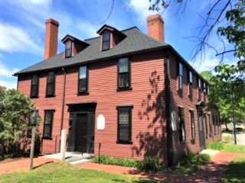
Wright Tavern Legacy Trust – Our Mission:
Enable the Wright Tavern to take its rightful place in telling the stories of Concord’s history and the founding of the United States.
Our Goals:
Preserve this iconic building in American history
Open it to the public for tours, meetings, programs, reenactments, and events year-round – A center for learning and engagement
Become financially self-sustaining and a collaborative partner
Notes:
Minor sentence edits.

Slide 5
Top 10 Accomplishments
Created the Wright Tavern Legacy Trust (501(c)(3)) – leased building for 30 years; to overseeing repairs, restorations and improvements and manage the programs and events
Created logo and new website – wrighttavern.org
Raised over $1.2 M for capital improvements.
Published: “Concord’s Wright Tavern: At the Crossroads of the American Revolution” (History Press)
Completed major structural repairs and created exhibits - displays, pictures, posters - that tell the stories of the Wright Tavern and its history

Slide 6
Top 10 Accomplishments
Now conducting personal tours and renting space for events, meetings, parties and other gatherings.
Prepared a Preservation Agreement between Concord, Mass Historical Society and First Parish in Concord
Rented 2 of 3 offices on second floor.
Finalizing plans for interior design plans – lighting, fixtures, flooring, paint, furniture – and for repairs and improvements to exterior and infrastructure
We have become known to the people of Concord – Patriots Day, Lafayette’s Farewell Tour, 2024 Mass Provincial Congress, WT Pub Choir. More are planned for 2025

Slide 7








Our Team of Resource Professionals
Ilisa Hurowitz:
Strategic Fundraising Consultants

Slide 8
Strategic Overview of Our Plans
Building Infrastructure
Improvement Plans
Interior Space “Visitor Experience” Plans
Programs & Service Plans
(Our Business Model)

Slide 9
Building Infrastructure Improvements
Primary Projects Funding Source
Completed major structural repairs and stabilization CPA Grant
Exterior repair, preservation and painting NPS Grant
– siding, doors, windows
Upgrade electrical service and Implement lighting plan CPA Grant
Plus private $
Upgrade plumbing and water and sewage systems NPS Grant
5. Install Refreshment Center and Catering Kitchen MOTT Grant
(2 phases) Linn Foundation

Slide 10
Building Infrastructure Impr (con’t)
Primary Projects Funding Source
Fire Suppression and Security Systems NPS Grant
New Entrance on Main Street MOTT Grant
Linn Foundation
Replace HVAC System with heat pump and To be determined
electric systems
NOTE: As we begin the project definition, contractor selection and planning process, we will come back to the CHC for informational and approval purposes.

Slide 11
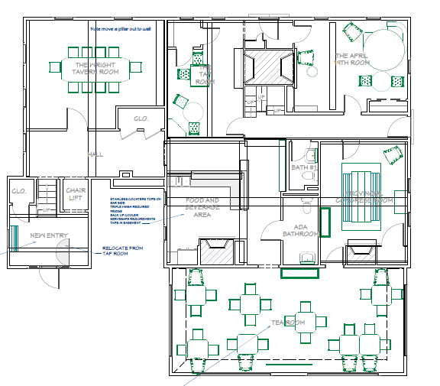
Interior “Visitor Experience” Plans
Wright
Tavern
Room
April 19th
Room
Tap
Room
First Parish
Entrance
Refreshment
Center
(Planned)
Provincial
Congress
Room
New Main
Entrance
(Plans are under development)
The Tea
Room

Slide 12
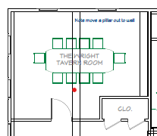
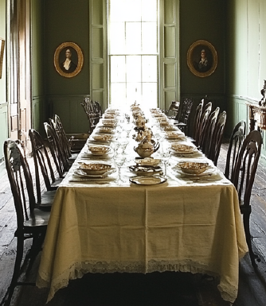
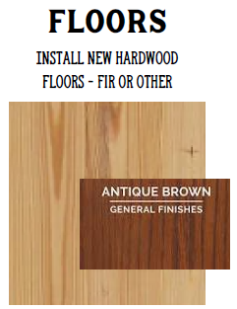
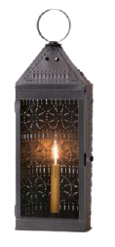
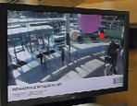
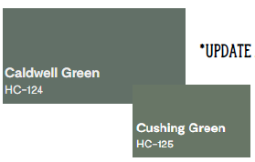
The Wright Tavern Room
Showplace room for meetings and special events
Tells the history of the Wright Tavern
Wainscoting, period comfortable chairs and video displays

Slide 13
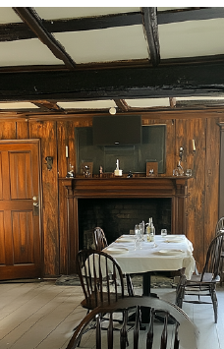
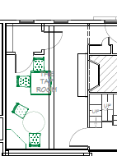

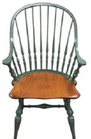
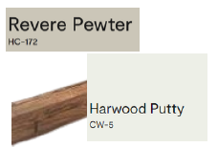
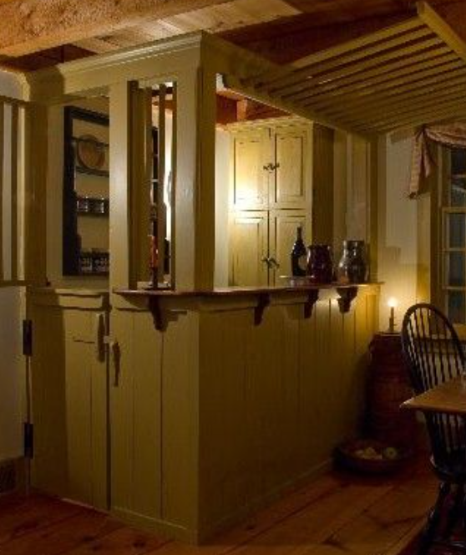
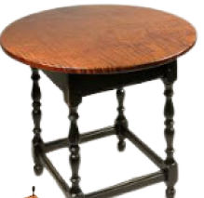
The Tap Room
Take you back in time to a Colonial Tap Room, the center of the Tavern
Partial open ceiling showing original wood structure, considering expanding
Tell the stories of the importance of Taverns in Colonial America
Add a “Cage Bar” as existed in the original structure
Simulated fire in the fireplace

Slide 14
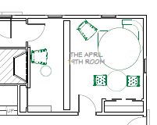
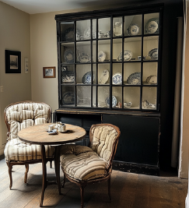
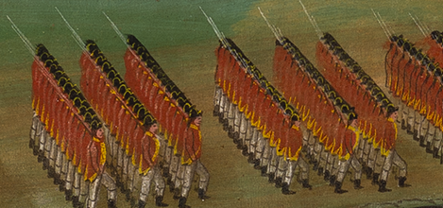
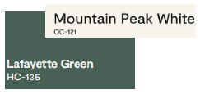
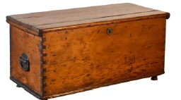
The April 19th Room
Tells the stories of what happened in Concord and how the women preserved the town and prevented Redcoats from finding supplies.
Window treatments will show marching Redcoats just outside
Wainscoting to make room more like a formal parlor
Have few chairs for setting and enjoying the space
Simulated fire in the fireplace
One-third of ceiling is exposed, considering expanding this

Slide 15
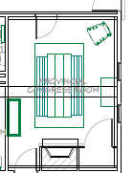
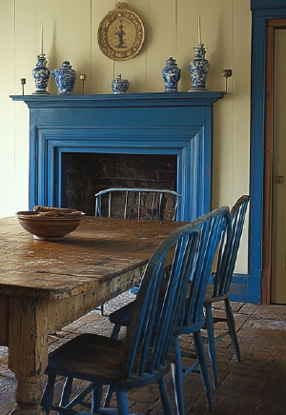

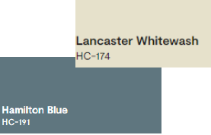
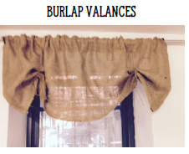
The Provincial Congress Room
Tell the stories about the Provincial Congress
Fireplace and trim painted Hamilton Blue; walls painted Lancaster Whitewash
Custom made, reproduction of conference table
Simulated fire in the fireplace
Windows to show old First Parish

Slide 16
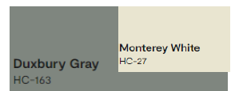
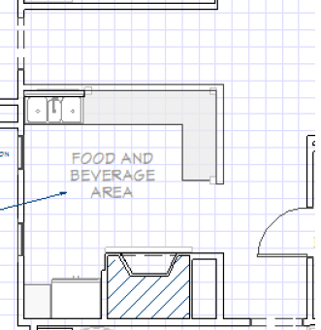


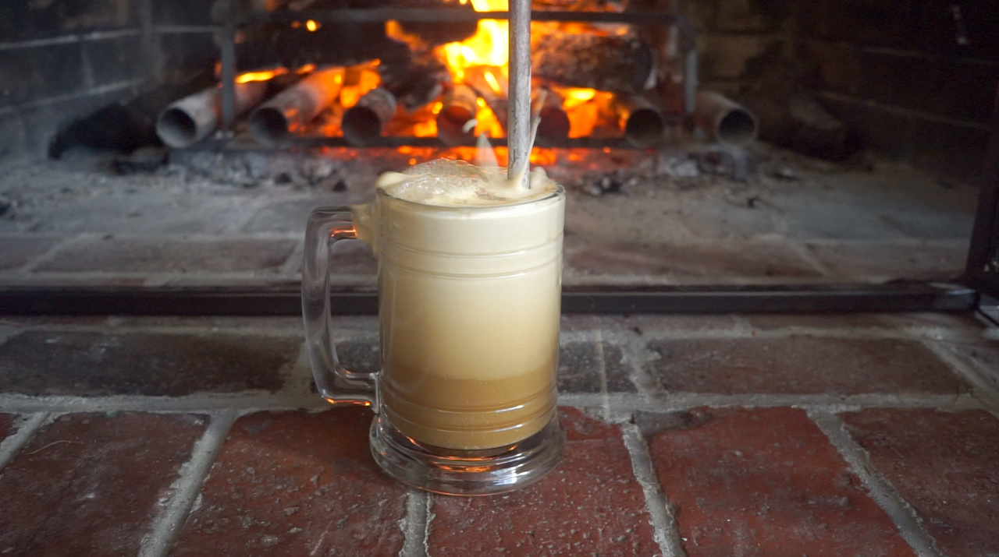
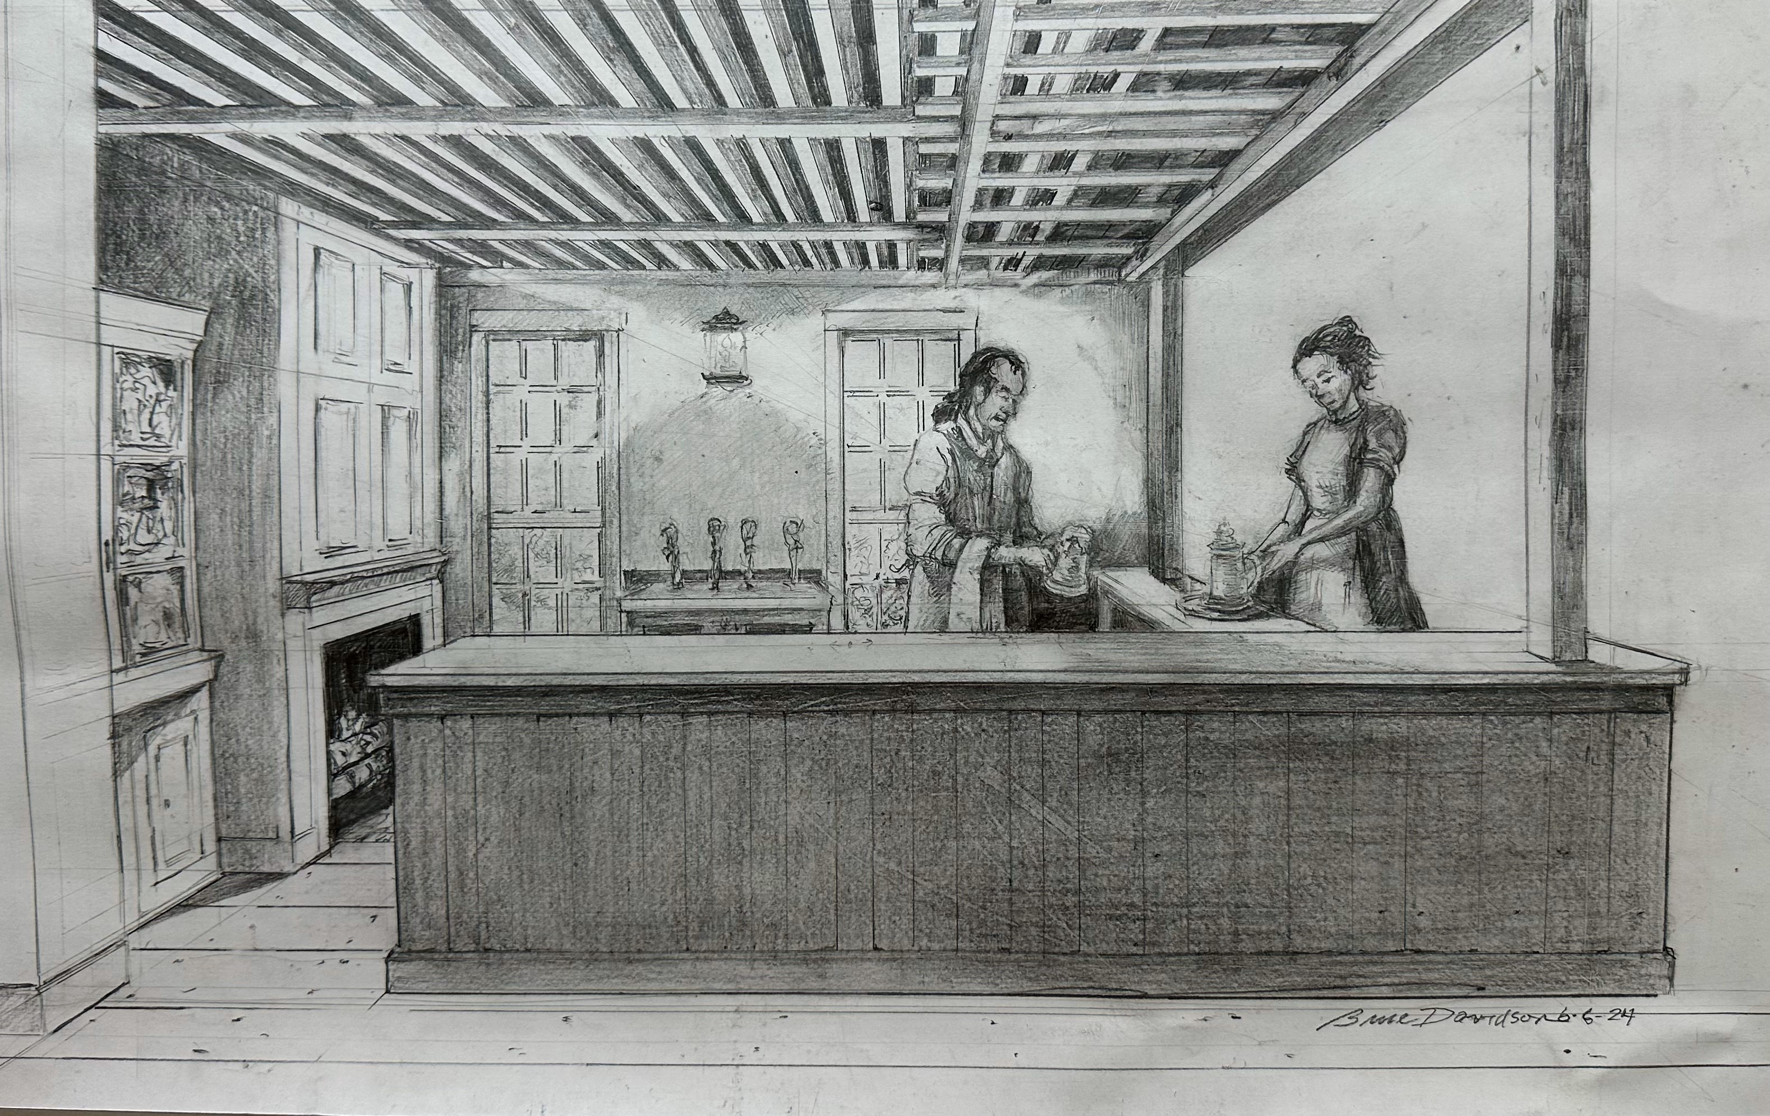
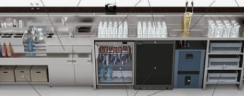
The Refreshment Center
Create a place for refreshments for tourist and guests year-round
Supports meetings, tourists, community and catered events
Alcoholic and non-alcoholic beverages, and prepared snacks
Souvenir items for sale

Slide 17
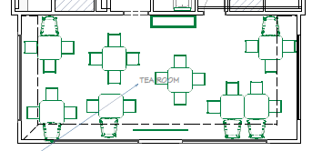
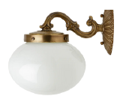
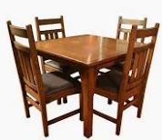
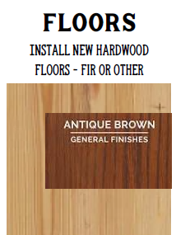
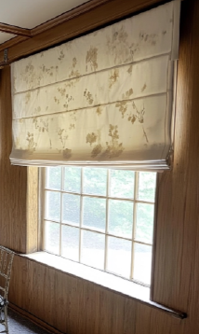

The Tea Room
Primary open seating area suitable for meetings, events, seminars, music, and just conversations
Tell stories of Tea Rooms and their impact on 20th Century society
Style and motif to be 1920’s
Replace floor, roman shades on windows, paint walls
Include presentation media capabilities
Flexible seating to move chairs into many configurations
Display artifacts from 19th & 20th Centuries

Slide 18
Interior “Visitor Experience” Plans
Project – Priorities to be done for April 19th*
Repair door on the First Parish side so it is fully functional
Replace flooring in Tea Room and Wright Tavern Room with wood
Prep and paint all walls, ceilings and some floors according to plan
Install new light fixtures
Purchase tables and chairs for all rooms (18 tables and 72 chairs)
Replace or add window treatments – Roman shades, image shades
Add wainscoting in Wright Tavern and April 19th Rooms
Purchase four hutches for merchandise/object displays

Slide 19
Interior “Visitor Experience” Plans
Project – Priorities to be done for April 19th*
Assess current conditions and need for both electrical and plumbing/ water systems throughout the building.
Acquire Merchandise products for resale
Install technology systems – videos, speakers, speakers aids
Add simulated fireplace fixtures
Replace or reconfigure doors to be more authentic
Add Cage Bar in Tap Room with other fixtures
Upgrade and paint/restyle two bathrooms
* These projects depend on acquiring the needed funding and CHC approval.

Slide 20
Preliminary Schedule and Plans for Implementation of Rehabilitation Projects

Slide 21
Programs and Services (Uses for the Wright Tavern)
Our Vision and Mission for the Wright Tavern
Tours and Educational Programs
Individual/ Company Events, Meetings, Celebrations
Programs by WTLT and Strategic Partners
A Place to Just Hang Out and Be with Friends
Individual Tours
Family Tours
Tour Groups
School Field-trip Programs
Concord Tourist Office Tours
Organizational meetings & Conferences
Individual celebrations
Holiday & Birthday Parties
Patriots Day
WT Pub Choir
Seminars
Music events
Provincial Congress
Art Shows
….. And more
Once the Refreshment Center Bar is open, come and enjoy the space, be with friends, find your community

Slide 22
Modifications Needing CHC Review
Replace door (ADA configured) on First Parish side with period specific (1700-1800 style) door with functional locks and ADA compliant system.
In the WT Room, move support beam to exterior wall; may require modifications to the main support beam exposed.
Combine two closets into one, reducing the footprint and having only one door.
In the April 19th Room, remove closet and expose original floor and wall.
Remove walls to create bar for the Refreshment Center.
Reconfigure closet in Tea Room to open into the Refreshment Center; close off in access to the Tea Room.
Remove rest of ceiling in the Tap Room and April 19th Room

Slide 23
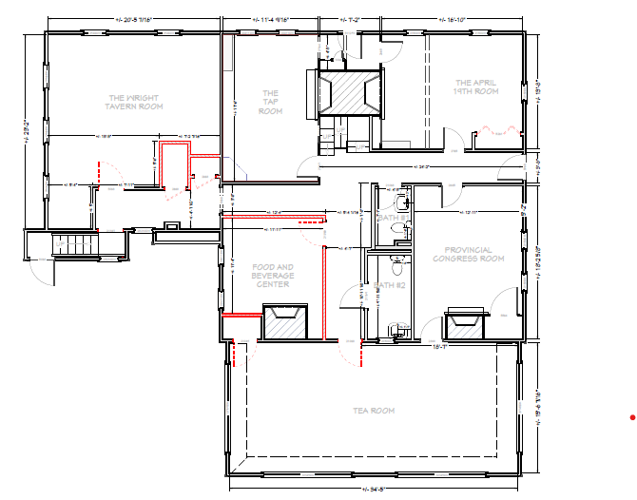
Interior “Visitor Experience” Plans
Structural changes to the interior space of the building:
2.
Planned Modifications
Replace FP facing door
Move support beam
Combine closets
Remove closet
Remove walls for RC
Reconfigure closet
Remove ceilings in Tap and April 19th Rooms
7.
7.
3.
4.
1.
5.
6.

Slide 24
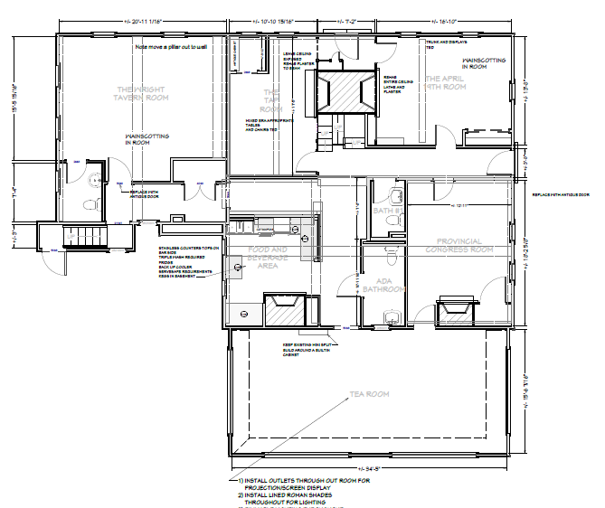
Interior “Visitor Experience” Plans
Structural changes to the interior space of the building:

Slide 25
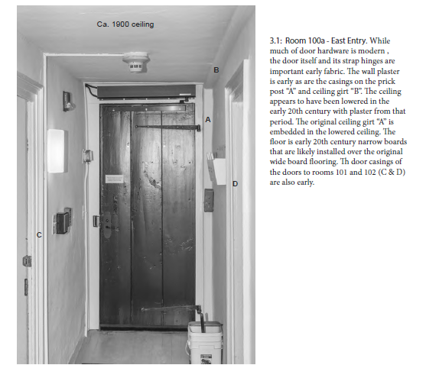
Documentation from the Preservation Restriction
Replace door (ADA configured) on First Parish side with period specific (1700) door with functional locks and ADA compliant system.

Slide 26
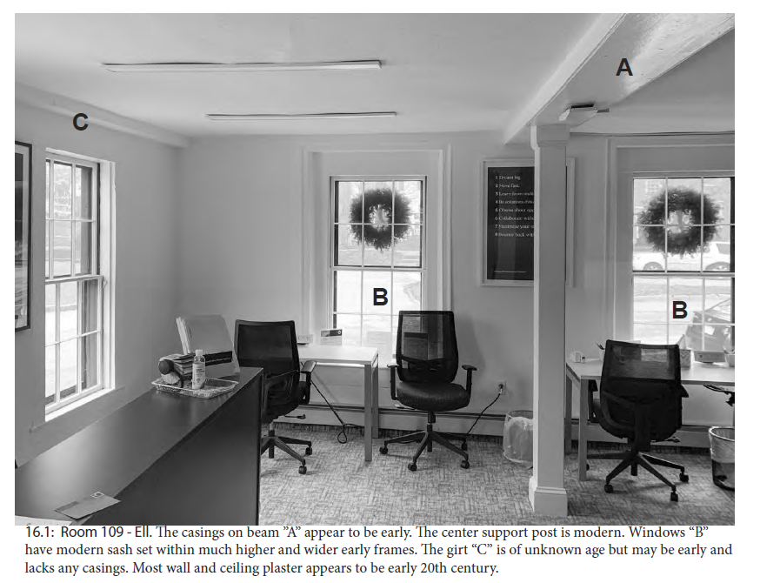
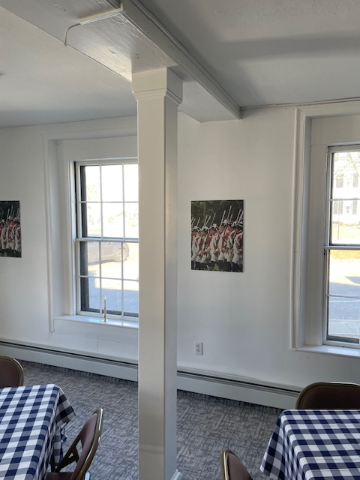
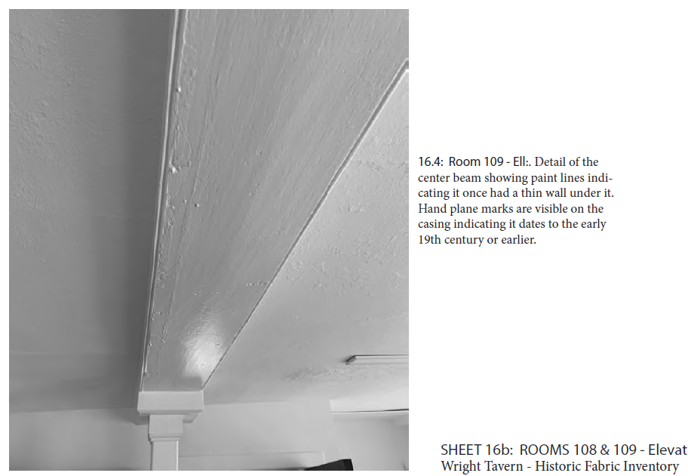
Documentation from the Preservation Restriction
2. In the WT Room, move support beam to exterior wall; may require modifications to the main support beam exposed.

Slide 27
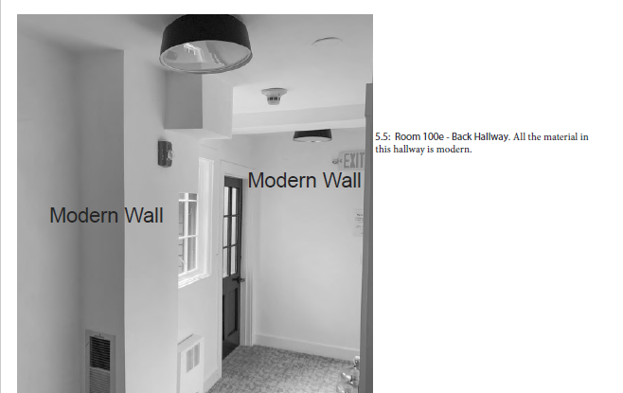
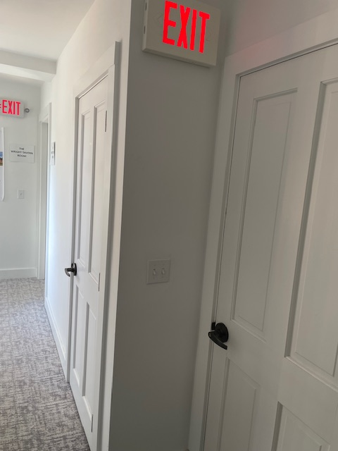
Documentation from the Preservation Restriction
3. Combine two closets into one, reducing the footprint and having only one door.

Slide 28
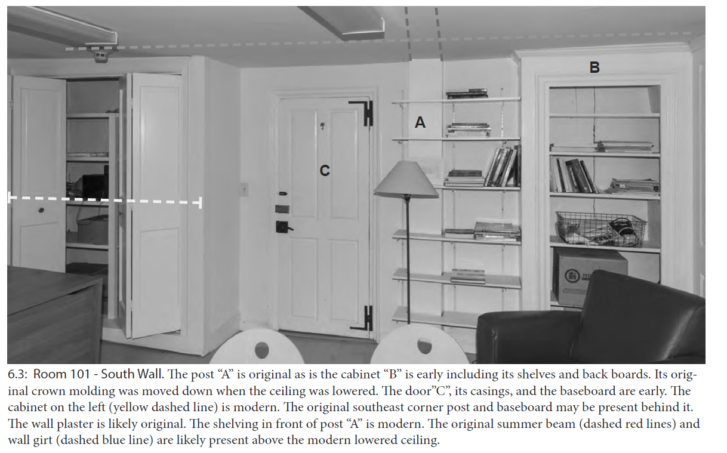
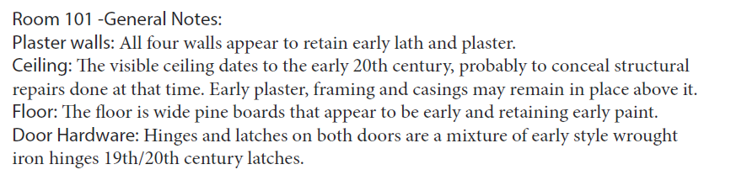
Documentation from the Preservation Restriction
4. In the April 19th Room, remove closet and expose original floor and wall.

Slide 29
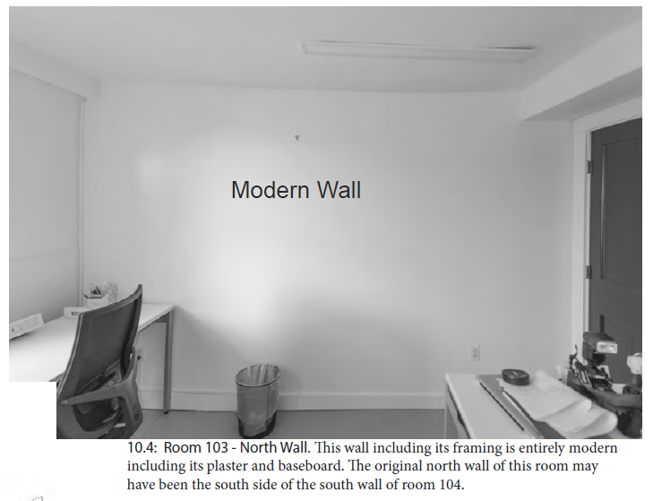
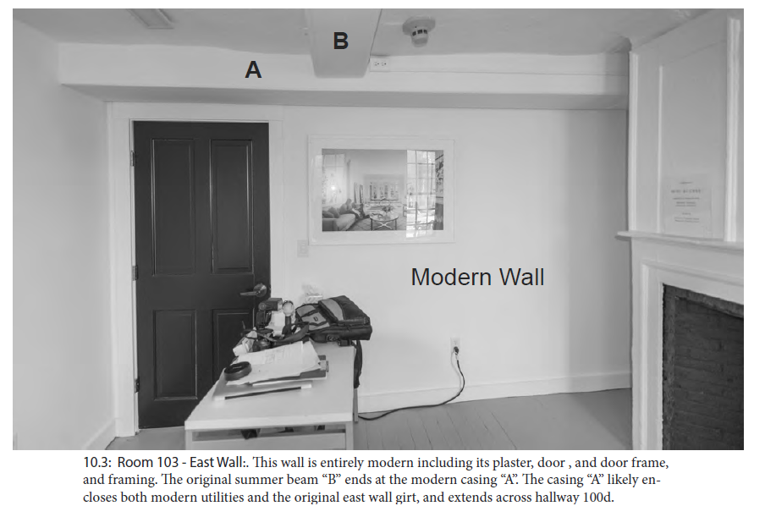
Documentation from the Preservation Restriction
5. Remove walls to create bar for the Refreshment Center.

Slide 30
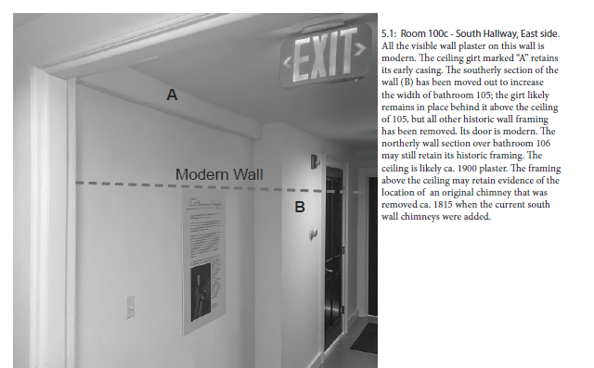
Documentation from the Preservation Restriction
5. Remove walls to create bar for the Refreshment Center (continued).

Slide 31
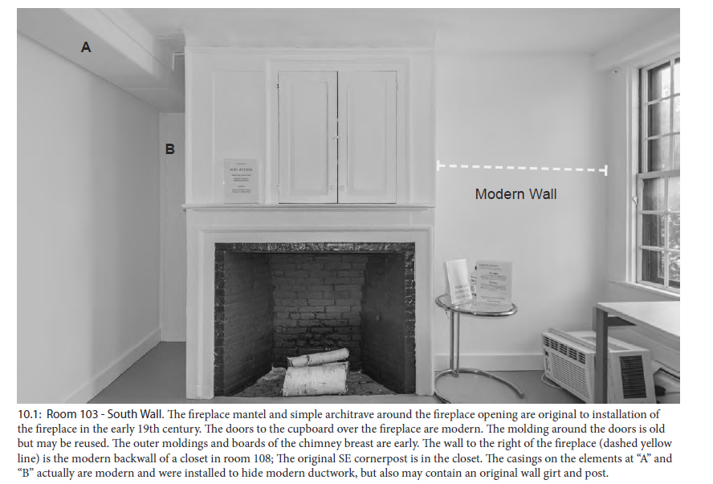
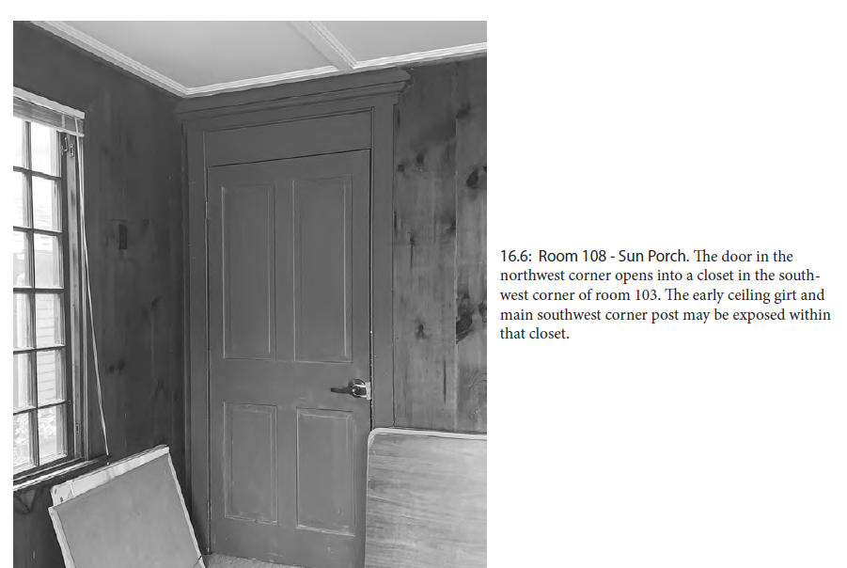
Documentation from the Preservation Restriction
6. Reconfigure closet in Tea Room to open into the Refreshment Center; lose off in the Tea Room.

Slide 32
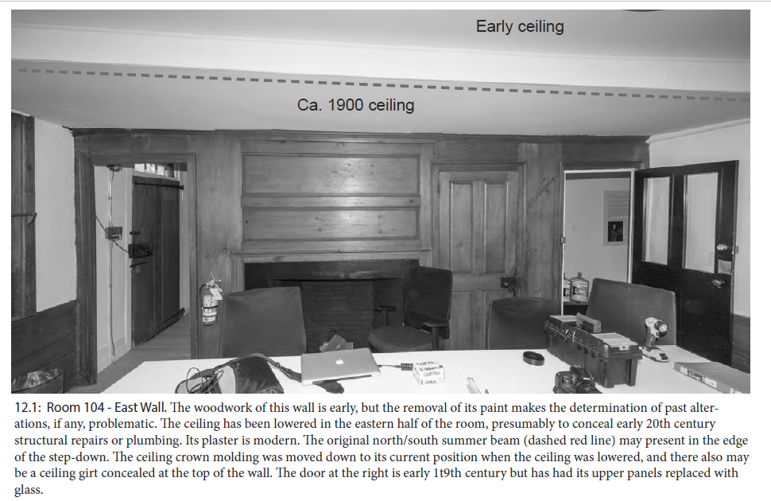



Documentation from the Preservation Restriction
7. Remove rest of ceiling in the Tap Room and April 19th Room

Slide 33

Documentation from the Preservation Restriction
7. Remove rest of ceiling in the Tap Room and April 19th Room

Slide 34
Summary for the CHC
Overall plan for interior modification and décor for the Wright Tavern will transform the space into a more authentic experience and create an attractive place to visit, gather with friends, have meetings. The plans will be implemented as we generate sufficient funding and hopefully have CHC support.
We will be preparing and painting the wall, ceilings and some of the floors so that the building will be attractive to visitors without losing its rustic charm. We will be adding furniture and objects as we find them and can afford them.
Removing the ceilings in the Tap Room and April 19th Room is still under discussion. The original work sought to examine existing structures that were shown to be sound. We may want to remove the rest of the ceiling to replicate what might have been there originally. We want to examine the look and feel of the ceiling without the plaster.
The Refreshment Center is critical to the financial viability of the Wright Tavern as a historic gathering place. If successful, it will reduce the reliance on annual fundraising, extensive use of volunteers, and enable us to rent the spaces for meetings, events, parties, etc. at a reasonable price.

Slide 35
Priorities for Next Phase:
Implement the capital and infrastructure improvements utilizing exiting grants. Supplement with additional grants and private funding where needed. Timing – 2025 – 2027
Acquire sufficient funding and implement interior, “visitor experience” plans. Timing 2024 – 2027
What we can accomplish by April 1 for the Concord250
Implement as funding and permits enable us to do so.
As the Refreshment Center becomes operational, acquire full liquor license and Wright Tavern merchandise, to begin serving customers and generating revenues to meet our obligation.
Promote room rental income and hosting events for marketing and net income generation. We will work these access opportunities around the renovations and rehabilitation work on the Tavern.
When cashflow turns positive, begin hiring professional staff to implement more plans and programs for the Wright Tavern.

Slide 36
Other Questions and Discussion

Slide 37








The Wright Tavern

