Slide 1
The Concord Community Preservation Committee
Recommendations for
2014 Annual Town Meeting
Warrant Article 36

Slide 2
Warrant Article 36 – CPA
The CPA in Concord
1.5% Surcharge on real estate property tax bill
$100,000 of taxable value is exempt
Persons with income less than 80% of area median income are exempt
Seniors with income less than 100% of area median income are exempt
Locally raised funds are matched on a percentage basis by funds in the State Community Preservation Fund

Slide 3
Warrant Article 36 – CPA
Concord has benefited from a 56% funding match over the life of the program.
To date, Concord has received
$4,089,832
in State Matching Funds for the $7,238,772
in Local CPA Surcharge Funds raised.

Slide 4
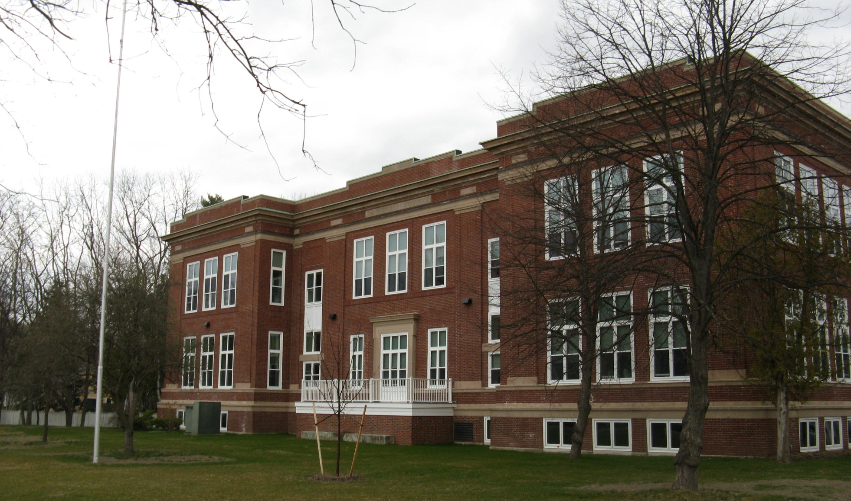
Warrant Article 36 – CPA
$2,978,150 for Community Housing
Peter Bulkeley Terrace Senior Housing (2009 & 2010)

Slide 5
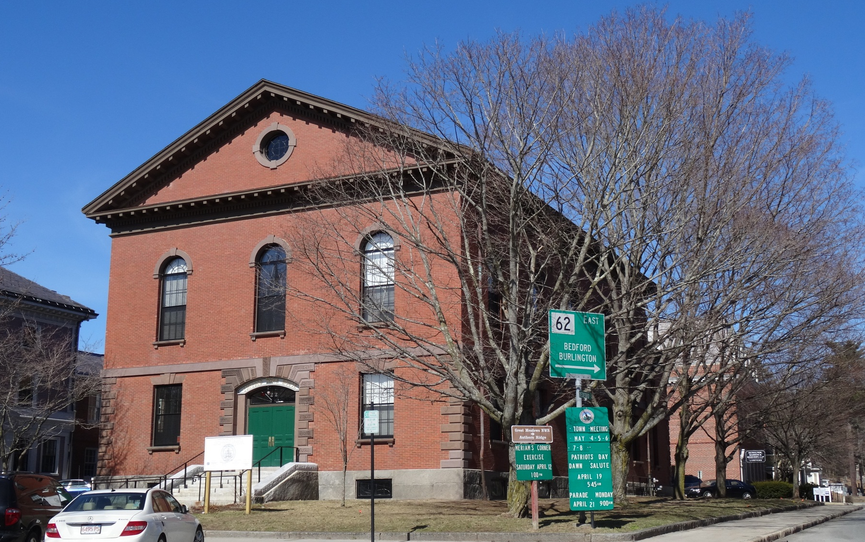
Warrant Article 36 – CPA
$5,268,300 for Historic Preservation
Town House Exterior Restoration (2013)

Slide 6
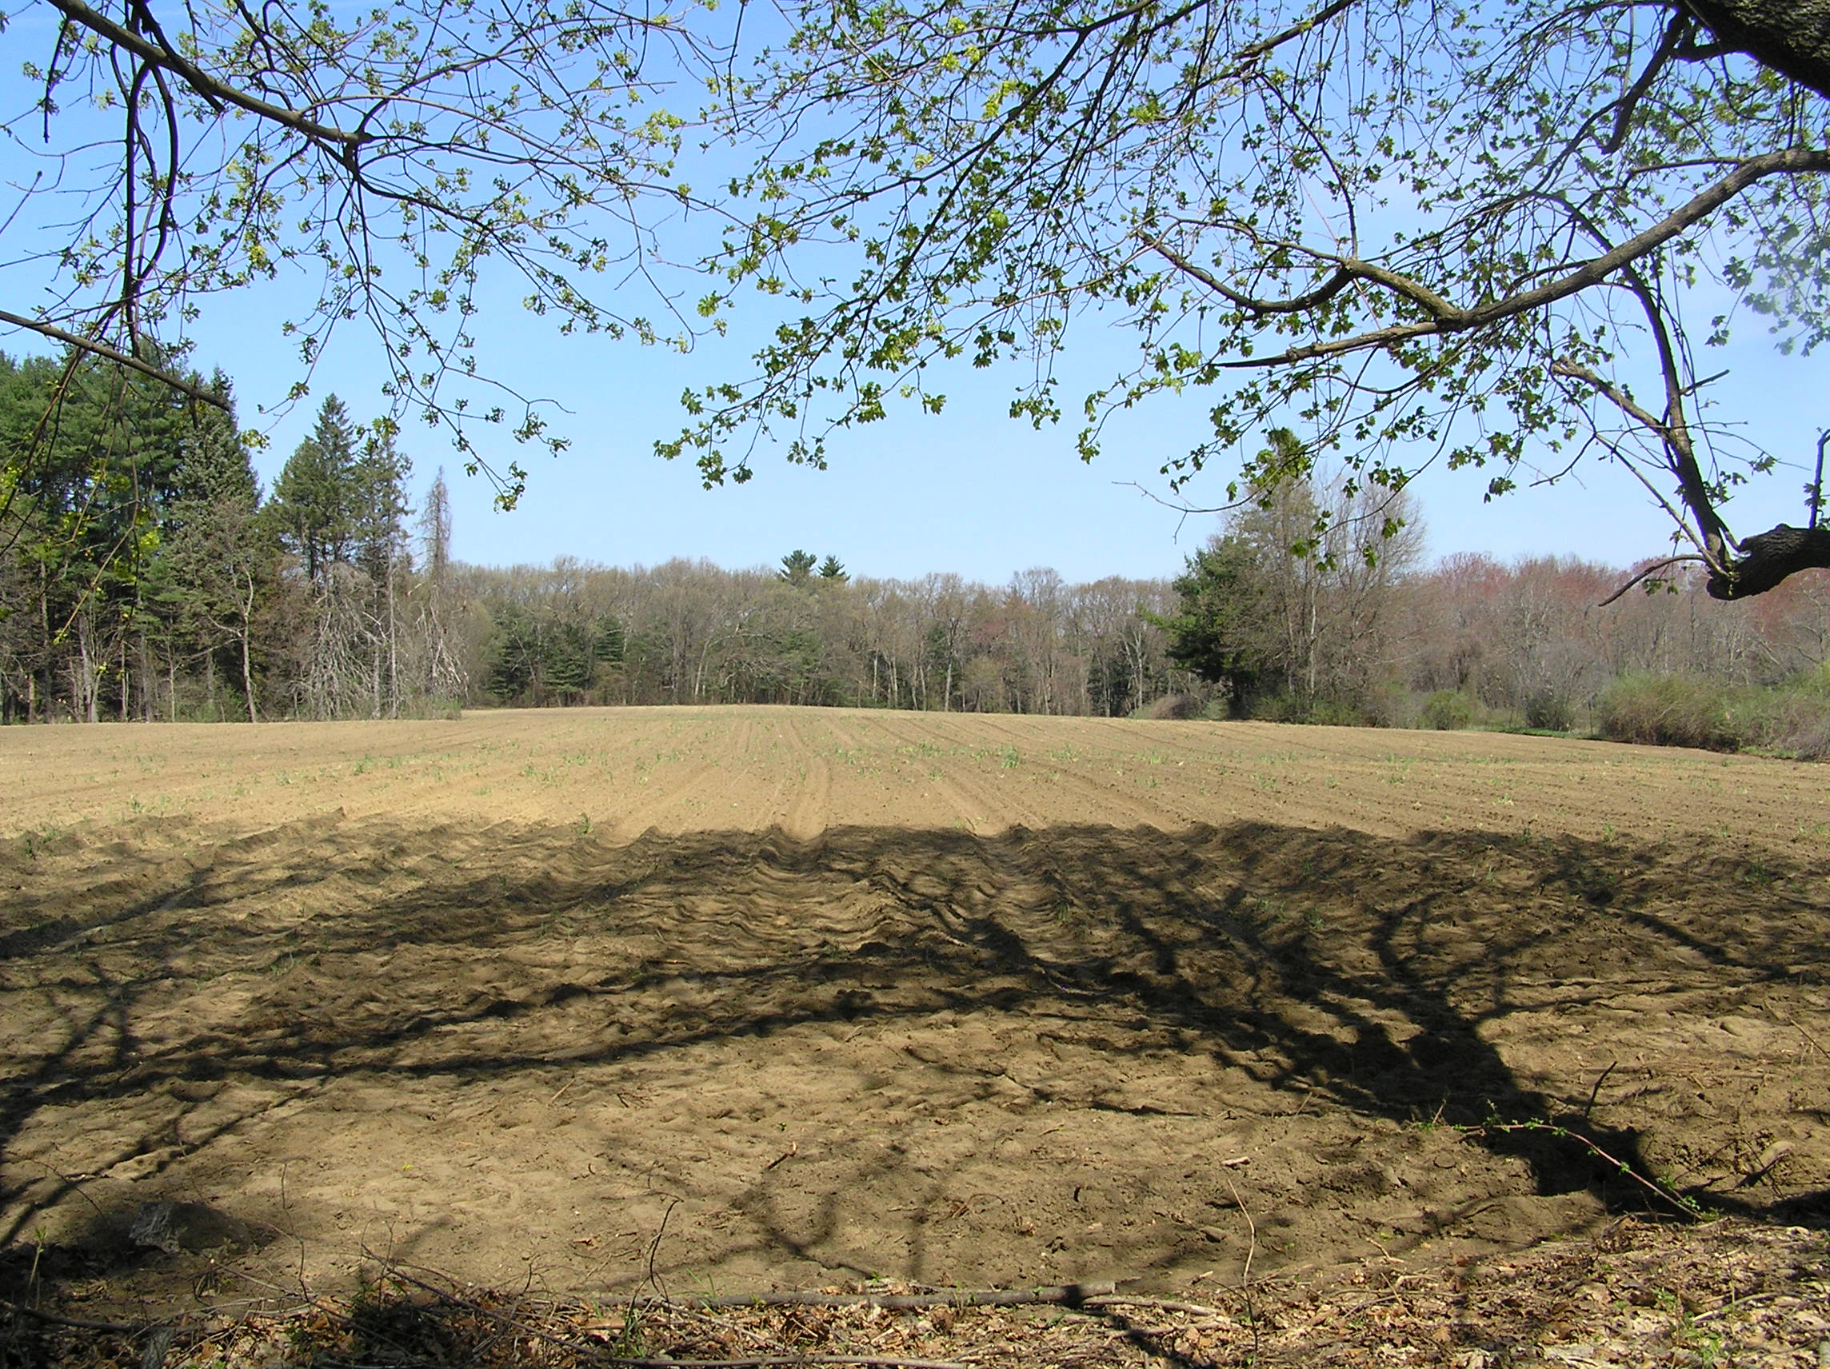
Warrant Article 36 – CPA
$2,033,689 for Open Space
Hubbard Brook Farm Field Acquisition (2008)

Slide 7
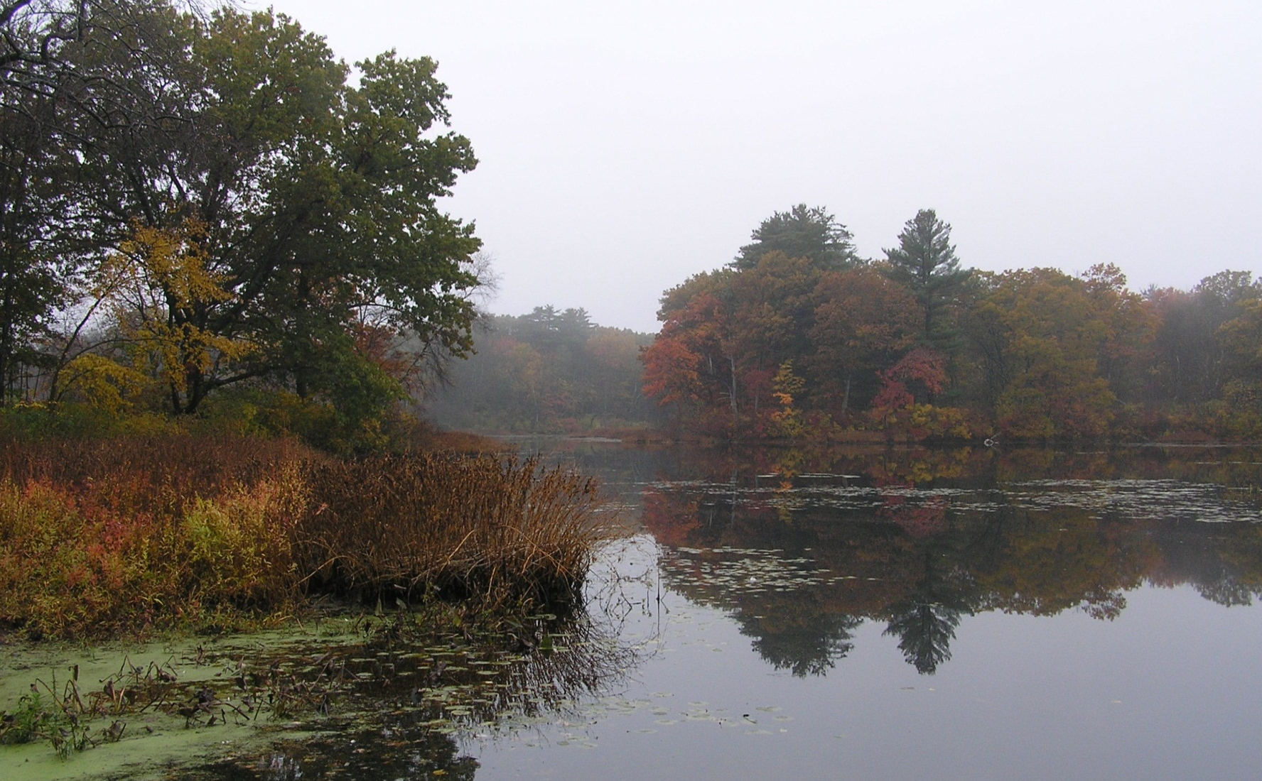
Warrant Article 36 – CPA
$1,996,889 for Recreation
Warner’s Pond Watershed Management Plan (2010)

Slide 8
Leveraging Ability of CPA Funds
Warrant Article 36 – CPA
$24,881,288
in Leveraged Matching Funds raised
for CPA Funded Projects
$12,541,055
CPA Project Funds Appropriated through 2013 Town Meeting

Slide 9
Warrant Article 36 – CPA
2014 Funds Available
Projected
Revenues FY’15 $1,248,000
Unappropriated
Revenue FY’14 75,875
Reserve Funds 701
Land Acquisition Fund 826
Total Revenues for $1,325,402
2014 Annual Town Meeting

Slide 10
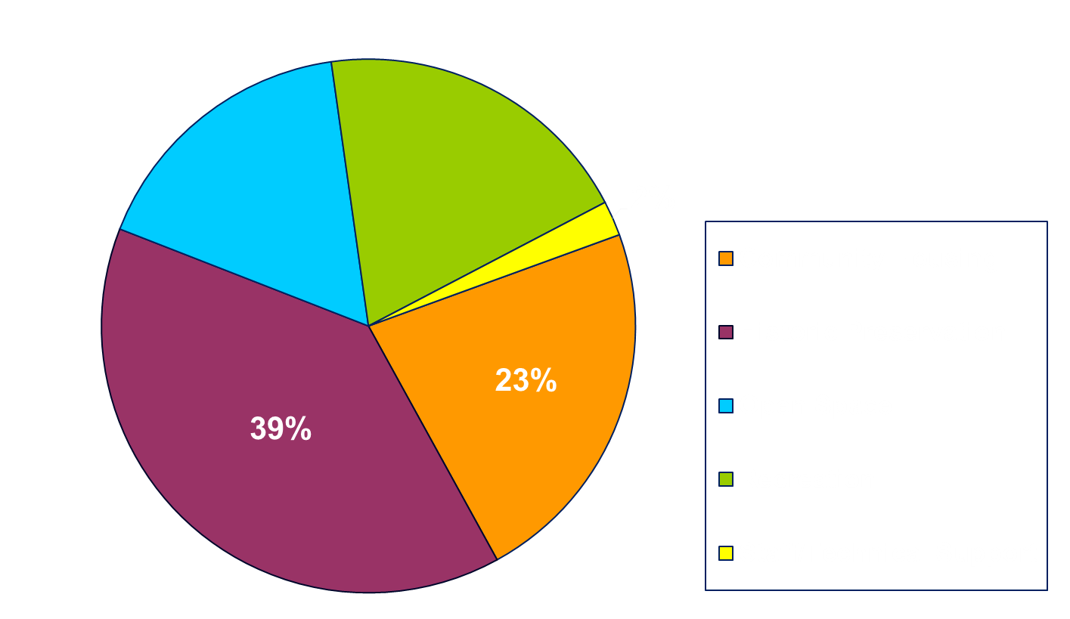
Warrant Article 36 – CPA
Total CPA Fund Appropriations including 2014 Recommendations
20%
16%
Notes:
Graphic Version of the Recommended Allocations

Slide 11
COMMUNITY PRESERVATION COMMITTEE APPROPRIATION RECOMMENDATIONS
Warrant Article 36 – CPA
Mr. Toomey Moves Motion as Printed on the Handout for Article 36

Slide 12
FY14 Recommendations for CPA Funding
Warrant Article 36 – CPA
Community Housing (3) $ 267,500
Historic Preservation (3) 133,782
Open Space (4) 182,520
Recreation (3) 710,073
Administration (1) 30,000
Total Recommended
Funding: $1,323,875

Slide 13

Warrant Article 36 – CPA
Regional Housing Services Program
Town of Concord
Regional Housing Services Office
Serving Acton, Bedford, Concord, Lexington,
Sudbury and Weston
Elizabeth Rust, Community Housing Coordinator
CPA Funding Recommendation: $17,500 for Community Housing

Slide 14
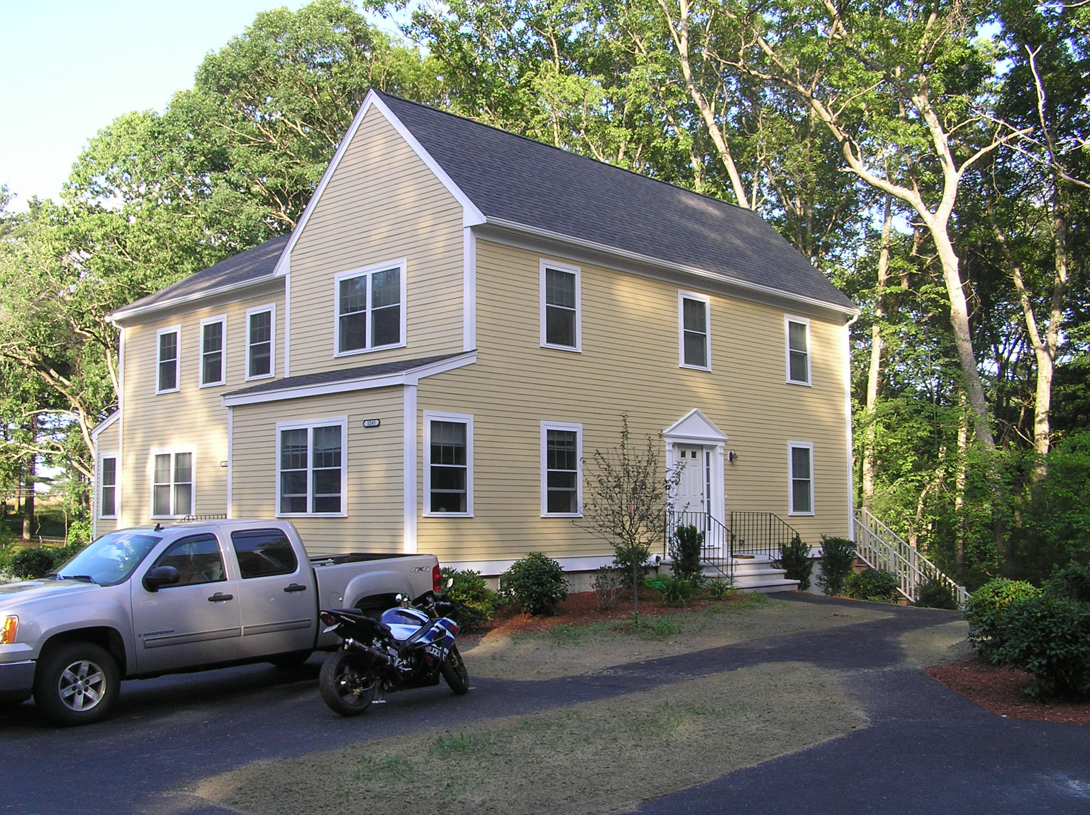
Warrant Article 36 – CPA
Broadening Affordable Housing for Concord
Concord Housing Development Corporation
CPA Funding Recommendation: $125,000 for Community Housing

Slide 15
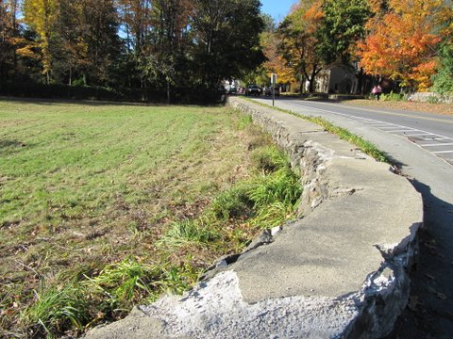
Warrant Article 36 – CPA
Heywood Meadow Stone Wall Reconstruction and Stone Stile Project
Town of Concord
CPA Funding Recommendation: $88,000
for Historic Preservation and Open Space

Slide 16
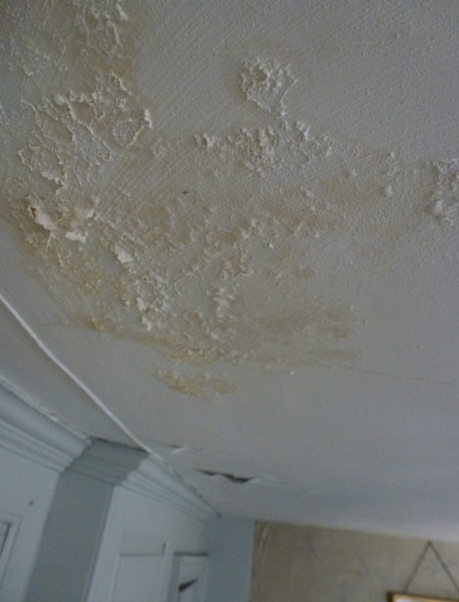
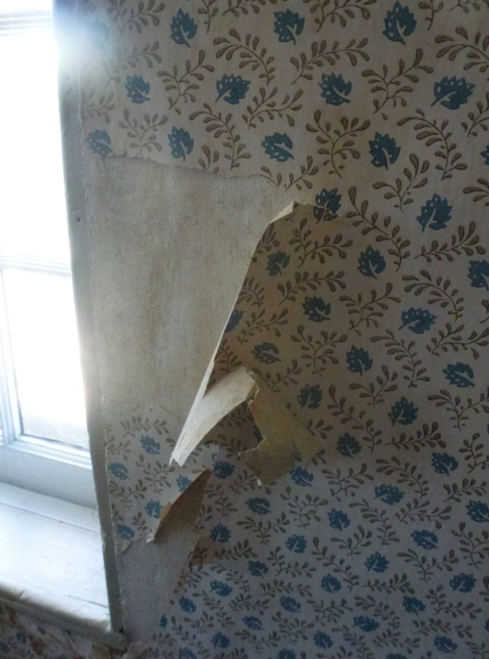
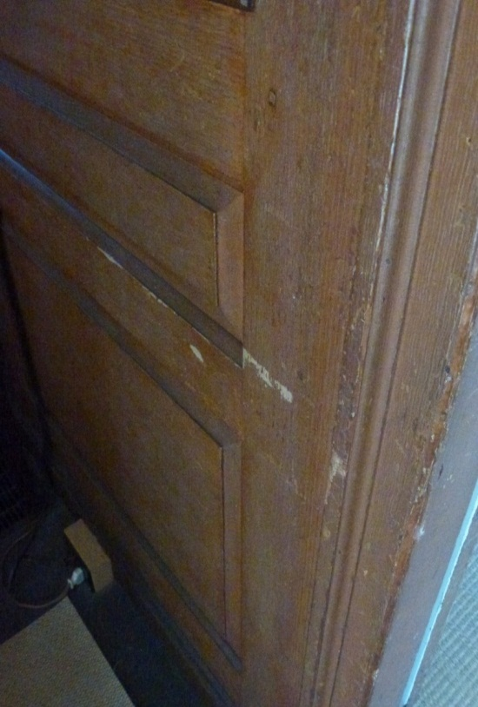
Warrant Article 36 – CPA
Old Manse Phased Interior Restoration and Preservation Program
The Trustees of Reservations (TTOR)
CPA Funding Recommendation: $45,782
for Historic Preservation

Slide 17
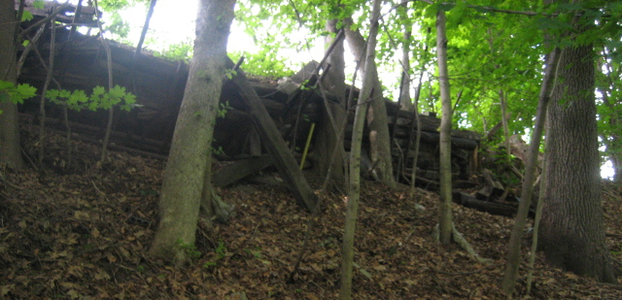
Warrant Article 36 – CPA
Rogers Land Slope Restoration
Town of Concord
CPA Funding Recommendation: $82,804
for Open Space

Slide 18
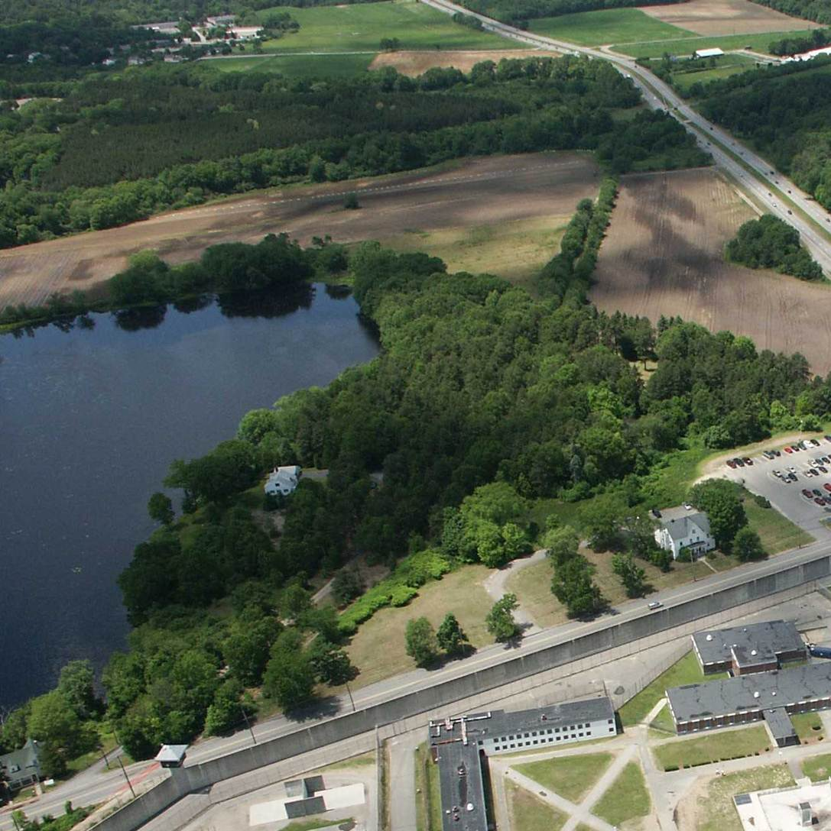
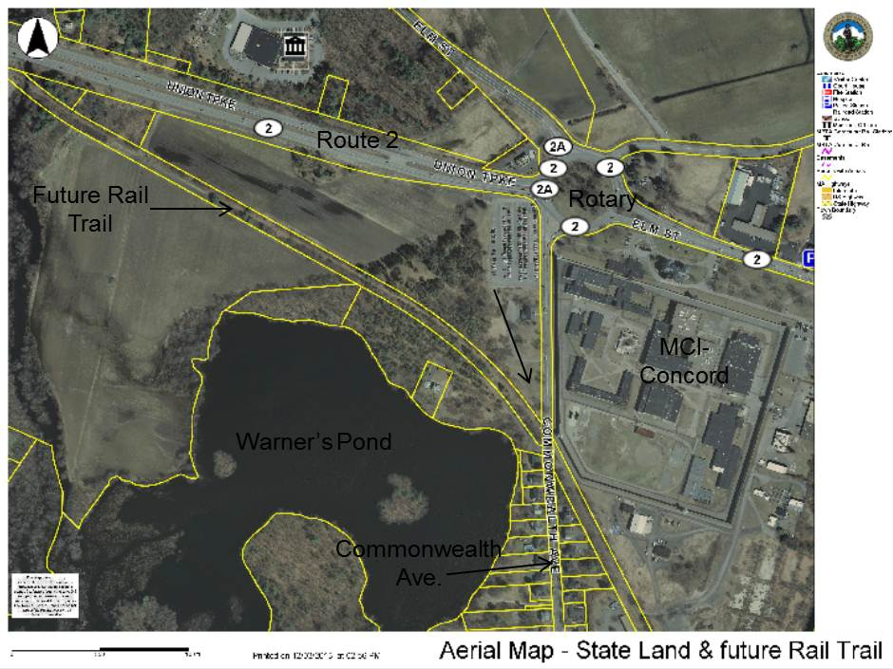
Warrant Article 36 – CPA
Bruce Freeman Rail Trail Phases 2B and 2C
Town of Concord
CPA Funding Recommendation: $250,000 for Open Space and Recreation

Slide 19
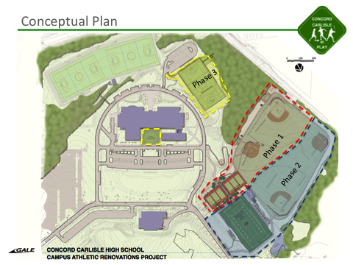
Warrant Article 36 – CPA
Fields Renovation Project at CCHS
Concord Carlisle at Play, Inc.
CPA Funding Recommendation: $433,000
for Recreation

Slide 20
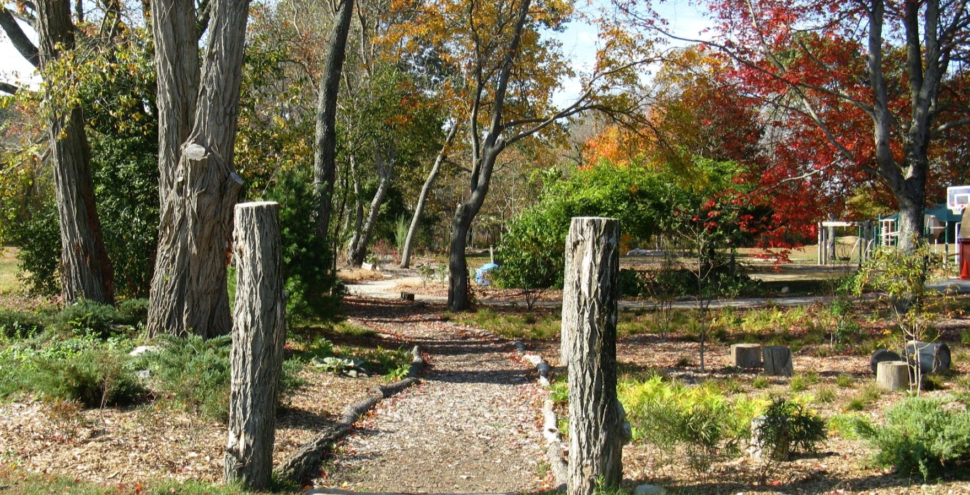
Warrant Article 36 – CPA
Phase II Infrastructure and Accessible Elements
Concord Children’s Center
CPA Funding Recommendation: $77,073
for Recreation

Slide 21
Community Housing Reserve Funds
Warrant Article 36 – CPA
$125,000 is recommended to be placed in reserve for future Community Housing projects.

Slide 22
Historic Preservation Reserve Funds
Warrant Article 36 – CPA
$15,000 is recommended to be placed in reserve for future Historic Preservation projects.

Slide 23
Open Space Reserve Funds
Warrant Article 36 – CPA
$34,716 is recommended to be placed in reserve for future Open Space projects.

Slide 24
Staff/Technical Support
Warrant Article 36 – CPA
$30,000 is recommended to provide the CPC with:
Planning Dept. Staff Support
Legal, technical and consulting services
Public notices, copying, and administrative expenses

Slide 25
COMMUNITY PRESERVATION COMMITTEE APPROPRIATION RECOMMENDATIONS
Mr. Toomey Moves Motion as Printed on the Handout for Article 36

Slide 26
