Slide 1

Roadway & Traffic Safety Forum
Town of Concord, MA
October 28, 2025

Slide 2
Agenda
  Definitions
  Current Roadway & Traffic Safety Request Management Process
  Communication Flow
  Workflow Overview: Requests to Implementation
  Roadway & Traffic Safety Request Workflow
  Project Development Types
  Project Examples
  Conclusion

Slide 3
Definitions
  Select Board: Elected board; Adopted the Traffic, Parking and Pedestrian Rules and Regulations; mechanism for public input.
  Public Works Commission (PWC): Appointed committee; Road Commissioners; policy guidance for Public Works; Capital Improvement Program Review and mechanism for public input.
  Transportation Advisory Committee (TAC): Appointed committee; makes recommendations to enhance local transportation; provides public education; mechanism for public input.
  Transportation Management Group (TMG): Staff review of requests, incidents, and projects related to the public roadway, traffic safety and parking related items.
  Staff Involved: Concord Public Works Engineering, Concord Public Works Highway & Grounds, Concord Police, Concord Planning and Land Management.

Slide 4
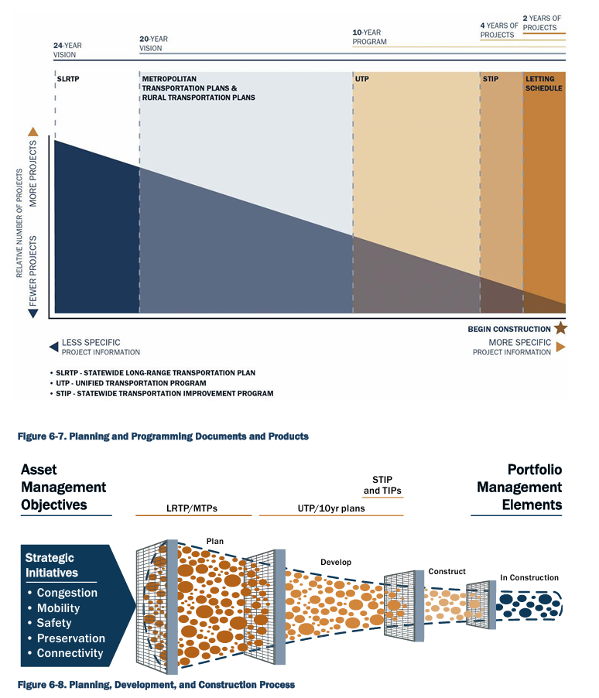
Current Roadway & Traffic Safety
Request Management Process
  TMG - Roadway Safety, Structured Process and Response:
    Requests: Verify, Evaluate, Rank, Recommend, Develop, Implement and Monitor
    Town of Concord: Traffic Calming Policy
    Town of Concord: Traffic, Parking and Pedestrian Rules & Regulations
    Manual on Uniform Traffic Control Devices – Federal Highway Administration
    MassDOT Highway Division Manuals and Publications
    Provide follow up communication
  Currently 228 existing requests, pending development/implementation:
    West Concord Master Plan - 2010
    Complete Streets - 2019
    Cut-through Streets – Jacobs 2019
    Stantec Transportation Plan Workshop – 2023
    Mothers Out Front – 2024
    Safe Route to Schools – AECOM 2024/2025
    Crosswalks and Sidewalks – 2025
    TMG Requests – Current
Requests:

Slide 5
Communication Flow
Public Works
H&G Operations
Planning
Requests
TMG
TMG makes
project
recommendation
to PWC
Public Works
Engineering
Police
TAC

Slide 6
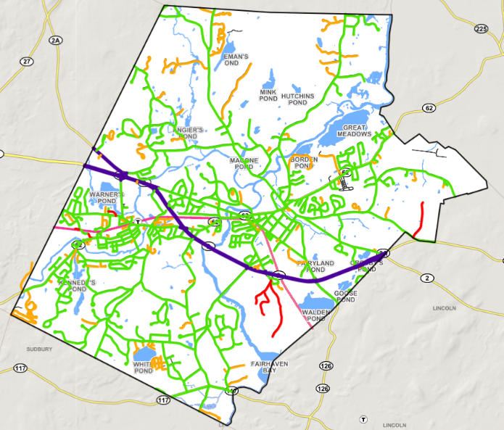
Workflow Overview: Requests to Implementation
Request Identified and Reviewed
Request identified
Request Assigned to Project
Project is Planned and Developed
Projects developed
Project is Designed and Constructed
Project designed and constructed
No further improvements
Process ends
Significant infrastructure modification/project – capital/chapter 90
Large repairs for CPW operations budget
Requests are simple fixes that go to existing infrastructure maintenance
Request submitted
TMG evaluates requests
Field Monitoring post-construction
Stantec prioritization is determined.
TMG finalizes Project Type Recommendation to PWC.
Input received from TAC
TMG finalizes project type
  Projects added to TMG tracker in GIS
  Project type status updated in GIS
Online Public GIS Project Tracker
Notes:
DRAFT NEW WORKFLOW

Slide 7
Roadway & Traffic Safety Request Workflow
Request Identified
Request Submitted
Request types:
Sidewalk/Ramp
Crosswalk
Pavement/Drainage
Intersection
Signage/Markings
Traffic/Speed
Individual Department Staff Review
Concern does not meet minimum criteria
TMG (Operations) Evaluate Requests
Maintenance Requests Existing Infrastructure
Projects types:
Roadway Paving
Pedestrian & Bicycle
Intersection Improvements
Cut-Through Mitigation
Complete Streets
Safe Routes to Schools
Large Repair (operations budget)
Significant Infrastructure Modification
(capital budget)
Further Develop Projects. Stantec prioritization is determined.
Add to TMG Tracker in GIS.
Develop TMG requests (to become prospective projects)
Program Status:
Plan
Develop
Construct
In construction
Complete
Note: Public/TAC may view list of projects online
Maintenance Completed
TMG (management) finalizes Project Type Recommendation to PWC (review and support)
(Once a month/as needed)
Funded Program types:
Roadway Paving
Pedestrian and Bicycle
Traffic Improvements
Signals
Identify CPW Funded Program, Funds, and Plan Year - TM & CFO
Update TMG Project Type Status in GIS
Design & Construction
Field monitoring
post-construction
No further improvements
Process Ends
Notes:
DRAFT NEW WORKFLOW

Slide 8
Project Development Types
Project Type | Planning and Development Duration | Typical Costs
Operating Budget (signs, repairs) | <6 months | Low <$25k
Cut-Through Mitigation (Traffic Control Signs – Recommended in 2018 Study) | <6 months | Low <$25k
SRTS Lines & Stripes (Thoreau School Walk Audit) | <6 months | Low <$25k
Grant & Local Funding (Safe Streets & Spaces – OMR) | 6 – 24 months | Medium $25k - $250k
Intersection Improvements (Main St/Walden St) | 6 – 24 months | Medium $25k - $250k
Roadway Paving (Collector and Arterial Streets) | 6 – 24 months | High >$250k
Pedestrian & Bicycle (Walden St Sidewalk – under design) | 6 – 24 months | High >$250k
Complete Streets (Hubbard St, Commonwealth Ave) | 6 – 24 months | High >$250k
Large Road Improvement (Main St/Baker Ave Intersection) | >24 months | High >$250k
Time
Cost
Quality

Slide 9
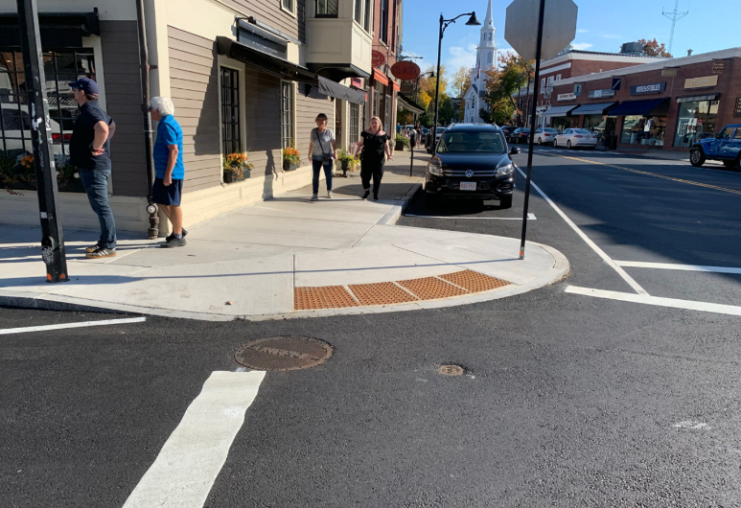
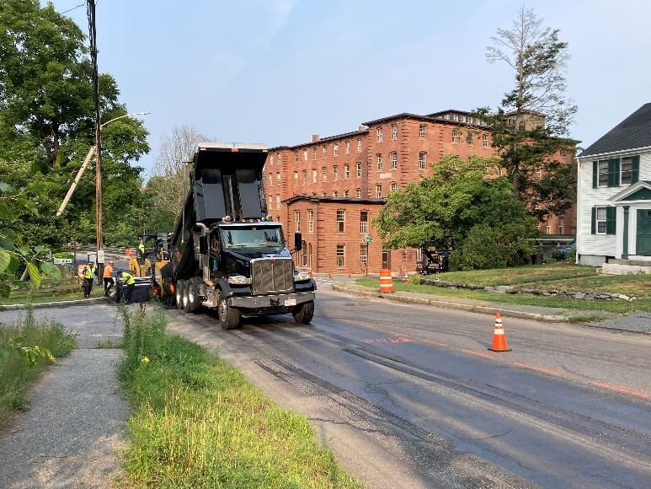
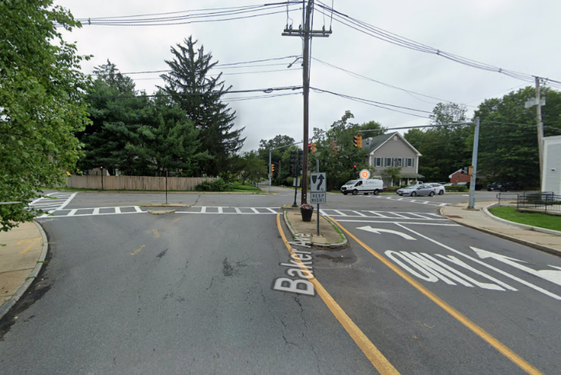
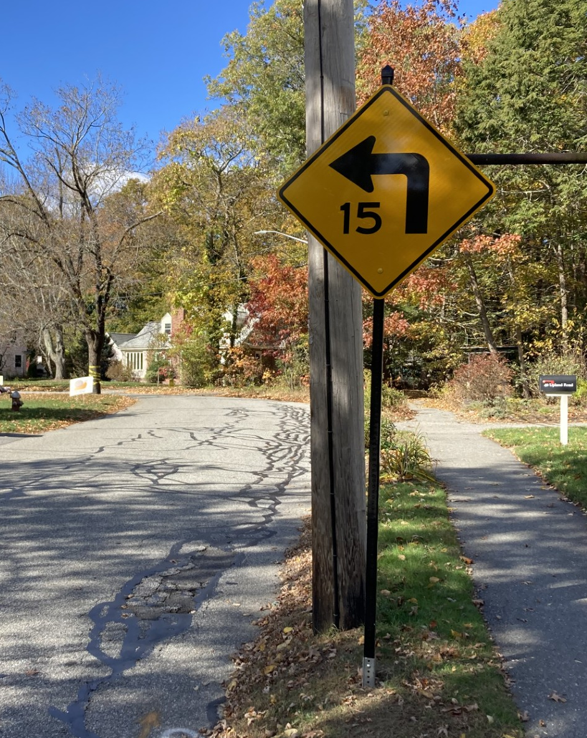
Project Examples
Main/Walden St
Project Type – Average Cost by Development Duration
Main St
Main/Baker Ave - Future
Upland Rd
Notes:
Note: Timelines may be extended depending on grant processing time, permitting, easements, etc.

Slide 10
Conclusion
  TMG request reporting system in progress – will improve tracking and transparency.
    Report an Issue: https://concordma.gov/1227/Reporting-an-Issue
    Email TMG: TMG@concordma.gov
  Feedback on Roadway & Traffic Safety Forum
    Email: RTSF@concordma.gov
  Questions?

