Slide 1



Fiscal Year 2026 Tax Classification Hearing Town of Concord November 17, 2025
Town of Concord
November 17, 2025

Slide 2





Timeline
Annual Town Meeting
Property Valuation Completed
Tax Classification Hearing
Spring
September
Final Rate Certification (State Approval)
December
Tax Bills Issued
December
Abatement Period
January 1-February 2
Review Values
September
November

Slide 3
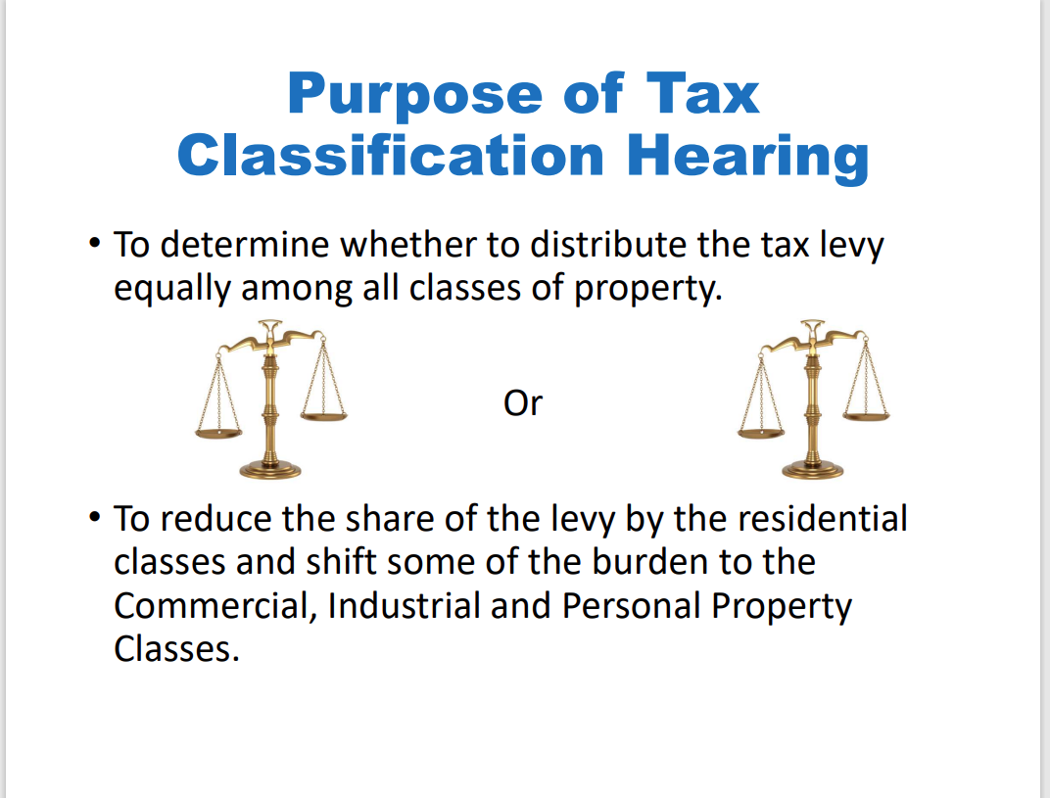

Slide 4
Select Board’s Role
The Select Board will consider four key decisions for tax classification:
Vote: Selection of a Minimum Residential Factor, Single or Split Tax Rate
Vote: Whether to Grant an Open Space Discount
Vote: Whether to Adopt a Residential Exemption
Vote: Whether to Adopt a Small Commercial Exemption
Selection of a Minimum Residential Factor, Single or Split Tax Rate
Selection of an Open Space Discount-or not
Granting of a Residential Exemption or not
Granting of a Small Commercial Exemption or not

Slide 5
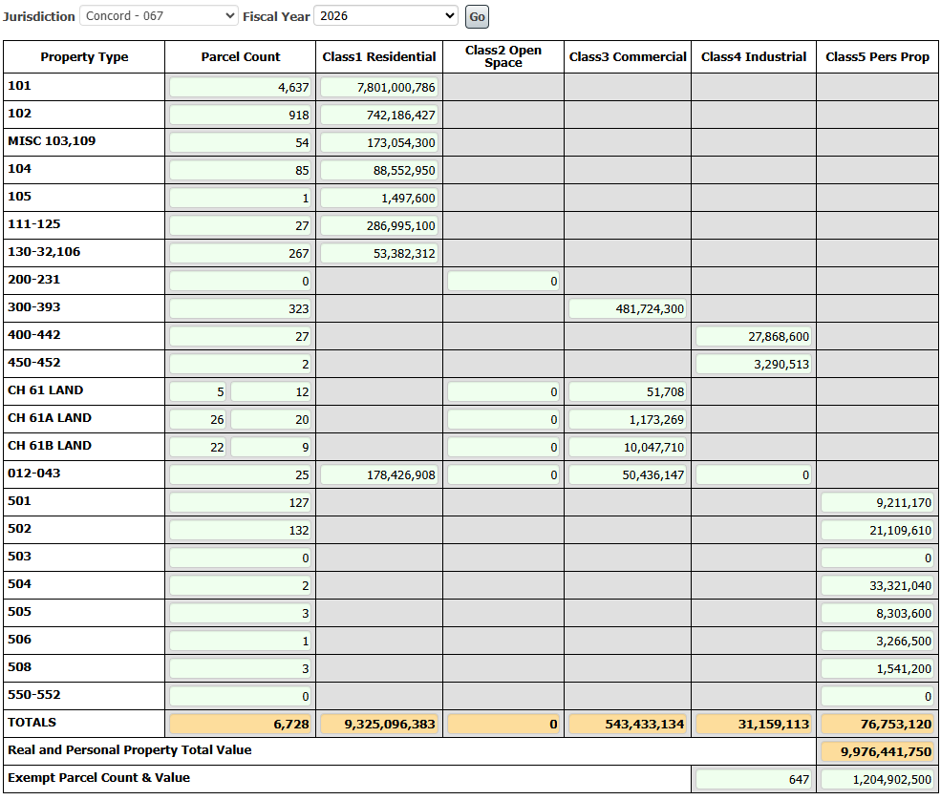
CERTIFIED VALUES—FISCAL YEAR 2026
* See Addendum #1 for historical data regarding Town Levy
PROPOSED TAX RATE = LEVY/CERTIFIED VALUES
$121,805,848 (LEVY)
$9,976,441,750 (VALUES)
Single Tax Rate =$12.21*
IF A FACTOR OF 1 IS SELECTED
(NO SHIFT)
*Subject to final approval
*647 Parcels are exempt, across all property class types

Slide 6
Tax Rate Calculation
Single Rate, with no shift, the Tax Rate would be $12.21/$1,000 of assessed value
=
FY2026 Property Tax Levy
$121,805,848
$12.21 per thousand dollars of assessed value
Town Taxable Valuation
$9,976,441,750
 | FY25 Value | Tax Rate w/out RTE | RE Taxes | FY26 Value | Tax Rate w/out RTE | RE Taxes
Average Assessed Value 101-Single Family: | $ 1,581,435 | $12.39 | $19,594.00 | $1,682,338 | $12.21 | $ 20,541.00
Median Assessed Value 101-Single Family | $ 1,331,300 | $12.39 | $16,495.00 | $1,429,750 | $12.21 | $17,457.00
Average Assessed Value 102-Condominium | $ 743,580 | $12.39 | $9,213.00 | $808,482 | $12.21 | $9,872.00
Median Assessed Value 102-Condominium | $ 639,587 | $12.39 | $7,924.00 | $699,900 | $12.21 | $8,546.00

Slide 7
Breakdown of Taxable Property Classes

Slide 8
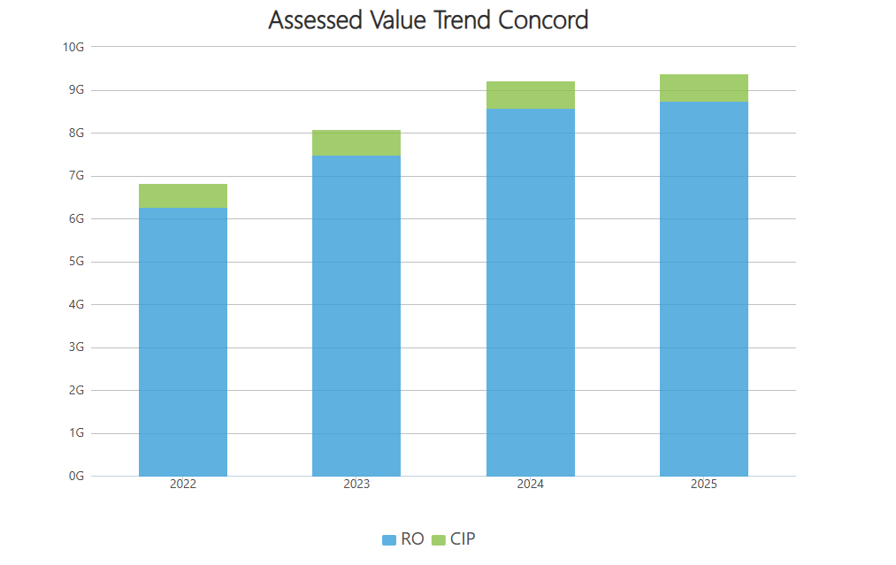
Residential & Open Space Blue vs. Commercial, Industrial, Personal Property Green
Value in Billions
2022
2023
2024
2025

Slide 9
SELECTION OF A MINIMUM RESIDENTIAL FACTOR, SINGLE OR SPLIT TAX RATE
VOTE 1

Slide 10
What is a Split Tax Rate?
Communities decide to tax Residential, Commercial, Industrial & Personal Property (CIP) differently.
Statute allows an increase in CIP’s share of the tax levy up to 50% higher than Residential
Does not generate new revenue; reallocates levy burden
Concord has used a single tax rate since 1998

Slide 11
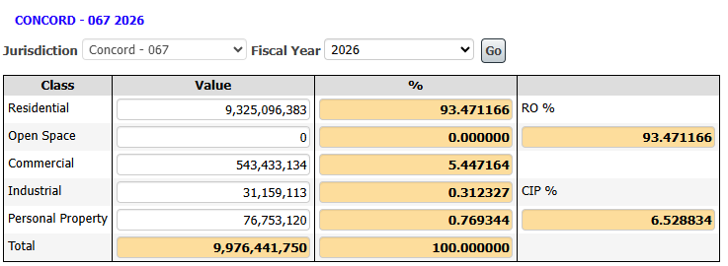
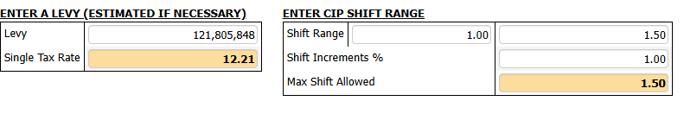
Minimum Residential Factor Comparison
Estimated Tax Rates with CIP Shift from 1.0-1.50
Since 1998 the Town has not shifted the tax burden to Commercial, Industrial, and Personal Property (CIP).

Slide 12
WHETHER TO GRANT AN OPEN SPACE DISCOUNT
VOTE 2

Slide 13
OPEN SPACE DISCOUNT
During the State mandated Classification Hearing, the Select Board must vote on the following in order to establish a tax rate:
OPEN SPACE DISCOUNT:
Open space is land maintained in an open or natural condition which contributes significantly to the benefit and enjoyment of the public and which is not:
Subject to a permanent conservation restriction;
Held for the production of income;
Taxable under the provisions of:
Chapter 61 (Forestry Land)
Chapter 61A (Agricultural/Horticultural Land)
Chapter 61B (Recreational Land).
The Select Board may discount up to 25% of the Open Space share of taxes.
Historically, the Town of Concord has not adopted an Open Space Discount.

Slide 14
WHETHER TO ADOPT A RESIDENTIAL EXEMPTION
VOTE 3

Slide 15
What Is It?
MGL c.59, sec. 5C
Enacted in 1979, the Residential Tax Exemption is an option under property tax classification MGL c.59, sec. 5C that shifts the tax burden within the residential class from owners of moderately valued residential properties to the owners of vacation homes, higher valued homes and residential properties not occupied by the owner, including apartments and vacant land.

Slide 16
Residential Tax Exemption
Community | Percentage
Barnstable | 25
Boston | 35
Brookline | 20
Cambridge | 30
Chelsea | 35
Concord | 10
Everett | 25
Malden | 30
Mashpee | 20^
Nantucket | 25
Oak Bluffs | 15
Provincetown | 35
Somerville | 35
Tisbury | 22
Truro | 35^
Waltham | 35
Watertown | 35
Wellfleet | 33^
West Tisbury | 5^
• The Residential Exemption Factor can be 1% up to 35% of the total average residential parcel value
• The property must be the "primary domicile" of the owner as used for income tax purposes as of January 1.
• This option exempts value only within the Residential Class of property & does not change the levy amount or impact Commercial, Industrial, or Personal (CIP) Property
The Select Board can authorize up to a 35% Residential Exemption.
19 communities, out of 351 in MA, chose to adopt in FY25-FY26.
The Residential Exemption is a fixed value reduction off the assessment for qualified taxpayers, meaning all qualified taxpayers receive the same amount subtracted from their assessed value.
The assessed value for the exemption is a percentage of the average residential value of the community.
* ^ Indicates RTE percentage increased for FY2026

Slide 17
How Is It Calculated?
To calculate the exemption, the average assessed value of all residential parcels must first be determined.
The adopted percentage is multiplied by the number of eligible parcels and then the amount is exempted from the residential parcel value.
The breakeven point is the point at which qualifying parcels will see an increase above the breakeven and a decrease below the breakeven. The breakeven point is benefit neutral.
A = Total Residential Value = $9,325,096,383
B = Total Residential Parcel Count = 6,014
C = Average Residential Value = $1,550,565
D = Selected Residential Exemption % = 10%
E = Residential Exemption = $155,056
F = Number of qualifying Residential Parcels = 3,863
G = Total Residential Exemption Value = $598,981,328
H =Total Residential Value-Exemption =$8,726,115,055
Break-Even Point A divided By F =$2,413,952

Slide 18
Tax Rate does not include Senior Means Tested

Slide 19
Tax Rate does not include Senior Means Tested

Slide 20
Tax Rate does not include Senior Means Tested

Slide 21
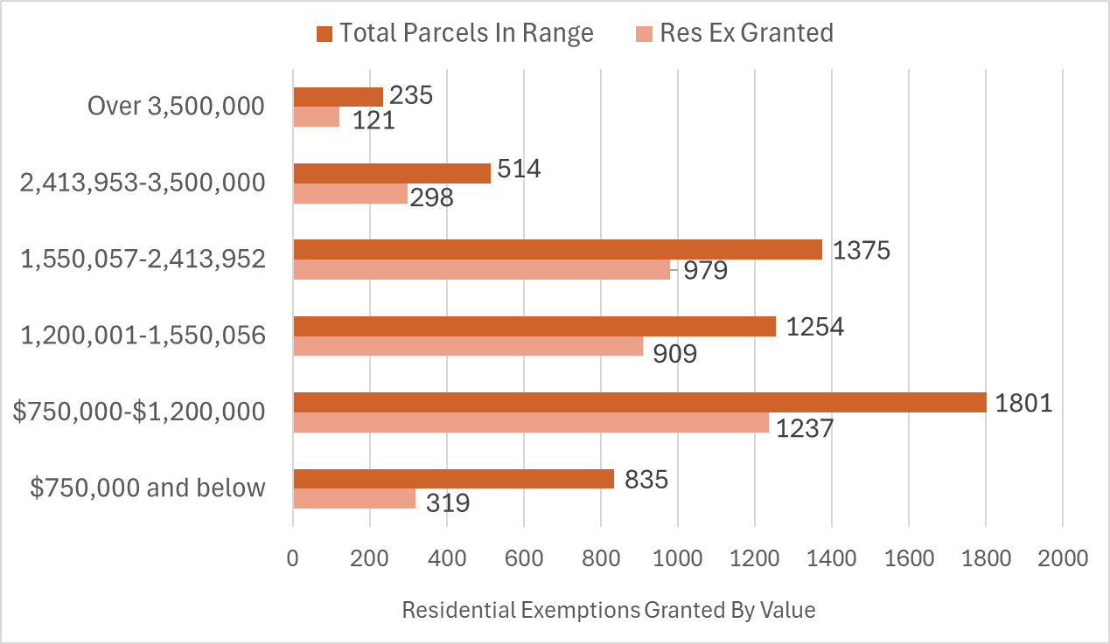
Total Parcel Count vs. Residential Exemptions Granted by Value Range
This chart shows how many Residential Exemption applications have been granted within each value range presented.
Class one properties also include 267 vacant land parcels, which are included in the total parcel count but cannot be granted a Residential Exemption

Slide 22
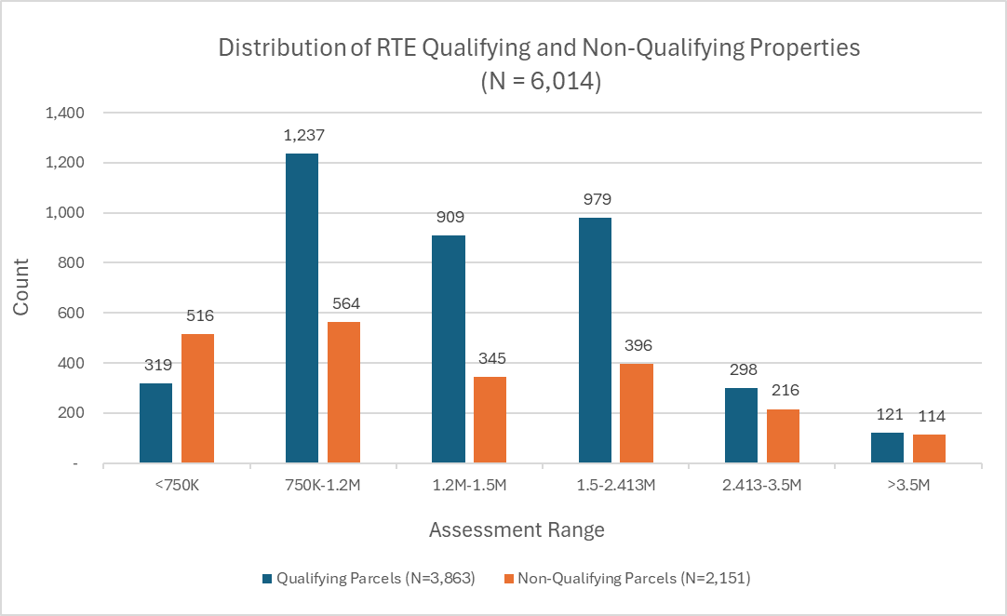
*Chart requested by Wendy Rovelli Select Board member for transparency

Slide 23
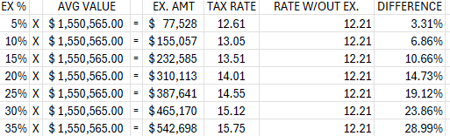
Percentage’s x Average Residential Value along with exemption value and tax rate
A. | Total Residential Value | $ 9,325,096,383
B. | Total Residential Parcels | 6014
C. | Average Residential Value | $ 1,550,565
D. | Exemption % | 10%
E. | Exemption Amount | $ 155,056.00
F. | Number of Eligible (est) | 3863
G. | Total Residential Exemption Value | $ 598,981,328
H. | Residential Value less Exemption | $ 8,726,115,055
I. | Break Even | $ 2,413,952
Options for Residential Exemption
(Example Calculation of 10%)

Slide 24
WHETHER TO ADOPT A SMALL COMMERCIAL EXEMPTION
VOTE 4

Slide 25
Small Commercial Exemption
The Select Board could adopt an exemption that reduces the taxable valuation by up to 10% of eligible Commercial parcels only.
Eligible businesses must have an average annual employment of not more than 10 people during the previous calendar year.
Assessed value of the parcel occupied by eligible business must be $1 million or less.
In order for a commercial parcel to qualify, every business occupying the parcel must also qualify for the exemption.
This exemption shifts the tax burden within the CIP Classes from small commercial properties to larger commercial and industrial parcels.
Increases the Commercial/Industrial/Personal Property tax rate.
The exemption goes to the building owner, not the business owner, so depending on lease agreements, a small business owner may or may not benefit.
Concord has not historically adopted this exemption

Slide 26


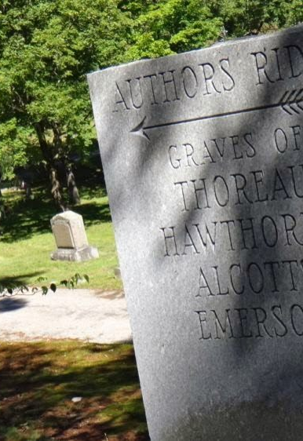

Town of Concord
Board of Assessors
Dr. Mera Tilley, Chair Yannis Tsitsas, Vice Chair Brendan Kemeza Arry Charles Shriram Bharath Assessing Division Meredith Stone- Town Assessor Michael Gibbons-Assistant Town Assessor Carolyn Dee-Office Administrator Lee Phalen-Data Lister Samantha Perry-Administrative Specialist
Notes:
Concord Assessors Office 24 Court Lane Concord Massachusetts 01742

Slide 27
ADDENDA
ADDENDUM #1—Historical Levy Data
ADDENDUM #2—LA-4 Residential/Commercial Values
ADDENDUM #3—LA-4 Personal Property/Exempt Values
ADDENDUM #4—LA-4 Total Values
ADDENDUM #5—Classification Hearing Terms

Slide 28
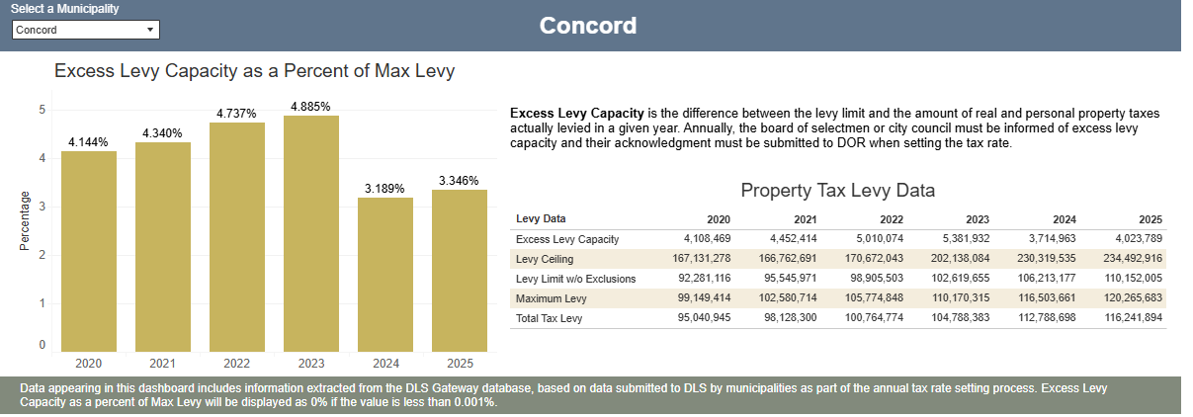
ADDENDUM #1
History of Town Levy 2020-Present
FY26 PROJECTED LEVY $121,805,848

Slide 29
ADDENDUM #2
Residential/Commercial
Property Type | Description | FY 2025 Mix Use Parcel Count | FY 2025 Parcel Count | FY 2025 Assessed Value | FY 2026 Mix Use Parcel Count | FY 2026 Parcel Count | FY 2026 Assessed Value | Parcel Diff | Parcel % Diff | Assessed Value Diff | Assessed Value % Diff
101 | Single Family |  | 4,628 | 7,318,881,900 |  | 4,637 | 7,801,000,786 | 9 | 0.2% | 482,118,886 | 6.6%
102 | Condominiums |  | 914 | 679,632,361 |  | 918 | 742,186,427 | 4 | 0.4% | 62,554,066 | 9.2%
MISC 103,109 | Miscellaneous Residential |  | 54 | 161,761,800 |  | 54 | 173,054,300 | 0 |  | 11,292,500 | 7.0%
104 | Two - Family |  | 90 | 86,515,200 |  | 85 | 88,552,950 | -5 | -5.6% | 2,037,750 | 2.4%
105 | Three - Family |  | 1 | 1,441,400 |  | 1 | 1,497,600 | 0 |  | 56,200 | 3.9%
111-125 | Apartment |  | 27 | 276,602,900 |  | 27 | 286,995,100 | 0 |  | 10,392,200 | 3.8%
130-32,106 | Vacant / Accessory Land |  | 273 | 52,906,112 |  | 267 | 53,382,312 | -6 | -2.2% | 476,200 | 0.9%
200-231 | Open Space |  | 0 | 0 |  | 0 | 0 | 0 |  | 0
300-393 | Commercial |  | 323 | 475,005,000 |  | 323 | 481,724,300 | 0 |  | 6,719,300 | 1.4%
400-442 | Industrial |  | 27 | 26,554,800 |  | 27 | 27,868,600 | 0 |  | 1,313,800 | 4.9%
450-452 | Industrial Power Plant |  | 2 | 3,430,404 |  | 2 | 3,290,513 | 0 |  | -139,891 | -4.1%
CH 61 LAND | Forest | 4 | 12 | 48,470 | 5 | 12 | 51,708 | 1 | 6.3% | 3,238 | 6.7%
CH 61A LAND | Agriculture | 26 | 20 | 1,143,159 | 26 | 20 | 1,173,269 | 0 |  | 30,110 | 2.6%
CH 61B LAND | Recreational | 22 | 8 | 9,329,005 | 22 | 9 | 10,047,710 | 1 | 3.3% | 718,705 | 7.7%
012-043 | Multi-use - Residential |  | 25 | 163,356,306 |  | 25 | 178,426,908 | 0 |  | 15,070,602 | 9.2%
012-043 | Multi-use - Open Space |  | 0 | 0 |  | 0 | 0 | 0 |  | 0
012-043 | Multi-use - Commercial |  | 0 | 48,443,429 |  | 0 | 50,436,147 | 0 |  | 1,992,718 | 4.1%
012-043 | Multi-use - Industrial |  | 0 | 0 |  | 0 | 0 | 0 |  | 0

Slide 30
ADDENDUM #3
Personal Property/Exempt
Property Type | Description | FY 2025 Mix Use Parcel Count | FY 2025 Parcel Count | FY 2025 Assessed Value | FY 2026 Mix Use Parcel Count | FY 2026 Parcel Count | FY 2026 Assessed Value | Parcel Diff | Parcel % Diff | Assessed Value Diff | Assessed Value % Diff
501 | Individuals / Partnerships / Associations / Trusts / LLC |  | 119 | 8,702,780 |  | 127 | 9,211,170 | 8 | 6.7% | 508,390 | 5.8%
502 | Corporations |  | 135 | 22,032,380 |  | 132 | 21,109,610 | -3 | -2.2% | -922,770 | -4.2%
503 | Manufacturing |  | 0 | 0 |  | 0 | 0 | 0 |  | 0
504 | Public Utilities |  | 2 | 31,146,640 |  | 2 | 33,321,040 | 0 |  | 2,174,400 | 7.0%
505 | Centrally Valued Telephone |  | 3 | 8,087,100 |  | 3 | 8,303,600 | 0 |  | 216,500 | 2.7%
506 | Centrally Valued Pipelines |  | 1 | 3,152,800 |  | 1 | 3,266,500 | 0 |  | 113,700 | 3.6%
508 | Wireless Telephone |  | 3 | 1,542,690 |  | 3 | 1,541,200 | 0 |  | -1,490 | -0.1%
550-552 | Electric Generating Plant |  | 0 | 0 |  | 0 | 0 | 0 |  | 0
EXEMPT VALUE | Exempt Property |  | 645 | 1,152,658,000 |  | 647 | 1,204,902,500 | 2 | 0.3% | 52,244,500 | 4.5%

Slide 31
ADDENDUM #4
TOTALS
Property Type | Description | FY 2025 Mix Use Parcel Count | FY 2025 Parcel Count | FY 2025 Assessed Value | FY 2026 Mix Use Parcel Count | FY 2026 Parcel Count | FY 2026 Assessed Value | Parcel Diff | Parcel % Diff | Assessed Value Diff | Assessed Value % Diff
Total Class 1 | TOTAL RESIDENTIAL |  | 6,012 | 8,741,097,979 |  | 6,014 | 9,325,096,383 | 2 | 0.0% | 583,998,404 | 6.7%
Total Class 2 | TOTAL OPEN SPACE |  | 0 | 0 |  | 0 | 0 | 0 |  | 0
Total Class 3 | TOTAL COMMERCIAL |  | 415 | 533,969,063 |  | 417 | 543,433,134 | 2 | 0.5% | 9,464,071 | 1.8%
Total Class 4 | TOTAL INDUSTRIAL |  | 29 | 29,985,204 |  | 29 | 31,159,113 | 0 |  | 1,173,909 | 3.9%
Total Class 5 | TOTAL PERSONAL PROPERTY |  | 263 | 74,664,390 |  | 268 | 76,753,120 | 5 | 1.9% | 2,088,730 | 2.8%
Total Taxable | TOTAL REAL & PERSONAL |  | 6,719 | 9,379,716,636 |  | 6,728 | 9,976,441,750 | 9 | 0.1% | 596,725,114 | 6.4%

Slide 32
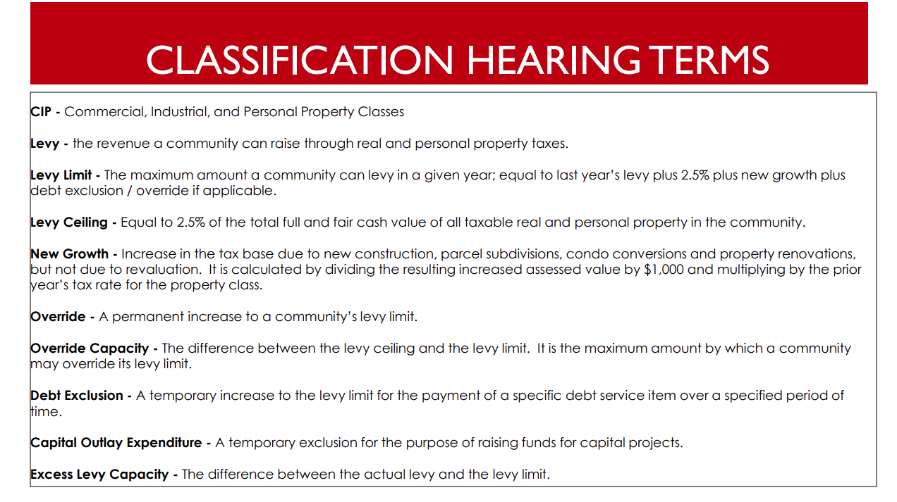
Add a Slide Title - 5
ADDENDUM #5

